Slide 1

Prototype Pseudo-Metacognition Module for
AI Reasoning
Presenter: Steve Chan
Future Computing 2026
Prototype Pseudo-Metacognition Module for AI Reasoning

Slide 2
Bottom Line Up Front
The Challenge of Robust Dialogue Management (RDM), which is a core capability needed for: Conversational AI Agents (CAA)
Future Computing 2026
Prototype Pseudo-Metacognition Module for AI Reasoning

Slide 3
Table of Contents
Introduction
CAA Inductive Reasoning (IndR) Approaches have been largely unexplored…
Background
A Pragmatic Reasoning Method and Reasoning Behavior for CAA:
Case-Based Reasoning (CBR)-> Graph-Based Reasoning (GBR)
The Paradox
(Deductive) Top-Down versus (Inductive) Bottom-Up
Experimentation
Explorations into a Prospective Metacognition Module (MM)
Conclusion
IndR Possibilities and the Prospects for Enhanced Coherence
Future Computing 2026
Prototype Pseudo-Metacognition Module for AI Reasoning

Slide 4
1 Introduction
CAA Inductive Reasoning (IndR) Approaches have been largely unexplored…
Future Computing 2026
Prototype Pseudo-Metacognition Module for AI Reasoning

Slide 5

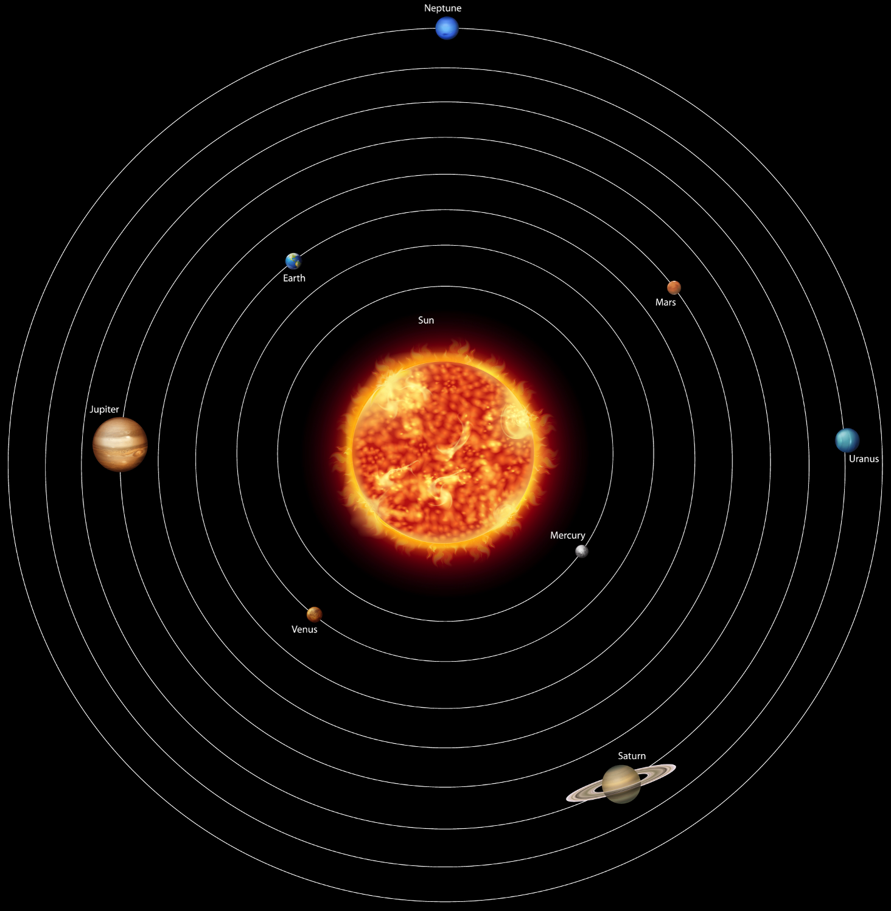
1 Introduction cont’d
Aristotle/Ptolemy/Galileo & Kepler
Future Computing 2026
Prototype Pseudo-Metacognition Module for AI Reasoning

Slide 6
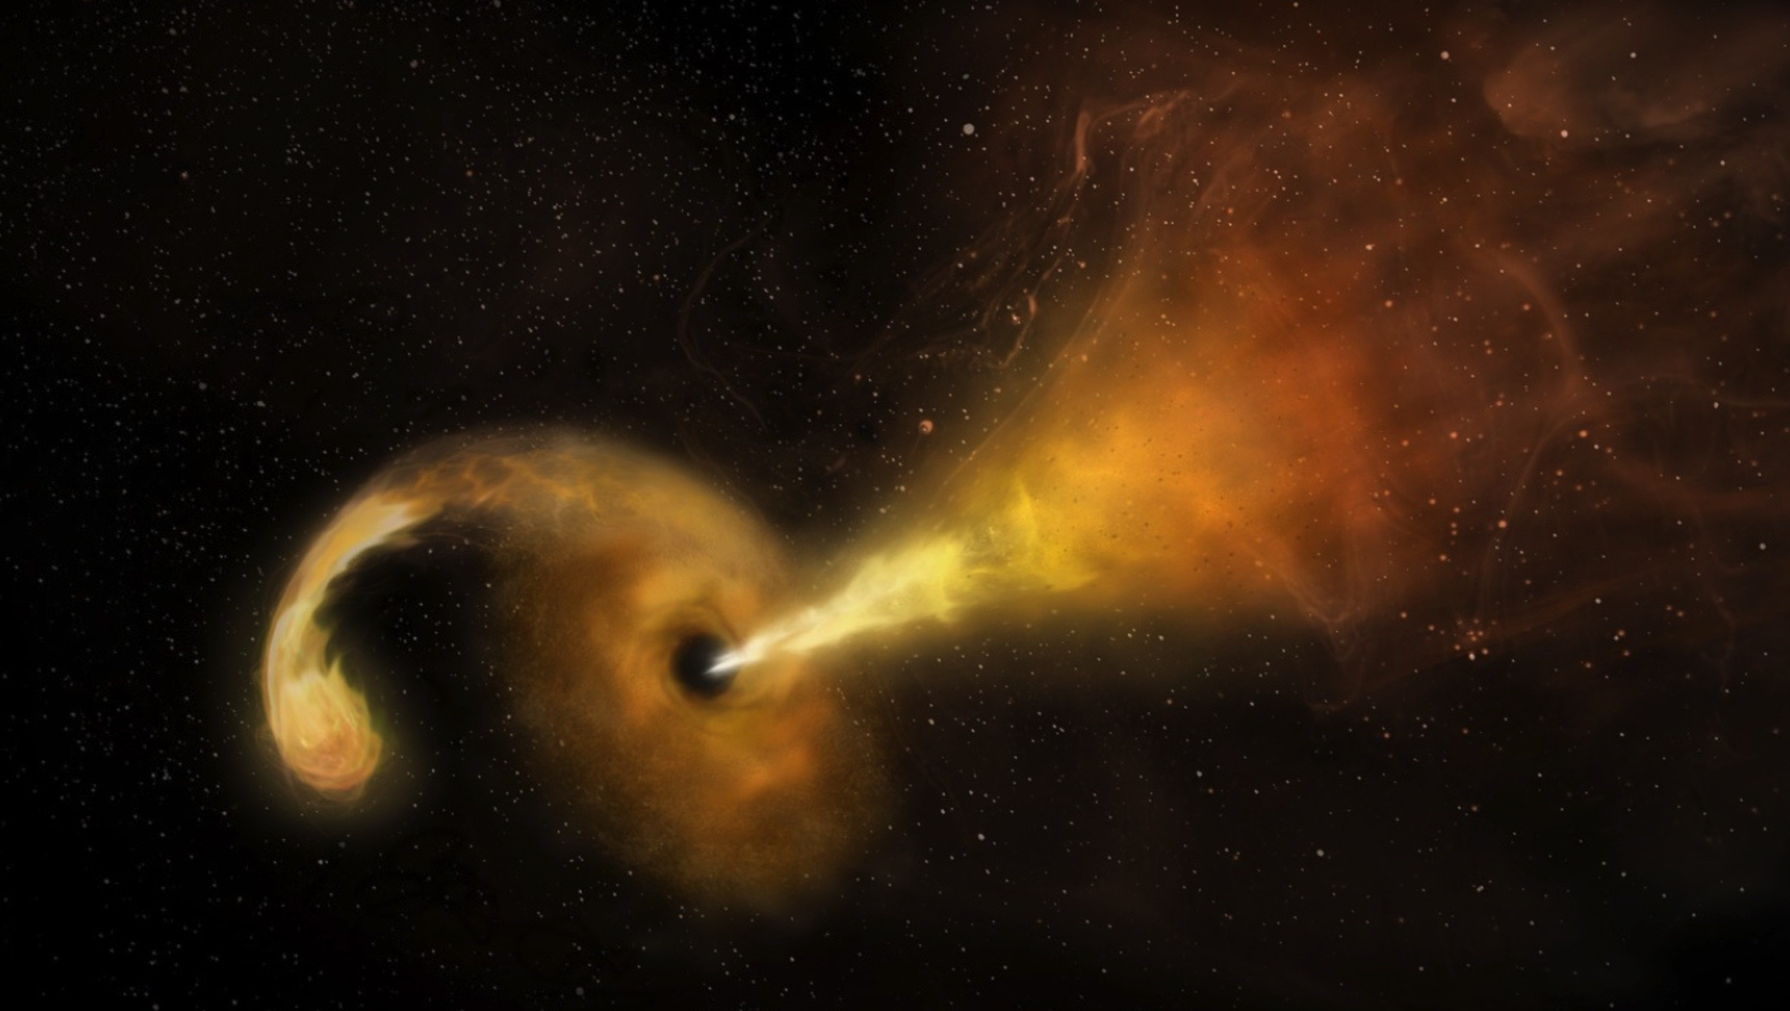
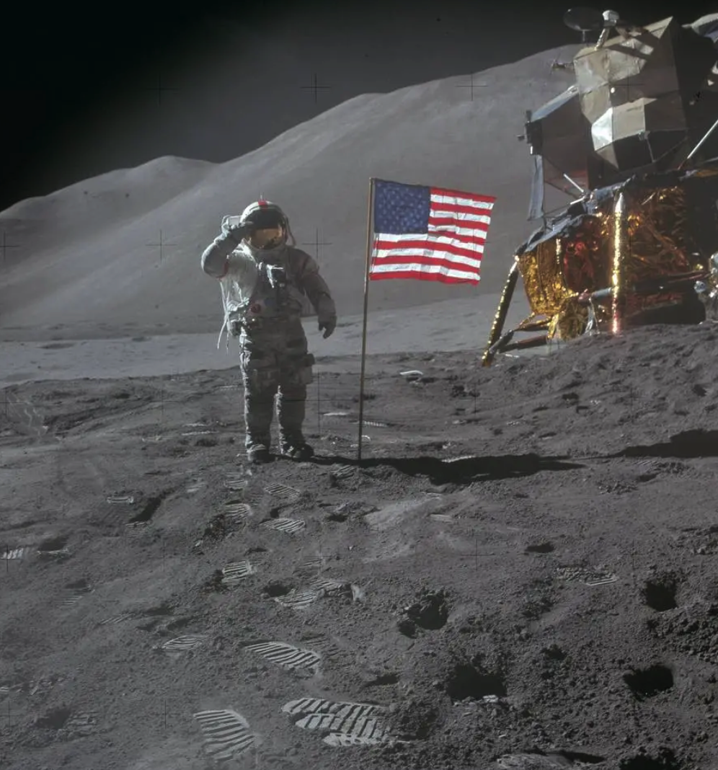
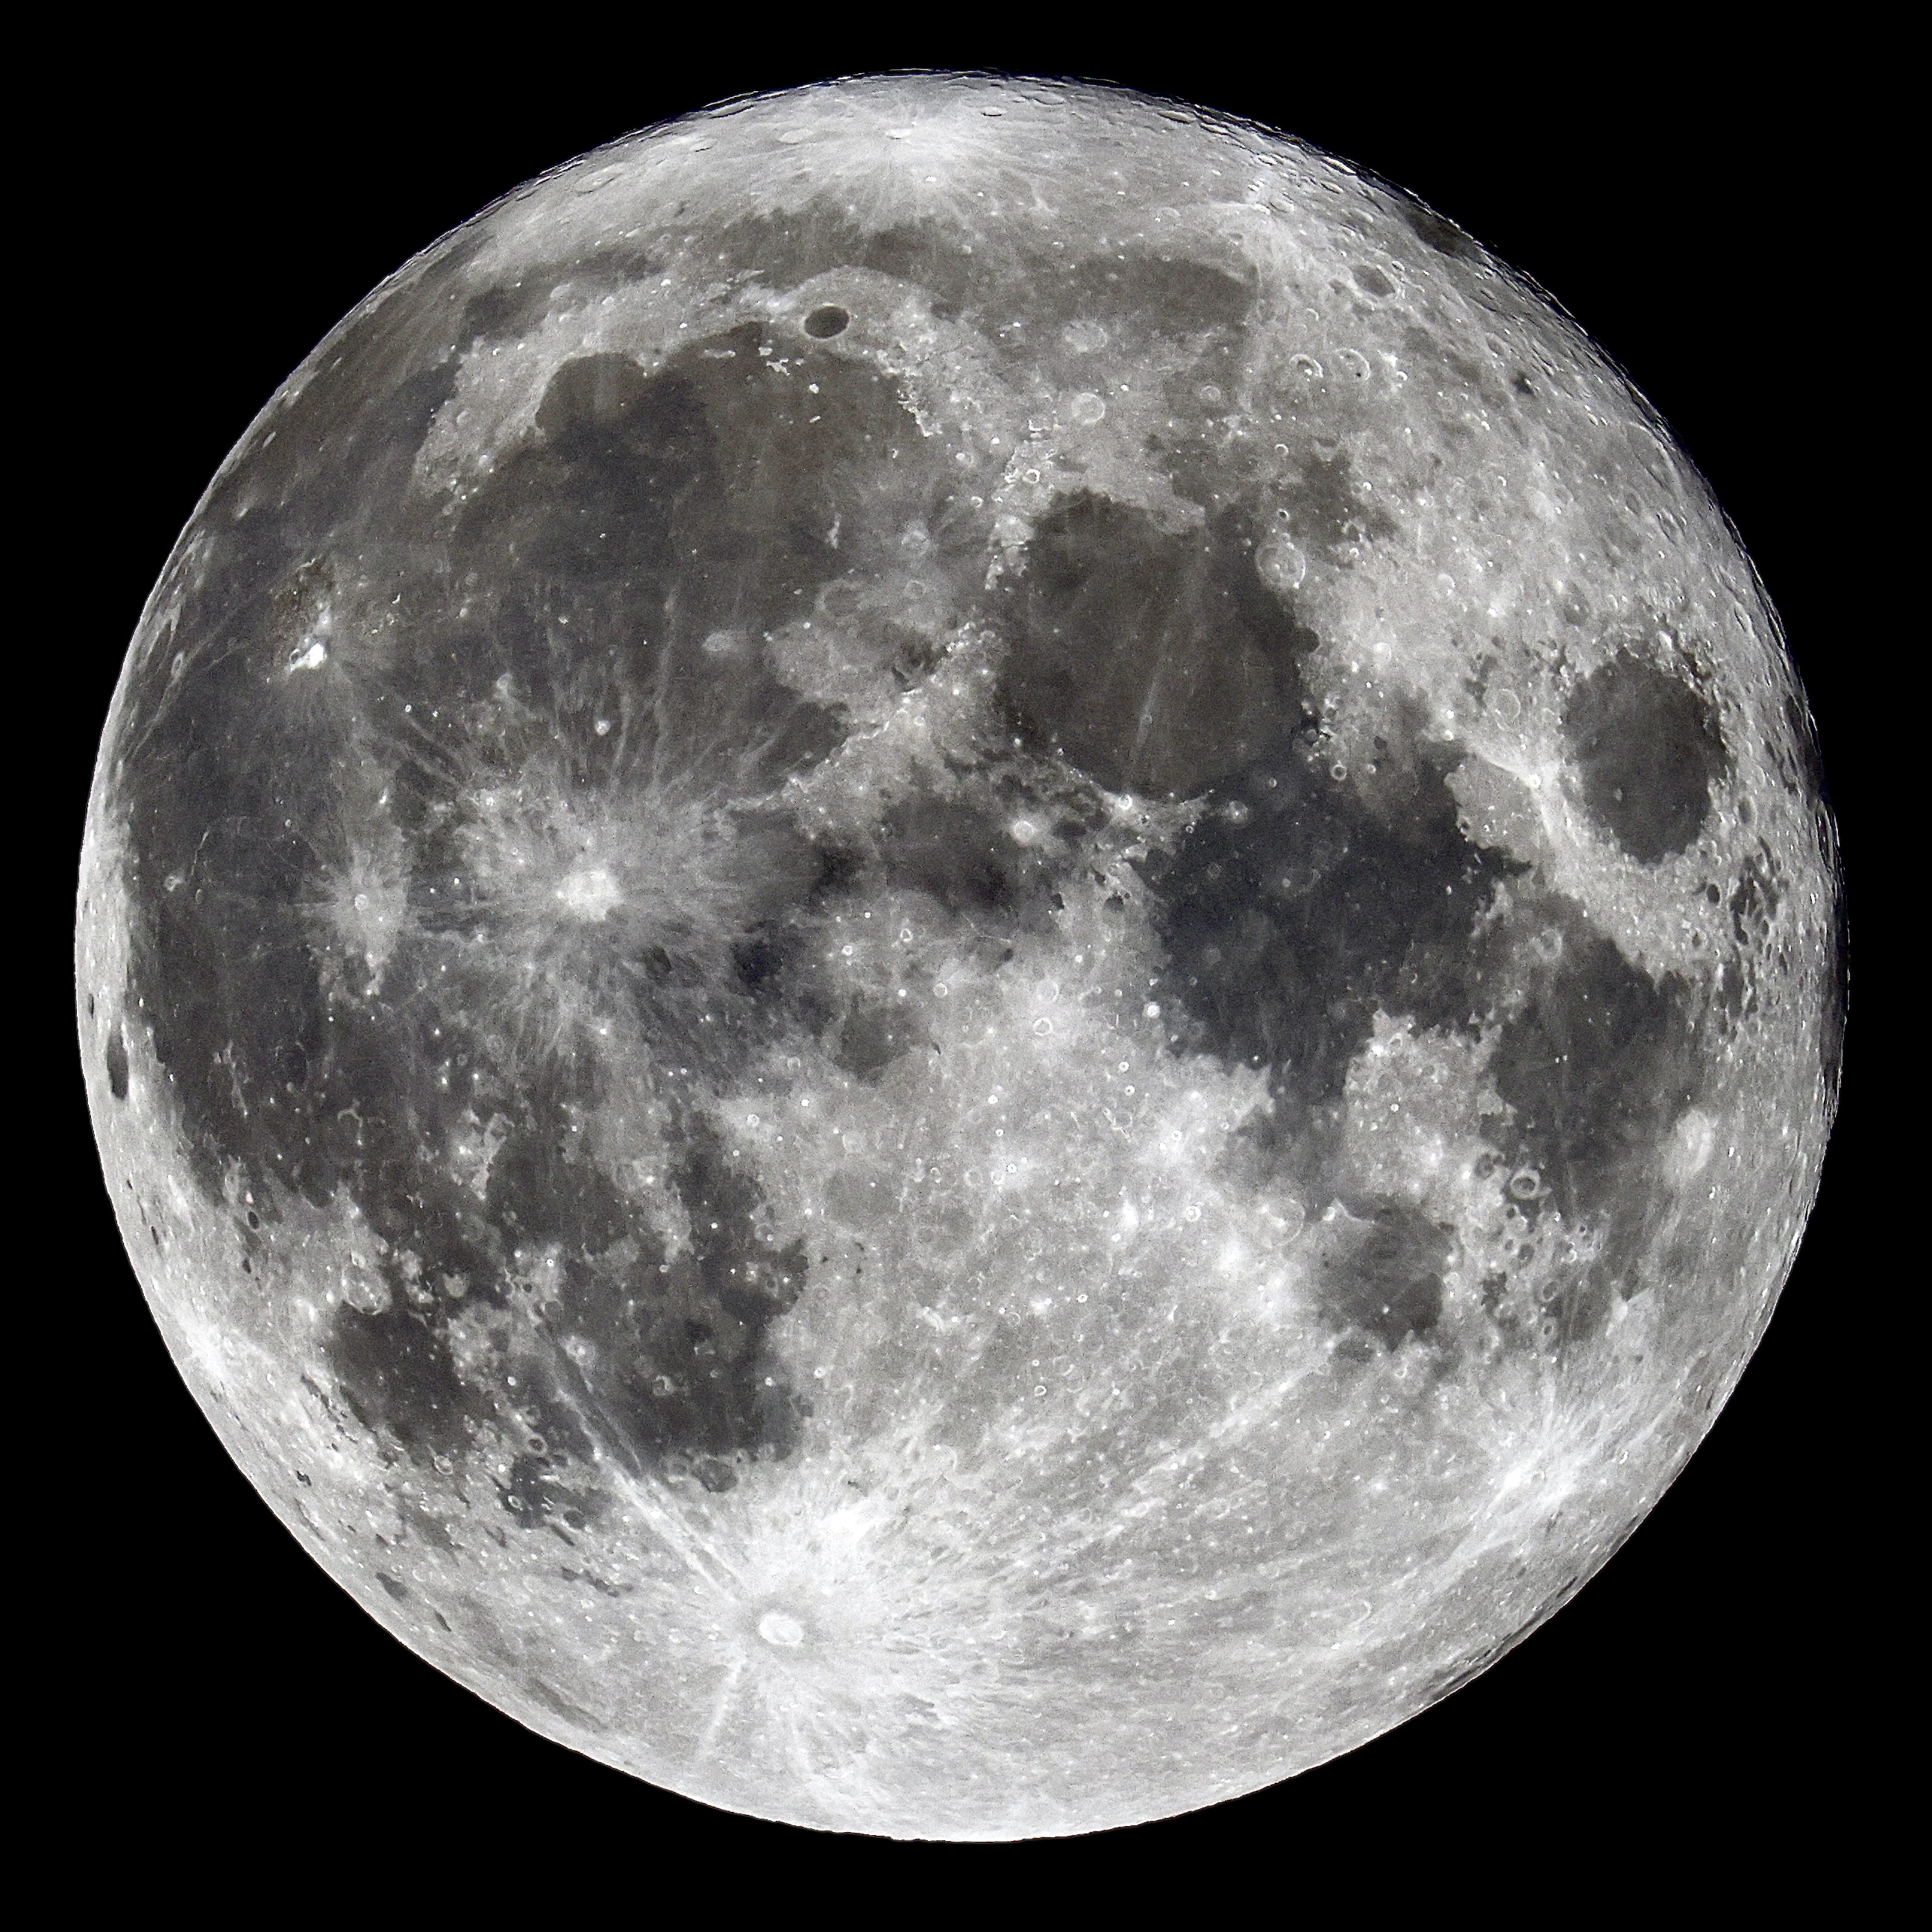
1 Introduction cont’d
Aristotle & Apollo 15 Hammer-Feather Drop
Source: National Aeronautics and Space Administration (NASA)
Future Computing 2026
Prototype Pseudo-Metacognition Module for AI Reasoning

Slide 7
1 Introduction cont’d
At the event horizon, even light cannot escape…
Einstein, Schwarzschild, Oppenheimer…
Source: U.S. Department of Energy and Sophia Dagnello, National Radio Astronomy Observatory (NRAO)/Associated Universities (AUI)/National Science Foundation (NSF)
Future Computing 2026
Prototype Pseudo-Metacognition Module for AI Reasoning

Slide 8
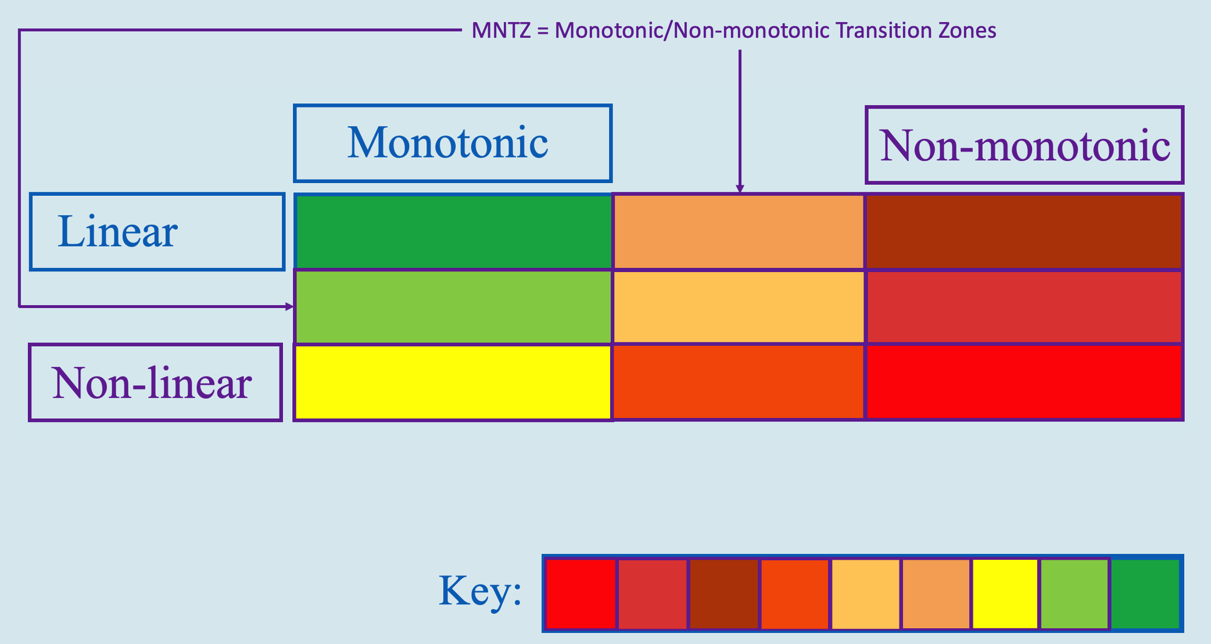
1 Introduction cont’d
Monotonic versus Non-monotonic
Future Computing 2026
Prototype Pseudo-Metacognition Module for AI Reasoning

Slide 9
2 Background
A Pragmatic Reasoning Method & Reasoning Behavior for CAA: Case-Based Reasoning (CBR)->Graph-Based Reasoning (GBR)
Future Computing 2026
Prototype Pseudo-Metacognition Module for AI Reasoning

Slide 10
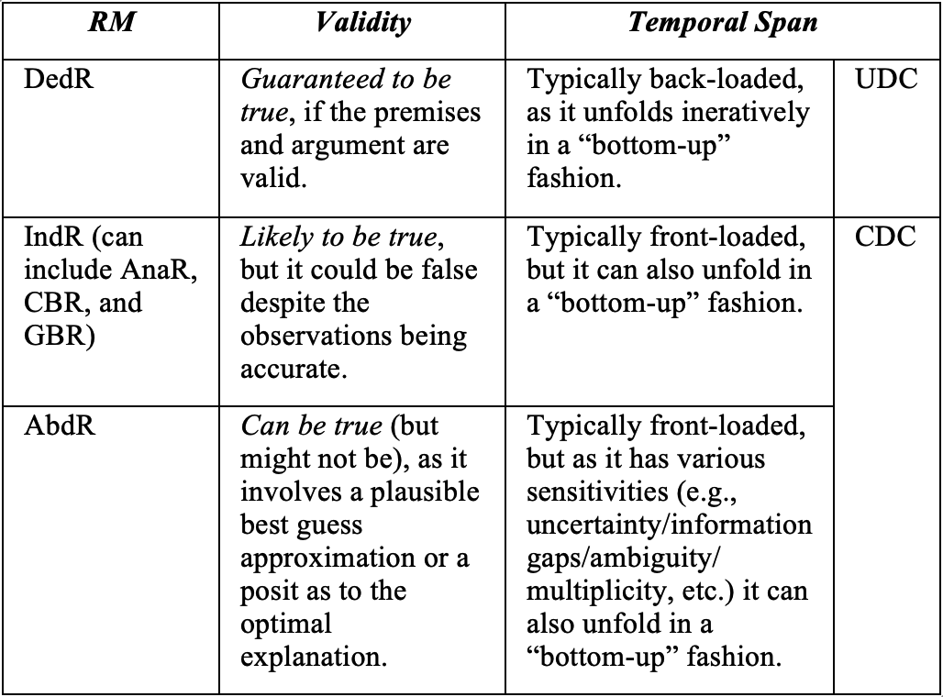
2 Background cont’d
Reasoning Methods with their Validities & Temporal Spans
Source: U.S. Department of Energy and Sophia Dagnello, National Radio Astronomy Observatory (NRAO)/Associated Universities (AUI)/National Science Foundation (NSF)
Future Computing 2026
Prototype Pseudo-Metacognition Module for AI Reasoning

Slide 11
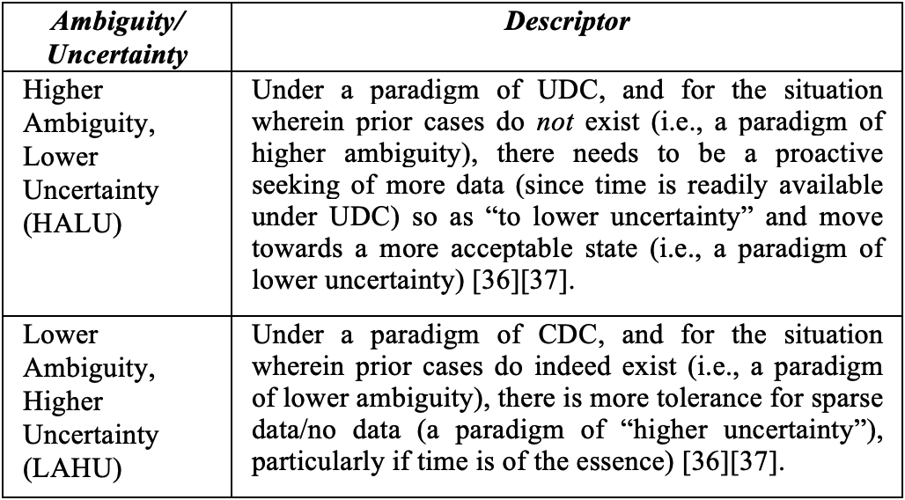
2 Background cont’d
Low Ambiguity Higher Uncertainty (LAHU)/HALU Module (LHM)
Future Computing 2026
Prototype Pseudo-Metacognition Module for AI Reasoning

Slide 12
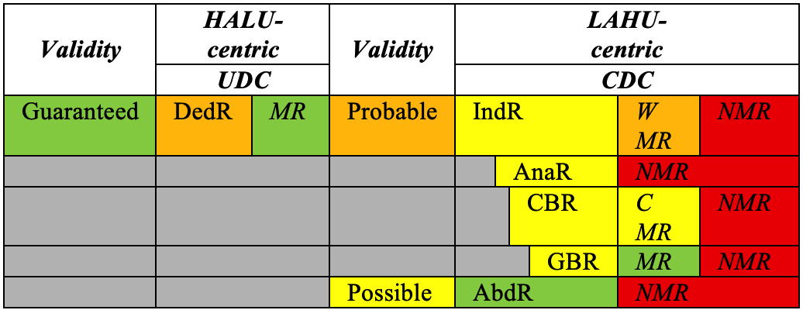
2 Background cont’d
RMs and RPs under UDC and CDC (with zero-shot circumstances)
Source: U.S. Department of Energy and Sophia Dagnello, National Radio Astronomy Observatory (NRAO)/Associated Universities (AUI)/National Science Foundation (NSF)
Future Computing 2026
Prototype Pseudo-Metacognition Module for AI Reasoning

Slide 13
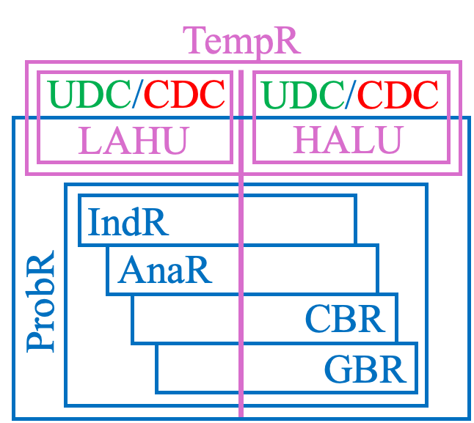
2 Background cont’d
Temporal Span & Temporal Reasoning
Source: U.S. Department of Energy and Sophia Dagnello, National Radio Astronomy Observatory (NRAO)/Associated Universities (AUI)/National Science Foundation (NSF)
Future Computing 2026
Prototype Pseudo-Metacognition Module for AI Reasoning

Slide 14
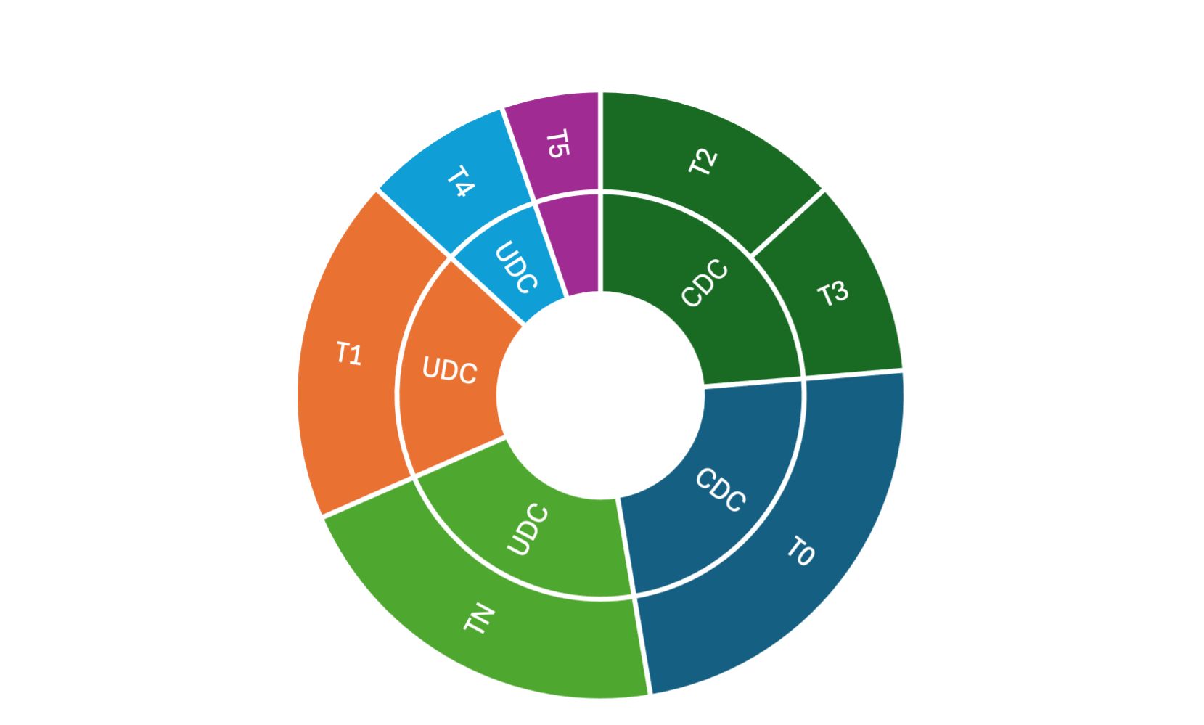
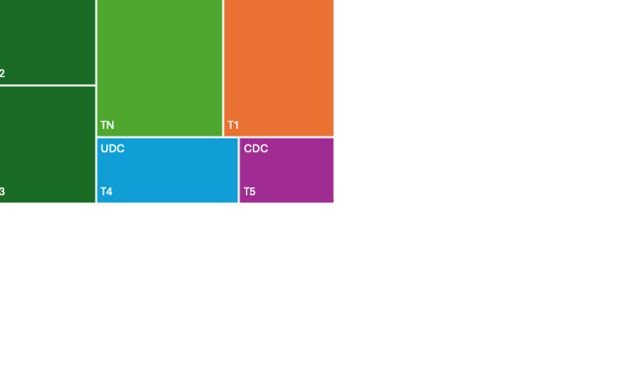
2 Background cont’d
TempR embodiment over an Elongated Temporal Span via LAHU:HALU amidst UDC/CDC circumstances
Future Computing 2026
Prototype Pseudo-Metacognition Module for AI Reasoning

Slide 15
3 The Paradox
(Deductive) Top-Down versus (Inductive) Bottom-Up
Future Computing 2026
Prototype Pseudo-Metacognition Module for AI Reasoning

Slide 16
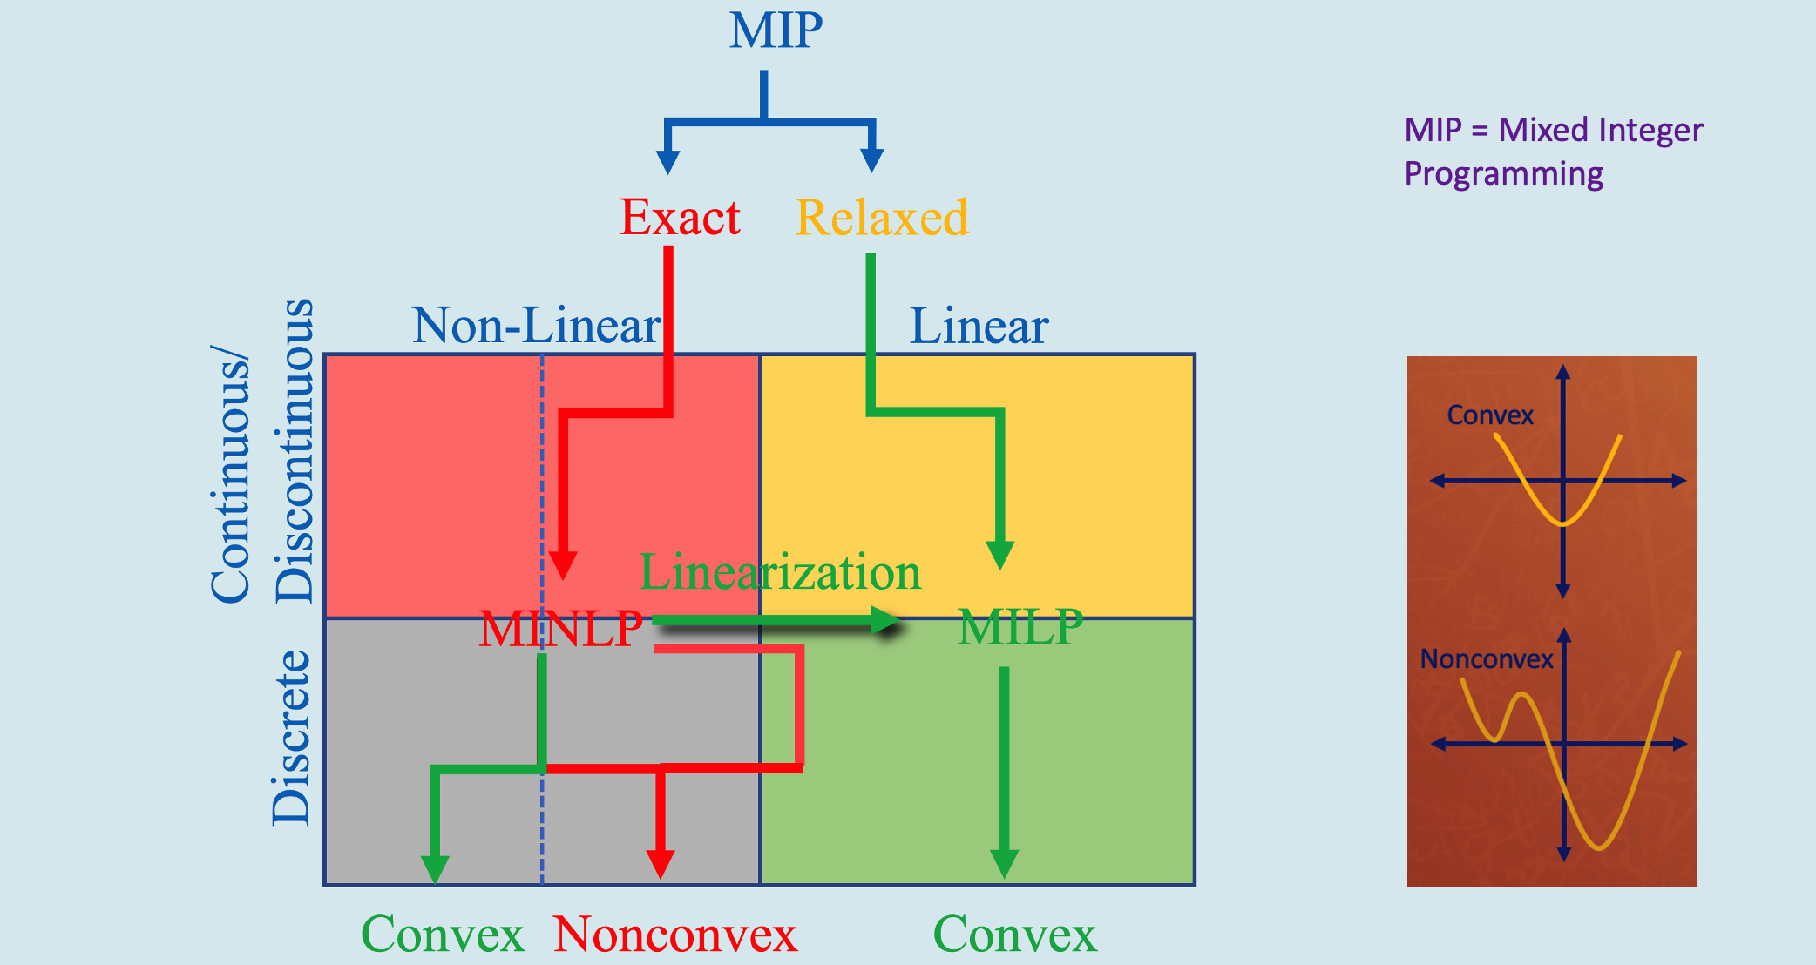
3 The Paradox cont’d
Monotonic versus Non-monotonic
Future Computing 2026
Prototype Pseudo-Metacognition Module for AI Reasoning

Slide 17
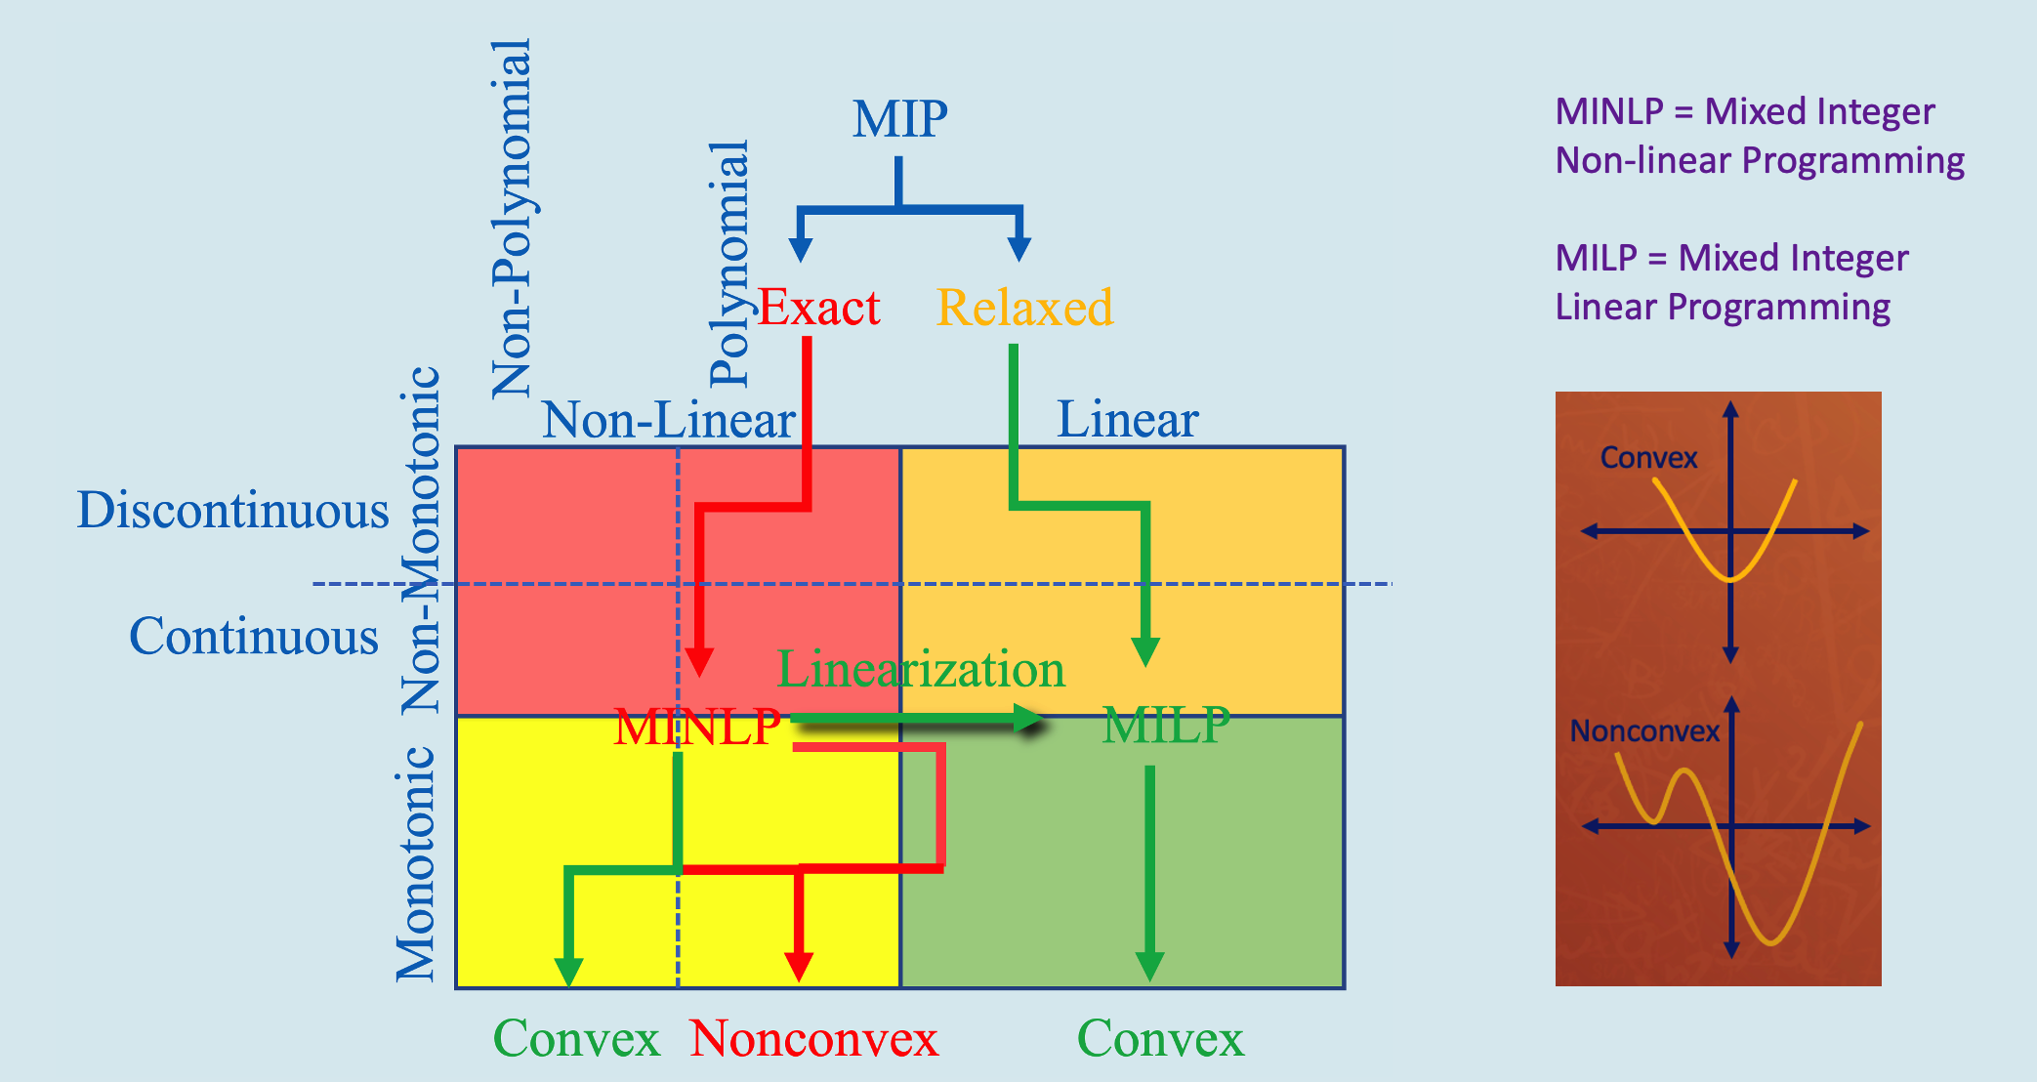
3 The Paradox cont’d
Monotonic versus Non-monotonic
Future Computing 2026
Prototype Pseudo-Metacognition Module for AI Reasoning

Slide 18
3 The Paradox cont’d
NP-Hard Spawning
Mixed Integer Programming (MIP)
Mixed Integer Linear Programming (MILP)
Mixed Integer Non-Linear Programming (MINLP)
Non-convex to convex Transformation Pathways (e.g., non-convex discontinuous non-linear MINLPs to convex form)
Non-convex to convex Transformation Pathways (e.g., non-convex[non-monotonic, discontinuous] non-polynomial MINLPs to convex form)
MIP
MIP
Non-Polynomial
Polynomial
Exact
Relaxed
Exact
Relaxed
Non-Linear
Linear
Non-Linear
Linear
Continuous/
Discontinuous
Discontinuous
Non-Monotonic
Linearization
Continuous
Linearization
MINLP
MILP
MINLP
MILP
Discrete
Monotonic
Convex
Nonconvex
Convex
Convex
Nonconvex
Convex
Future Computing 2026
Prototype Pseudo-Metacognition Module for AI Reasoning

Slide 19

3 The Paradox cont’d
Data-based Decision Support/Decision-Making and
Kahneman, Klein, and the isomorphic-centric LAHU/HALU
Kahneman System 1 -> potential biases
Klein Recognition-Primed Decision-Making (RPD)
Highly-trained Tasks
Low Ambiguity High Uncertainty (LAHU)
Reduces the need for more Big Data
High Ambiguity Low Uncertainty (HALU)
Necessitates more Big Data (and elongates Gestaltian Closure)
Kahneman System 2 -> potential overthinking/overtraining
Future Computing 2026
Prototype Pseudo-Metacognition Module for AI Reasoning

Slide 20
3 The Paradox cont’d
Algorithm vs. Heuristic vs. Hyper-Heuristic
Algorithm
According to computer scientist Harold Stone, an algorithm involves “a set of rules that precisely define a sequence of operations” (i.e., “it endeavors to determine an optimal solution that usually involves more computational time”).
Heuristic
According to Gigerenzer & Gaissmaier, a heuristic is “a problem-solving method that does ‘not guarantee an optimal solution,’ and is ‘a strategy that ignores part of the information, with the goal of making decisions more quickly, frugally, and/or accurately than more complex methods’” (i.e., “it endeavors to determine a good solution with less computational time”). STEA/I&E can help detect for potential errors, biases, and brittleness as well as areas for optimization and enhancement.
Hyper-Heuristic:
According to Drake and Carvalho, a hyper-heuristic is a “problem-solving method that ‘intelligently select[s] or generat[es] a suitable heuristic for a given situation;’ it can start simply as a ‘heuristic to choose heuristics;’ however, when an appropriate heuristic or amalgam of heuristics is not available or sub-optimal, a new heuristic(s) may need to be generated. Zhao and others (e.g., Bouazza) refer to this as an algorithm ‘that adaptively selects the optimizer to address complex problems.’”
Future Computing 2026
Prototype Pseudo-Metacognition Module for AI Reasoning

Slide 21
4 Experimentation
Explorations into a Prospective Metacognition Module (MM)
Future Computing 2026
Prototype Pseudo-Metacognition Module for AI Reasoning

Slide 22
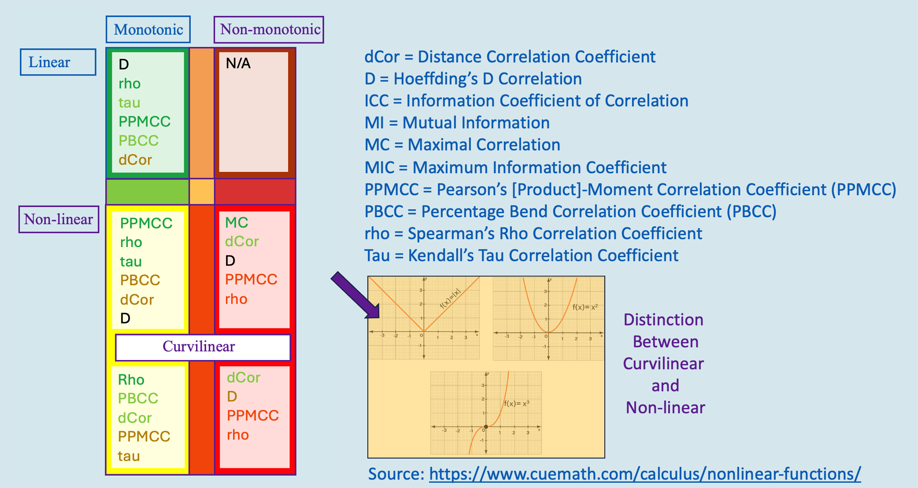
4 Experimentation cont’d
Monotonic versus Non-monotonic
PCC = Pearson Correlation Coefficient
Linear, Monotonic
Any Dependence
Nonlinear, Non-monotonic
Can’t tell direction…
No Non-monotonic
No Non-monotonic
Future Computing 2026
Prototype Pseudo-Metacognition Module for AI Reasoning

Slide 23
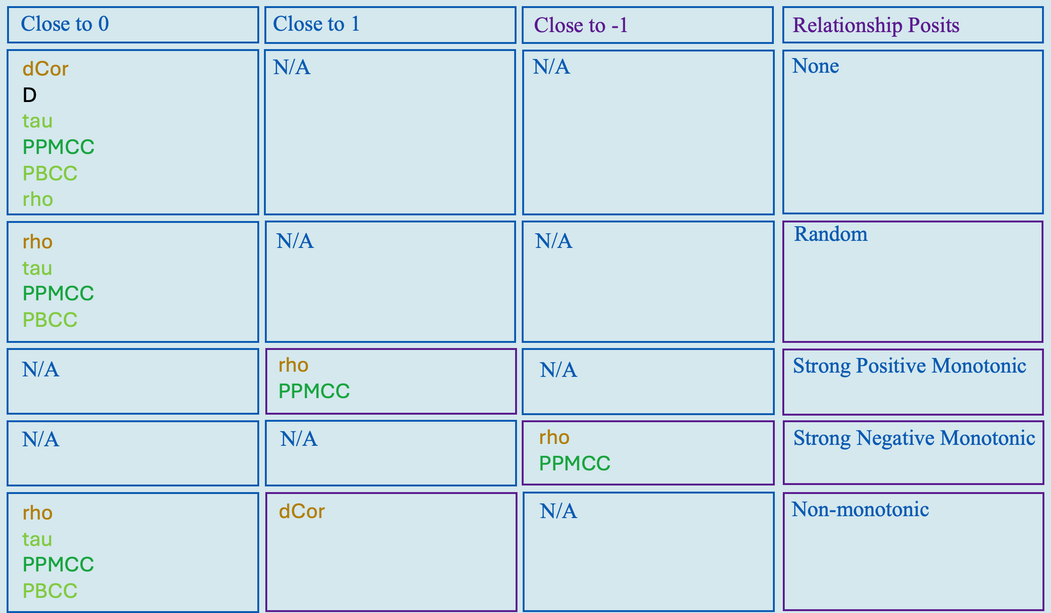
4 Experimentation cont’d
Monotonic versus Non-monotonic
Future Computing 2026
Prototype Pseudo-Metacognition Module for AI Reasoning

Slide 24
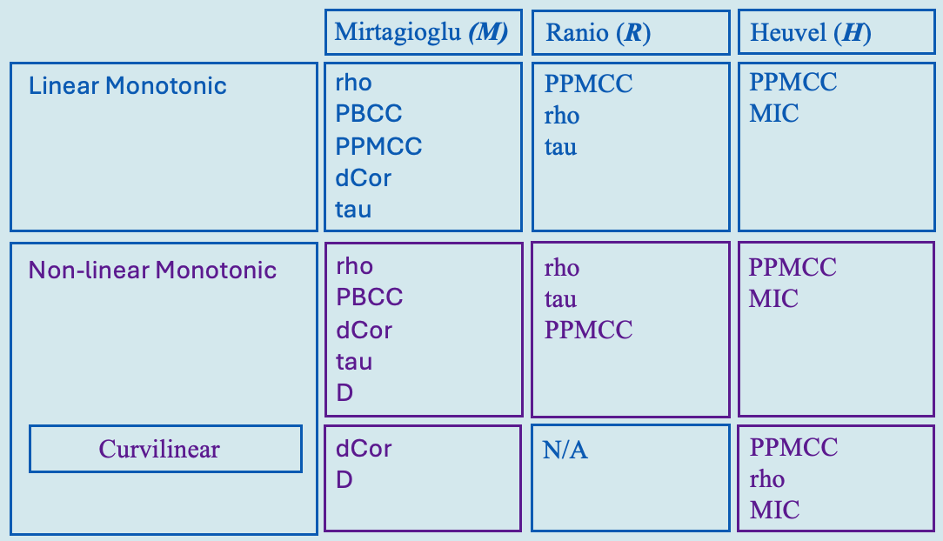
4 Experimentation cont’d
Monotonic versus Non-monotonic
Future Computing 2026
Prototype Pseudo-Metacognition Module for AI Reasoning

Slide 25
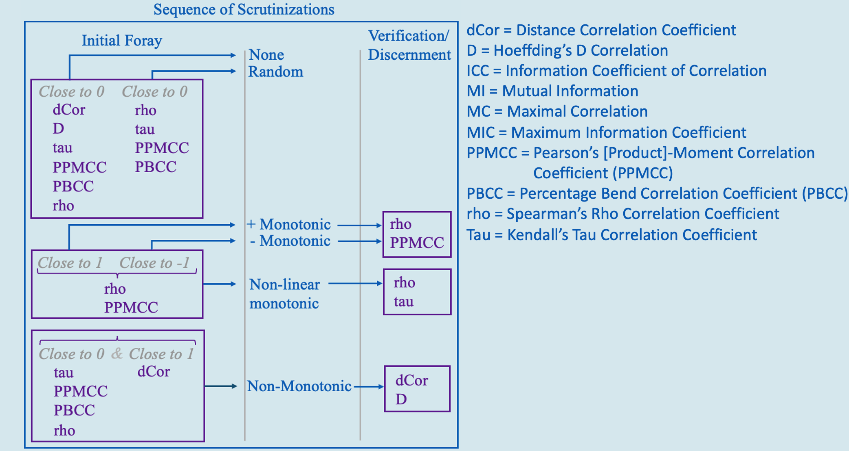
4 Experimentation cont’d
Monotonic versus Non-monotonic
Future Computing 2026
Prototype Pseudo-Metacognition Module for AI Reasoning

Slide 26
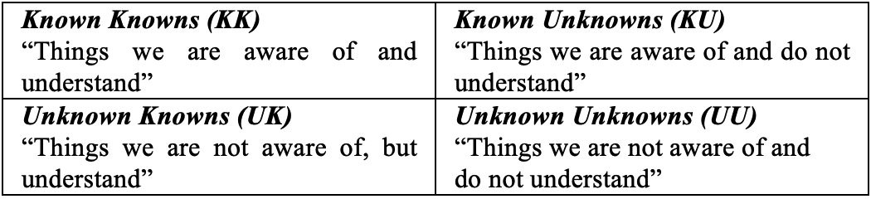
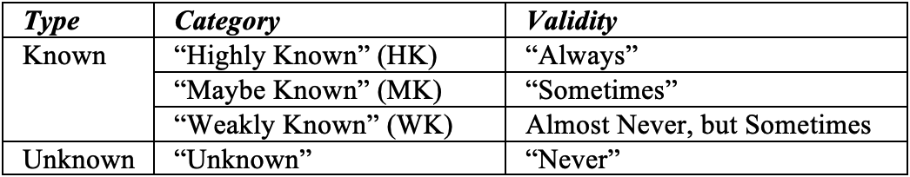
4 Experimentation cont’d
Epistemological constructs
Gekhman’s Sampling-based Categorization of Knowledge (Slick) Model
Future Computing 2026
Prototype Pseudo-Metacognition Module for AI Reasoning

Slide 27
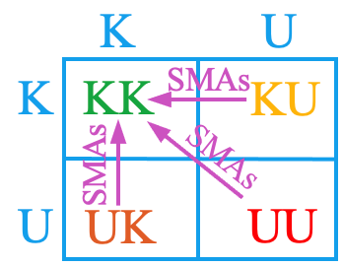
4 Experimentation cont’d
Kanthan’s Posit regarding bridging the Known to Unknown
Kanthan’s thoughts that the constituent elements of figurative language, such as Similes, Metaphors, and Analogies (SMAs) can “bridge the Known to the Unknown”
Notional Quasi-Mixture of Experts (MOE)
Embodiment of Gekhman and Kanthan
Li’s Commonsense Analogy from E-HowNet (CA-EHN) and AnaR
DedR
IndR
ProbR
AnaR
CA-EHN
DeepProbLog
CBR
Chhikara’s Mem0 and GBR
GBR
TensorLog, Mem0
AbdR
Cohen’s TensorLog and GBR
Manhaeve’s DeepProbLog and ProbR
Future Computing 2026
Prototype Pseudo-Metacognition Module for AI Reasoning

Slide 28
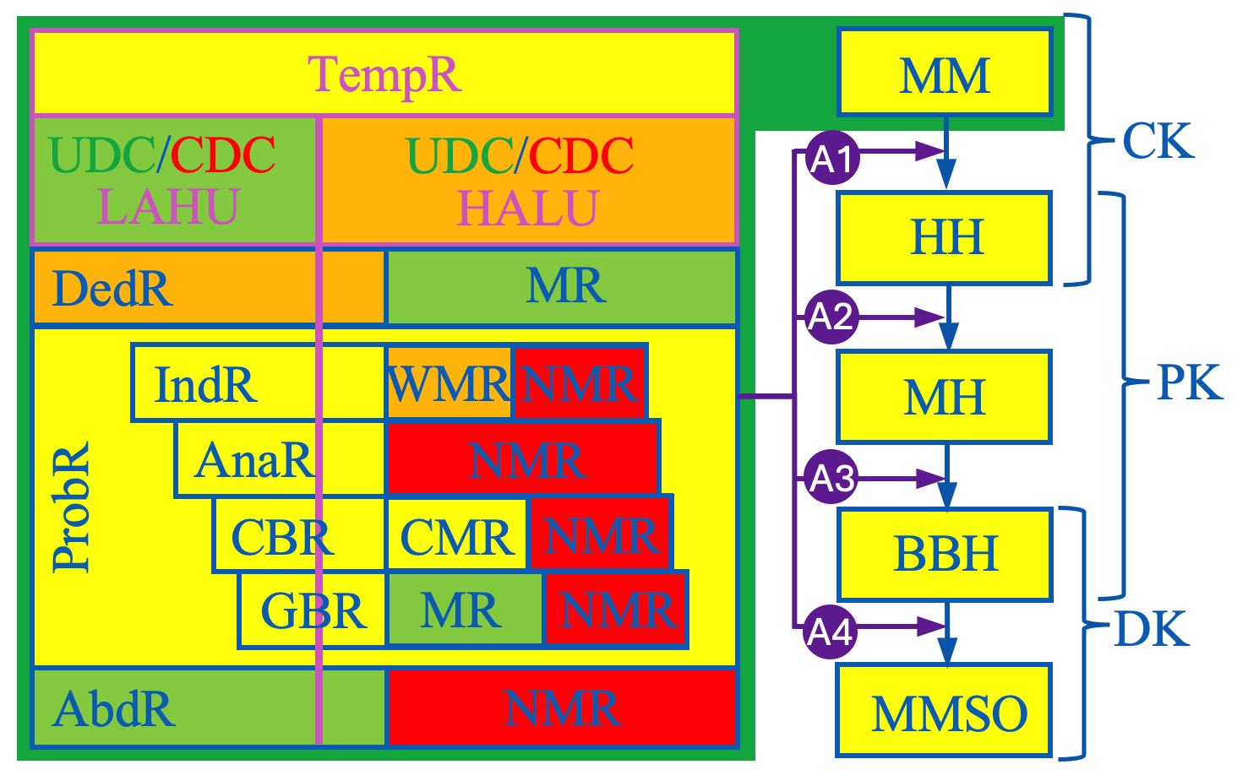
4 Experimentation cont’d
Prototype MM Embodiment Architecture
Declarative Knowledge (DK):
(e.g., recitals of fact,
concepts)
Procedural Knowledge (DK):
(e.g., step-by-step skills,
knowing how)
Conditional Knowledge (CK):
(e.g., knowing when and
why)
Dong:
2 error types: (1) factual, such as mistakes in specific solution steps, and (2) thinking errors, which are flaws in the reasoning.
Multi-Attribute Decision-Making (MADM) and/or Multi-Objective Decision-Making (MODM) Subjective/Objective (MMSO)
Future Computing 2026
Prototype Pseudo-Metacognition Module for AI Reasoning

Slide 29
5 Conclusion
IndR Possibilities and the Prospects for Enhanced Coherence
Future Computing 2026
Prototype Pseudo-Metacognition Module for AI Reasoning

Slide 30
5 Conclusion cont’d
Exemplar HH Construct
Exemplar Metaheuristic Schema
Metaheuristic (MH)
Hyper-Heuristic (HH)
Selection
Generation
Mixed
Evolutionary Algorithms (EAs)
Swarm Intelligence (SI)
Algorithms
Physical
Law-based
Algorithms (PLA)
…
…
HH₁
HH₂
HH₃
HH₄
Domain Barrier
Low-Level Heuristic (LLH)
Genetic Algorithm
(GA)
Differential Evolution (DE)
Algorithm
Particle Swarm Optimization (PSO) Algorithm
Firefly
Algorithm
(FA)
Simulated Annealing (SA) Algorithm
Gravitational Search Algorithm (GSA)
…
H₁
H₂
H₃
…
…
Solution Search Space
Exemplar HH, MH, and LLH Schema
S₁
…
S₂
S₃
Based upon Bouazza’s work in: W. Bouazza, “Machine
Learning-Based Hyper-Heuristics: A Clear Insight,” Proc.
of the 2024 7th Int. Conf. on Comput. Intell. And Intell.
Syst. (CIIC), Feb. 2025, pp. 29-37.
Bouzza
AIS
HH
MH
LLH
Future Computing 2026
Prototype Pseudo-Metacognition Module for AI Reasoning

Slide 31
5 Conclusion cont’d
Selection
Generation
Mixed
HH₁
HH₂
HH₃
HH₄
HH₅
…
2
1
3
4
5
6
…
LLH₁
LLH₂
LLH₃
LLH₄
LLH₅
…
S₁
S₂
S₃
AIS
HH
Bouzza
MH
LLH
Future Computing 2026
Prototype Pseudo-Metacognition Module for AI Reasoning

Slide 32
5 Conclusion cont’d
Exemplar MCDM MADM/MODM SM/OM & HH, MH, and LLH Construct
Enhanced STEA/I&E AI/ML Mechanism
MCDM MADM/MODM SM/OM
Apropos H_{BB} available from repertoire?
BB = Building Block
(Building Block Heuristic)
Selection of Metaheuristic
Y
N
Metaheuristic
Selection of Algorithmic Approach
Not a re-selection?
Generation HH
Y
N
Selection HH
Re-Selection HH
Constructive HH
Perturbative HH
S = Selected
(Selected Heuristic)
H_{S}
H_{G}
G = Generated
(Generated Heuristic)
H_{O}
able to handle the Data?
O = initial H
O = Operational
(Operational Heuristic)
Y
N
PR = Problem Resolution
Proceed to PR, etc.
Refer to HH for re-selection/generation
Future Computing 2026
Prototype Pseudo-Metacognition Module for AI Reasoning

Slide 33
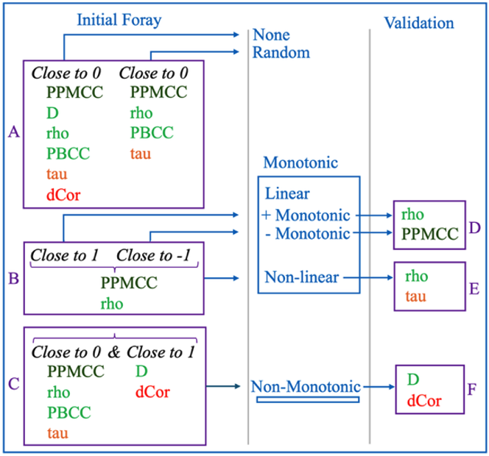
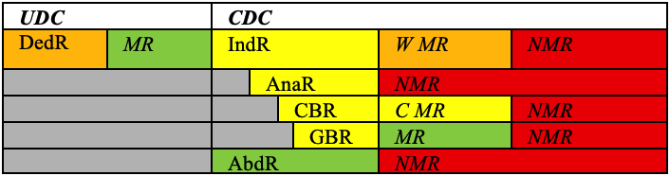
5 Conclusion cont’d
Advancing the state of CAA Coherency:
IndR, AnaR, CBR
Graph-Based Reasoning (GBR) to support CBR
Pre-Isomorphic Paradigms (IsoP), Relaxed IsoP, IsoP, and Post-IsoP
MNTZ inclinations for various measures, RMs, and RPs:
Future Computing 2026
Prototype Pseudo-Metacognition Module for AI Reasoning

Slide 34
5 Conclusion cont’d
Paradigm of “Construct Validity Amidst Uncertainty:”
CnVx = Content Validity
Topic
CsVx = Construct Validity
Concept
CcVx = Concurrent Validity
Correlation of new test with
previously validated tests
CtVx = Criterion-related Validity
Extent of Agreement with
“Platinum Standard”
PdVx = Predictive Validity
Robustness of Posit with
regards to future behavior
Depth
(& Accuracy)
Depth vs.
Breadth
Breadth
Temporal
considerations
Temporal vs.
Non-temporal
Conventional
metrics
Non-Temporal “Platinum Standard” Consideration
Future Computing 2026
Prototype Pseudo-Metacognition Module for AI Reasoning

Slide 35
Recap
Introduction
CAA Inductive Reasoning (IndR) Approaches have been largely unexplored
Background
A Pragmatic Reasoning Method and Reasoning Behavior for CAA:
Case-Based Reasoning (CBR)-> Graph-Based Reasoning (GBR)
The Paradox
(Deductive) Top-Down versus (Inductive) Bottom-Up
Experimentation
Explorations into a Prospective Metacognition Module (MM)
Conclusion
IndR Possibilities and the Prospects for Enhanced Coherence
Future Computing 2026
Prototype Pseudo-Metacognition Module for AI Reasoning

Slide 36
Thank you very much for your time and attention!
Questions?
Future Computing 2026
Prototype Pseudo-Metacognition Module for AI Reasoning

