Slide 1


Reducing Frame Synchronization Loss through Optimized Start Frame Delimiter
Deyuku Maeda, Naoki Morita
Presented by: Deyuku Maeda, Tokai University
Email: maedaduke@gmail.com

Slide 2

Presenter's Short Resume. 1
Biography
I earned my Bachelor's degree in Communication and Network Engineering from the School of Information and Telecommunication Engineering at Tokai University in 2022. Currently, I am pursuing a Master's degree at the same institution.
From 2022 to July 2024, I worked at a publicly traded IT company, contributing to the development of a railway management system for two and a half years. My research focuses on telecommunications and AI-based image recognition.
I have presented my work at eKNOW 2020, including topics such as "Efficient Parameters for Rotation Processing of Data Augmentation" and "Shoot Counting System Based on SegNet".

Slide 3
Introduction : About SFD 2
SFD
DATA
Frame
Start Frame Delimiter (SFD) is most important part of the frame synchronization. Frame synchronization is achieved by the transmitter sending a frame in which SFD is injected at the beginning of each transmission data.

Slide 4
Introduction : About SFD 3
EX.
1111111111100111010101011111…
The SFD for now is 110

Slide 5
Introduction : About SFD. 4
EX.
1111111111100111010101011111…
The receiver detects the arrival of a packet by searching for the SFD, then removes the SFD from the data stream to restore the transmitted message

Slide 6
Introduction : Problem. 5
1111111111100111010101011111…
Frame synchronization loss occurs when noise superimposed on the SFD causes synchronization failure, resulting in incorrect detection and requiring time to resynchronize. This loss directly affects the reliability of the entire communication channel, necessitating solutions to further reduce its occurrence frequency.

Slide 7
The Purpose of this study 6
Purpose of this study is to optimal SFD that can mitigate the issue of synchronization loss.

Slide 8
About barker code. 7
The Barker sequences serve as a known reference signal that we used for frame synchronization.

Slide 9
Methodology. 8
Shorter SFD reduces noise superimposition but increases accidental matches.
110110101111101011111010111

Slide 10
Methodology. 9
Shorter SFD reduces noise superimposition but increases accidental matches.
110110101111101011111010111

Slide 11
Methodology 10
Longer SFD increases complexity and noise vulnerability.
110110101111101011111010111
111110011010101011111010111

Slide 12
Methodology 11
Longer SFD increases complexity and noise vulnerability.
110110101111101011111010111
111110011010101011111010111

Slide 13
Methodology 12
We conducted Monte Carlo simulations to evaluate the impact of each Barker code used as the SFD on frame synchronization loss.

Slide 14
Simulation : Simulation setup 13
SFD
DATA
Frame
Randomly generated data
⇩
Forward Error Correction (FEC) using Reed-Solomon code
255 Byte length
Barker code

Slide 15
Simulation : Simulation setup. 14
Frame
Idling
Frame
Idling
・・・
Idling
Frame
channel
Random length
Channel : The transmission channel is modeled as an Additive White Gaussian Noise (AWGN) channel
Packet : 1000 packets

Slide 16
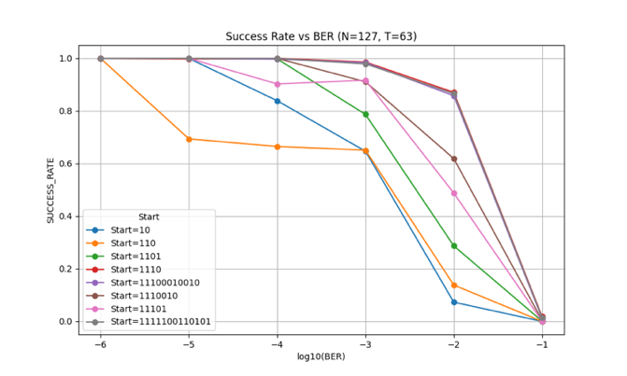
Result 15

Slide 17
Result 16

Slide 18
Result and Consideration 17
In an environment with BER10^(-5), no noise superimposition on the SFD was observed.
For the SFD pattern "110," frame synchronization errors occurred even in favorable communication environments.
By comparing the number of noise superimpositions on the SFD with the number of false recognitions, it was considered possible to identify the optimal SFD that minimizes the risk of accidental matches.
Simulation results revealed that SFD patterns "1110," "11100010010," and "1111100110101" had a higher number of noise superimpositions than false detections.
In the environment with BER10^(-3), the noise superimposition counts were observed in the order of "1111100110101 > 11100010010 > 1110," suggesting that reducing the occupancy rate of the SFD in the transmission channel can lower the probability of noise superimposition on the SFD.
It was confirmed that as the SFD length increases, the false detection rate decreases.
When comparing the number of successful receptions in the environment with BER10^(-3), the results showed "1110 > 11100010010 > 1111100110101."
Therefore, the most optimal SFD is “1110,” which has the shortest bit length and mitigates synchronization errors while maintaining a high success rate.

Slide 19
Conclusion and future work 18
In this study, simulations were conducted to evaluate the impact of noise superimposition on SFD and frame synchronization errors to identify the optimal SFD pattern.
The simulation results revealed that reducing the occupancy rate of the SFD effectively suppresses the probability of noise superimposition.
Particularly, the SFD pattern "1110" demonstrated excellent results, being the shortest in bit length while reducing false recognitions and improving frame synchronization success rates.
While the optimal SFD was identified in this study, the problem of frame synchronization errors has not been fully resolved. Further research is necessary to explore different approaches to address this issue.

