Slide 1
"Teachers, Reload Your Toolboxes"
Advances on Societal Digital Transformation
DIGITAL 2023
Using a Task Design Framework and ChatGPT to Generate Motivational Exercises for Female Learners in Computer Science
Sibylle Kunz & Claudia Hess IU International University of Applied Sciences
sibylle.kunz@iu.org
claudia.hess@iu.org

Slide 2
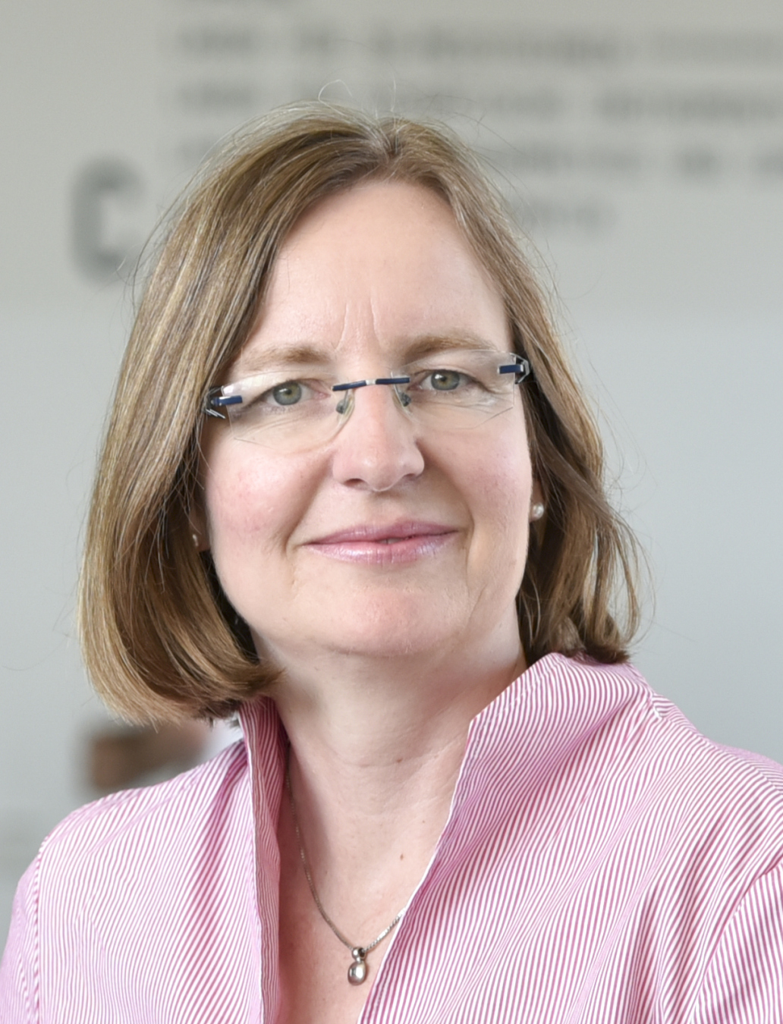
Prof. Dr. Claudia Hess
Professional Experience
Professor and Head of study programme Media Computer Science at IU International University of Applied Science in online distance learning and in dual studies since 2020
2011-2020 Academic Lecturer at Universities of Applied Sciences Mainz and Darmstadt
Digital Teaching Award at University of Applied Sciences Darmstadt 2020
IT-Consultant and Trainer for application systems (SAP, MS Excel, MS Access, MS VBA etc.) since 1993 (Freelancer)
Current Research Activities
Media Computer Science, Digital Reading
Augmented, Mixed and Virtual Reality
Corporate Digital Responsibility
Women in STEM

Slide 3
Using a Task Design Framework and ChatGPT to Generate Motivational Exercises for Female Learners in Computer Science

Slide 4
Agenda
How to catch them all: The Framework |  | 1
Using ChatGPT for Task Creation: An Iterative Approach |  | 2
Case study: Creating a task and solution hints |  | 3
Fighting Fire with Fire: Using LLM-Biases for Good |  | 4

Slide 5
The Problem
The "Leaky STEM Pipeline"
Girls lose interest in Science, Technology, Engineering, Mathematics - and Computer Science during school time
Reasons
Lack of self-confidence
Sense of inadequacy in meeting the requirements of universities.
Solution
Promote competencies needed for studying computer science -> Competency-based Education (CBE)
Foster conscious lesson and task design
But:
Many learning activities do not appeal to girls, but teachers do not have the time or knowledge to create more suitable exercises.
https://www.pexels.com/de-de/foto/menschen-frau-laptop-madchen-7689763/

Slide 6
The cycle of exercise developmenT
Define learning objectives
Update task description based on experiences or technical updates
Define task type and resulting artefacts
Grade and explain rating
Describe task and the requirements for the solution in a text
active role of teacher
Let pupils do the task Supervise, feedback & reflection
Provide information about tools & methodology
support by framework
support by AI Chatbot
Formulate feedback-patterns
Add a background story/context
Set criteria for grading
Provide hints or partial sample solutions

Slide 7
How to catch them all: The Framework
"Design an interface for a coffee vending machine"
Learning Activity Dimension | Characteristics/Choices
Competency | Inventive | Thinking concretely | Analytic/ thinking in an abstract way | (Others)
Class organization | Single learner | Partnership work, two learners | Group-/ teamwork 3-6 learners | -
Gender pairing | Single- gender | Mixed- gender | - | -
Duration | Asynchronous during several lessons based on work packages | Synchronous during one lesson | Synchro­nous in more than one lesson | -
Task type | Focus on programming an algorithm | Focus on Human Computer Interaction (HCI-)design | Focus on physical construc­tion | (Others)
Tools/ Media | Software tools | Real-world tools, hardware-based | Combina­tion of hardware and software tools | -
Number of possible solutions: | There’s only one correct sample solution | Many sample solutions can be correct | Unlimited number of correct solutions | -
Assessment (frequency) | No support, no interaction | Sporadic support during lessons | Regular support in and between lessons | -
Assessment (method) | Formative during creation | Summative when finished | - | -
Documentation required | Yes | No
Grading | Yes | No
S. Kunz and C. Hess, “How to catch’em all: Designing attractive learning activities for girls in computer science. A systematic framework”, The 4th International Conference on Teaching and Education Management (ICTEM 2023), Berlin, Germany, June 2023 (in press).

Slide 8
Using ChatGPT for Task Creation: An Iterative Approach
Preparation
- Provide ChatGPT with problem and framework.
- Check for interdependencies among dimensions.
Design
- Run prompt.
- Check completeness and usability.
- Add more context.
- Re-run, refine.
Evaluation
- Check: enough information for pupils to solve the task?
Create Sample Solution
- Code outlines & snippets, class structures
- Explain code in natural language
Test
- Let pupils solve the task.
- Provide feedback & (optional) grading.
Optimize
- Refine Prompts.
- Update solutions.

Slide 9
Case study: Creating a task and solution hints
Zero-shot prompt as a test:
Create a school task for a computer science lesson. The task should appeal to girls and the goal should be to create a user interface. Use up to 500 words
Task Title: Design Your Dream Fashion App
Objective: The goal of this task is for students to practice basic computer science principles by creating a user interface for a fashion-app. This activity aims to appeal to girls with an interest in fashion design while also fostering essential computer programming skills.
Overview:
[…]
In this task, students will take on the role of app designers, and their assignment is to create a unique fashion app that offers users an interactive and creative experience. The app should have features that girls would enjoy, such as:
1. Personal style profile creation
2. Outfit recommendations based on weather and events
3. A virtual wardrobe to mix and match outfits
4. Fashion news, trends, and […]

Slide 10
Case study: Creating a task and solution hints
Providing the framework:
I will give you a framework for designing interesting tasks for lessons ins computer science for school girls aged 12-19. I will list the important properties and the possibilities for each category. You will create a task according to these categories. Make sure the properties you choose fit well together.
The properties are:
Fostered Competency should be one or more of these: like “thinking concretely”, "analytic”, “thinking in an abstract way”, “being able to visualize”, “thinking holistically”
Class organization should be either individual work, working in pairs or working in groups
Gender pairing should either be girls-only or mixed groups
Duration should be either 1 lesson or several lessons
Task type should be either programming, HCI-design, constructing a switch board, building a robot or any other computer science related work
Tools and Media should be used, list sample tools to fulfill the task
Number of possible solutions: either only one solution is correct or the task can have different solution variants or even an infinite number of solutions
Assessment: the task can be graded or not graded
Documentation: the task could require a written documentation or just a self-explaining artefact
Grading: describe if the task can be easily graded concerning certain quality properties
Chose topics that girls are generally interested in. The task description should contain of a maximum of 2000 words and contain suggestions for all ten properties.”

Slide 11
Case study: Creating a task and solution hints
The resulting task description
Result: Task: Designing a Mobile App for a Sustainable Fashion Community
Fostered Competency: Thinking holistically, thinking in an abstract way, being able to visualize.
Girls will need to think about the overall concept of a sustainable fashion community, consider abstract ideas related to fashion and sustainability, and visualize the app's design and functionality.
[…]
Gender Pairing: Girls-only.
Girls can work on this task in a girls-only setting, creating a comfortable environment that encourages participation and collaboration among female students.
Duration: Several lessons.
This task requires multiple lessons to give students enough time to research, plan, design, and prototype their mobile app concept.
Task Type: HCI-design (Human-Computer Interaction design) and programming.
Girls will design the user interface and user experience (HCI-design) of a mobile app for a sustainable fashion community. They will also have the option to implement a basic prototype using programming tools.
Tools and Media:
HCI-design tools: Figma, Adobe XD, Sketch, or any other design software the school has available.
Programming tools: Thunkable, App Inventor, or any other beginner-friendly app development platform.
Research materials: Access to the internet or school library for researching sustainable fashion practices, existing fashion communities, and mobile app design inspiration.
[…]

Slide 12
Case study: Creating a task and solution hints
The resulting task description
The task can be graded based on the clarity and creativity of the app concept, the usability and visual appeal of the user interface, the functionality and effectiveness of the app features, and the completeness and coherence of the written documentation.
Task Description (within the maximum word limit):
In this project, you will have the exciting opportunity to design a mobile app for a sustainable fashion community. The app will provide a platform for fashion enthusiasts to connect, share ideas, and promote sustainable practices in the fashion industry.
You will be working individually on this project, allowing you to explore your creativity and problem-solving skills. Throughout several lessons, you will research, plan, design, and prototype your unique mobile app concept.
To foster your holistic thinking, you will need to consider various aspects of sustainable fashion and abstract ideas related to fashion communities. Visualizing your app's design and functionality will be crucial to creating an engaging and user-friendly experience.
You will utilize HCI-design tools such as Figma, Adobe XD, or Sketch to create the user interface and design the user experience of your app. These tools will enable you to bring your creative ideas to life visually. Additionally, you will have the option to implement a basic prototype of your app using beginner-friendly programming tools like Thunkable or App Inventor.
Your app design can take different forms, reflecting your unique perspective and creativity. While there may be common elements, such as user profiles, discussion forums, and sustainability resources, you have the freedom to explore various features and functionalities

Slide 13
Case study: Creating a task and solution hints
Creating a background-story
Create a background story for the sustainable fashion app you suggested first. The story should raise the girls' interest and contain a maximum of 250 words.
Once upon a time, in a world where fashion reigned supreme, a group of passionate young girls embarked on a mission to change the industry for the better. Their names were Mia, Lily, and Ava. […]
Rewrite the background story using a famous female computer scientist as a role model. Give a few biographical details on the woman and make it sound less pathetic.
In the realm of technology, where innovation thrived, a group of aspiring young girls found themselves captivated by the remarkable story of Dr. Carol Shaw, a pioneering computer scientist who left an indelible mark on the gaming industry. Inspired by her groundbreaking achievements, they set out on a mission to combine their passion for fashion with their love for technology.
Dr. Shaw, an exceptional programmer and game designer, blazed trails in a male-dominated field. Her talent and perseverance led her to become one of the first female video game developers, shaping the landscape of interactive entertainment. The girls admired her technical brilliance, creative vision, and the barriers she shattered along her journey

Slide 14
Fighting Fire with Fire: Using LLM-Biases for Good
Typical LLM biases: stereotypes about girls' favorite topics (fashion, beauty, pets…)
Will these biases be enforced?
Using the bias to attract (allure?) more girls to computer science is a legitimate approach - if it works.
There’s evidence that girls solving gender-stereotypical mathematical tasks can outperform girls in a control group.

Slide 15
Thank YOU!
IU International University of Applied Sciences
Sibylle Kunz & Claudia Heß sibylle.kunz@iu.org; claudia.hess@iu.org

Slide 16
List of Sources
S. Kunz and C. Hess, “How to catch’em all: Designing attractive learning activities for girls in computer science. A systematic framework”, The 4th International Conference on Teaching and Education Management (ICTEM 2023), Berlin, Germany, June 2023 (in press).

