Slide 1

Effect of Touching Care on Fear in French and Japanese Subjects
François-Benoît Vialatte ¹⁾, Tsubasa Tokunaga ²⁾, Yoshikazu Washizawa ²⁾, Kazuko Hiyoshi ³⁾
¹⁾ Institut Pi-Psy, ²⁾ The University of Electro-Communications, ³⁾ Taisei Gakuin University
Notes:
I’d like to thank you for the opportunity to give this presentation. I am Kazuko HIYOSHI from Japan. The title of this presentation is Effect of Touching Care on Fear in French and Japanese Subjects.

Slide 2
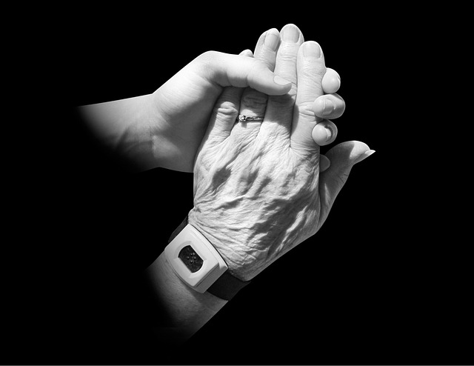
Introduction
Touch plays a key role in interpersonal emotional regulation :
  touch between intimate partners enhances affect and well-being.
  it plays a crucial role in maternal-child bonds, and promotes the child’s ability to self-regulate.
  Comforting touch alleviates distress.
Interaction between the observation-execution network and emotion regulation network may contribute to pain reduction during social touch.
Notes:
First, I’m here to talk about background of touching care. Touch plays a key role in interpersonal emotional regulation. For example, the touch between intimate partners enhances affect and well-being. In addition, we know that interaction between the observation-execution network and emotion regulation network may contribute to pain reduction during social touch.

Slide 3

Introduction
Is this effect innate, or the outcome of education and cultural biases?
In order to answer this question, we compared the regulation of emotions between people living in Japan and those living in France (to identify the common points and the differences).
Notes:
But is this effect innate, or the outcome of education and cultural biases?
In order to answer this question, we compared the regulation of emotions between people living in Japan and those living in France.

Slide 4

Aim
Measure the effect of empathy on the regulation of emotions :
  Volunteers watched videos triggering negative emotions with a virtual reality headset.
  Emotional response measured by electroencephalographic evoked potentials (EEG).
Notes:
This study’s aim is Measure the effect of empathy on the regulation of emotions, we clarify if culture correlates with emotion by touching care. :
Subjects watched videos triggering negative emotions with a virtual reality headset.
Emotional response were measured by EEG.

Slide 5


Method
Subjects: 7 healthy Japanese adults, 7 French adults
Stimulus: Using VR 3D 360-degree video, shown with VR goggles
①Fear emotion-inducing video
② Videos that do not induce fear
Intervention: touching, no touching
⇒In Japanese, randomly every 5 seconds
⇒The French went every minute
Notes:
Next is Method. We used subject of Japanese and French, each with seven people.
We used the VR 3D video, and VR goggles.
The stimulus are Fear emotion-inducing videos and Videos that do not induce fear .
We compared two conditions : touching the shoulder versus no touching.

Slide 6
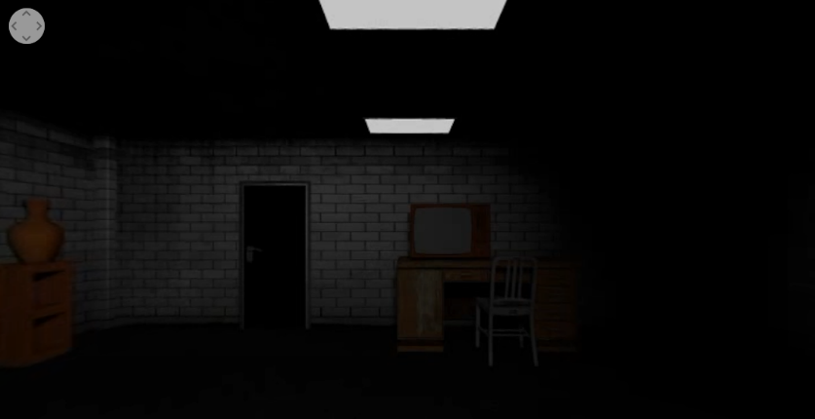


Method
①
②
③
Fear Videos：①Horror：https://www.youtube.com/watch?v=9vgBDiDpLmU
②Roller Coaster：https://www.youtube.com/watch?v=injtBhJCNdA
Not Fear Video： ③https://www.youtube.com/watch?v=zURLuAHOZ_w
Notes:
These are videos. One is horror, two is roller coasters. These videos are a fear stimulus.
Three is no fear video, waterfall.
We used PSD by analysis of EEG.

Slide 7
Result
Correlation coefficients between PSD and Subjective score (Japanese Subjects)
Correlation coefficients between PSD and Subjective score (French Subjects)
Frequency range | Area | Horror video | Coaster video
δ | Frontal | 0.527 | 0.322
δ | Central | 0.366 | 0.143
δ | Parietal | 0.034 | -0.156
θ | Frontal | 0.230 | -0.038
θ | Central | -0.208 | 0.025
θ | Parietal | -0.269 | -0.049
α | Frontal | 0.138 | -0.247
α | Central | 0.063 | -0.195
α | Parietal | 0.074 | -0.376
β | Frontal | 0.519 | 0.277
β | Central | 0.641 | 0.679
β | Parietal | 0.652 | 0.058
γ | Frontal | 0.381 | -0.051
γ | Central | 0.351 | -0.010
γ | Parietal | 0.164 | -0.570
Frequency range | Area | Horror video | Coaster video
δ | Frontal | -0.555 | 0.383
δ | Central | -0.581 | 0.035
δ | Parietal | -0.575 | -0.418
θ | Frontal | -0.474 | 0.522
θ | Central | -0.576 | -0.029
θ | Parietal | -0.545 | -0.264
α | Frontal | -0.677 | 0.499
α | Central | -0.710 | 0.155
α | Parietal | -0.871* | 0.068
β | Frontal | -0.496 | 0.466
β | Central | -0.611 | 0.270
β | Parietal | -0.688 | 0.159
γ | Frontal | -0.355 | 0.423
γ | Central | -0.496 | 0.266
γ | Parietal | -0.583 | 0.126
Frequency range | Area | Horror video | Coaster video
δ | Frontal | 0.527 | 0.322
δ | Central | 0.366 | 0.143
δ | Parietal | 0.034 | -0.156
θ | Frontal | 0.230 | -0.038
θ | Central | -0.208 | 0.025
θ | Parietal | -0.269 | -0.049
α | Frontal | 0.138 | -0.247
α | Central | 0.063 | -0.195
α | Parietal | 0.074 | -0.376
β | Frontal | 0.519 | 0.277
β | Central | 0.641 | 0.679
β | Parietal | 0.652 | 0.058
γ | Frontal | 0.381 | -0.051
γ | Central | 0.351 | -0.010
γ | Parietal | 0.164 | -0.570
Frequency range | Area | Horror video | Coaster video
δ | Frontal | -0.555 | 0.383
δ | Central | -0.581 | 0.035
δ | Parietal | -0.575 | -0.418
θ | Frontal | -0.474 | 0.522
θ | Central | -0.576 | -0.029
θ | Parietal | -0.545 | -0.264
α | Frontal | -0.677 | 0.499
α | Central | -0.710 | 0.155
α | Parietal | -0.871* | 0.068
β | Frontal | -0.496 | 0.466
β | Central | -0.611 | 0.270
β | Parietal | -0.688 | 0.159
γ | Frontal | -0.355 | 0.423
γ | Central | -0.496 | 0.266
γ | Parietal | -0.583 | 0.126
Notes:
Next is results.
You can observe in these two tables correlation scores between PSD and subjective scores of fear. Japanese data is on the left, and French data on the right.
The correlation scores are weaker for Japanese subjects, especially in the parietal alpha area.

Slide 8
Result
Figure 2 PSD difference: French, Delta (*: p<0.05)
Figure 1 PSD difference: Japanese, Delta (*: p<0.05)
Notes:
This slide presents result in the delta range. Left is Japanese data and right is French data. One can observe in the horror condition, in blue in the figure, a general increase for both populations as compared to the two other conditions. This effect is counter-balanced, in both populations, when the subject is in the touch condition.

Slide 9

Discussion
In both populations :
Broadband increase of EEG activity in touch vs. non touch condition. Could be a correlate of improved emotional regulation.
Significant δ range activity increase in the frontal and central areas (known correlate of emotional regulation) in touch condition, during the horror video (most fearful stimulus).
➔ cross-cultural positive effect of touching care on emotional regulation
Notes:
When looking for common points observed in both populations, we can observe:
A broadband increase of EEG activity in touch vs. non touch condition. Could be a correlated of improved emotional regulation.
A significant δ range activity increase in the frontal and central areas in touch condition, during the horror video.
From these results, we can confirm some neural correlates of a cross-cultural, positive effect, of touching care on emotional regulation.

Slide 10

Discussion
Between the two populations :
Japanese population: no significant difference when comparing touch vs. non touch cognition.
French population : several areas presented significant changes between those conditions.
French population only : parietal α activity (correlate of relaxed states) anti-correlated with subjective reports of fear.
Cultural specificities in emotional regulation strategies ?
Note : experimental bias might have affected these results.
Notes:
When looking for differences between the two populations, Japanese population had no significant difference when comparing touch vs. non touch cognition.
On the other hand, in French population several areas presented significant changes between those conditions.
This difference may be attributed to cultural specificities in emotional regulation strategies. However, the experimental bias might also have affected these results. In future studies, it would be of interest to double-check if our results remain stable when recording data in the exact same conditions.

