Slide 1

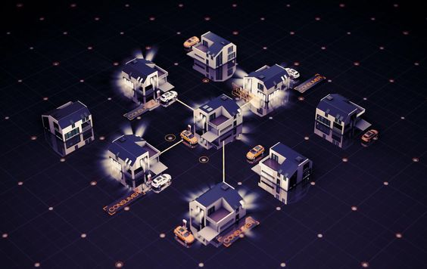



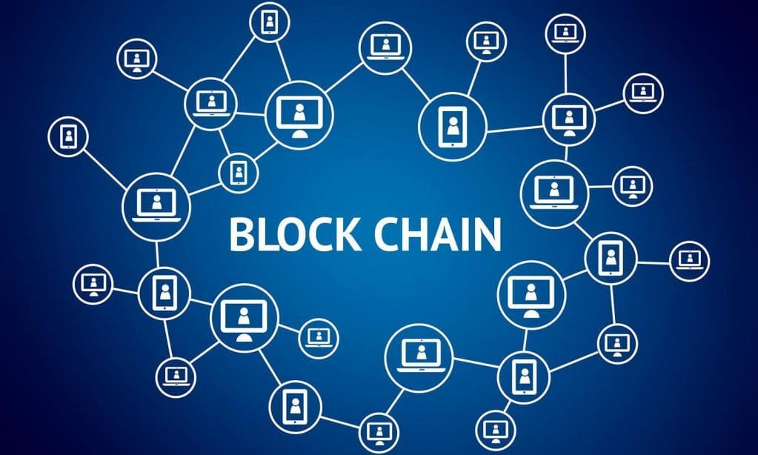
EKNOW 2022, Porto, Portugal,
Special Track BCI (Blockchain for Industry)
Laboratory of Automation and Manufacturing, Algeria
Analysis of blockchain in solar energy systems
NIDHAL TAFERGUENNIT
AND
Samia aitouche
nidhaltaferguennit@gmail,com
samiaaitouche@gmail.com

Slide 2
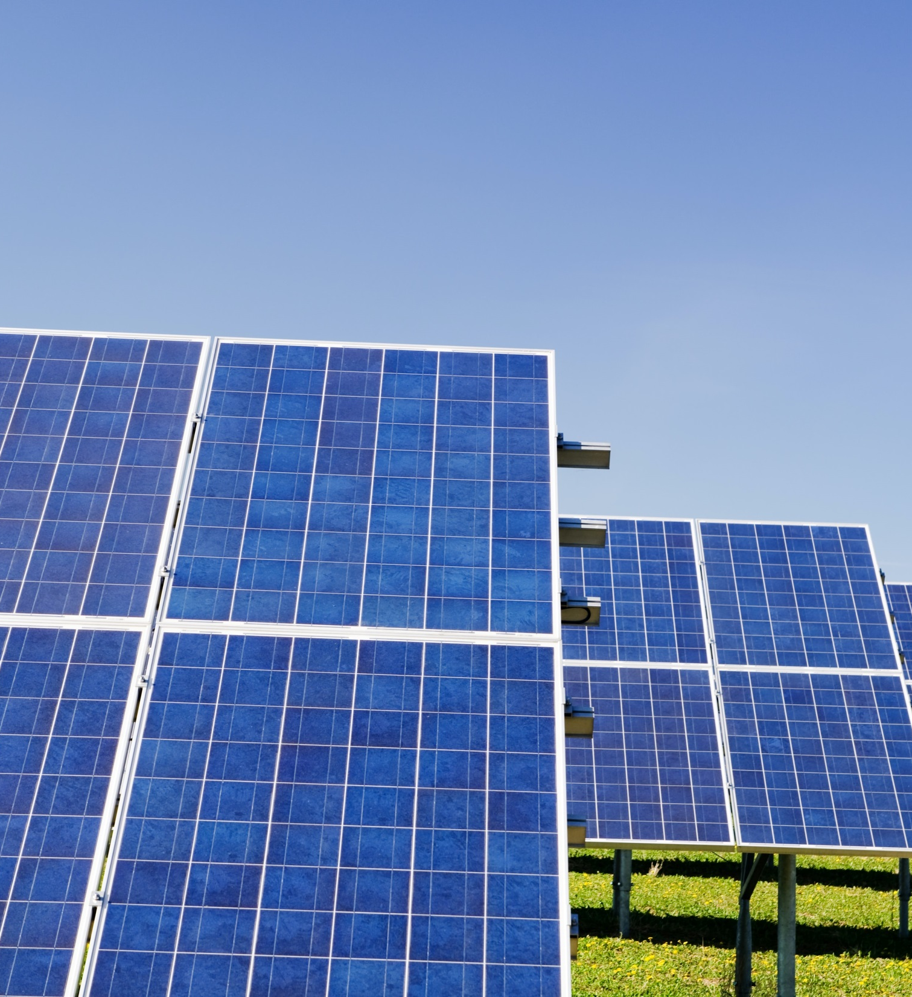
01
Introduction
02
Scientific production analysis
03
Citation analysis
04
Keywords analysis
05
Qualitative aspects of the analysis
06
Conclusion

Slide 3
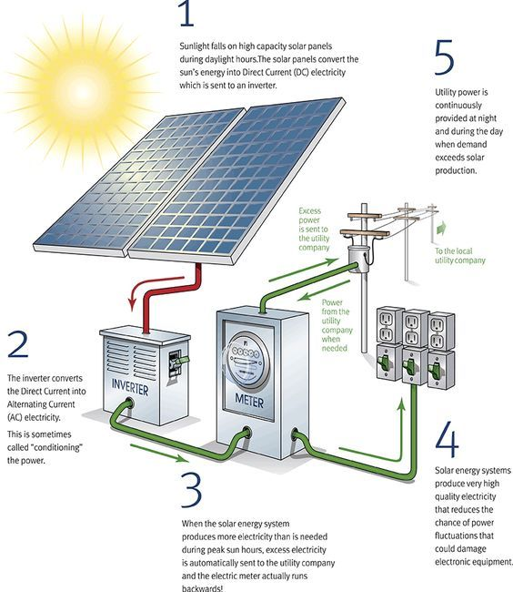
By this presentation , we are trying to shed light on the usage of the blockchain technology in the solar energy systems represented by the photovoltaic systems
The general principle is self-consuming [1] the solar energy and trading the surplus, this system is called prosumer

Slide 4
Schema of an example of generation for trading solar energy [8]

Slide 5

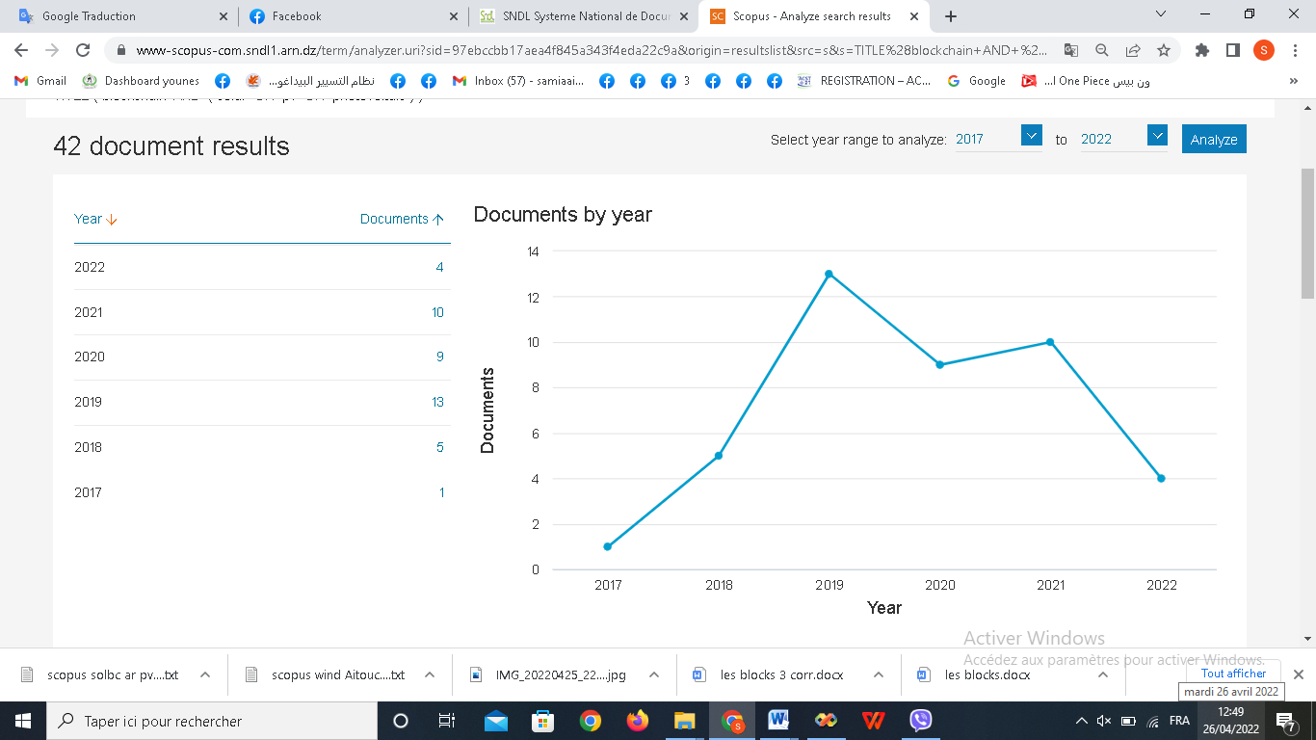
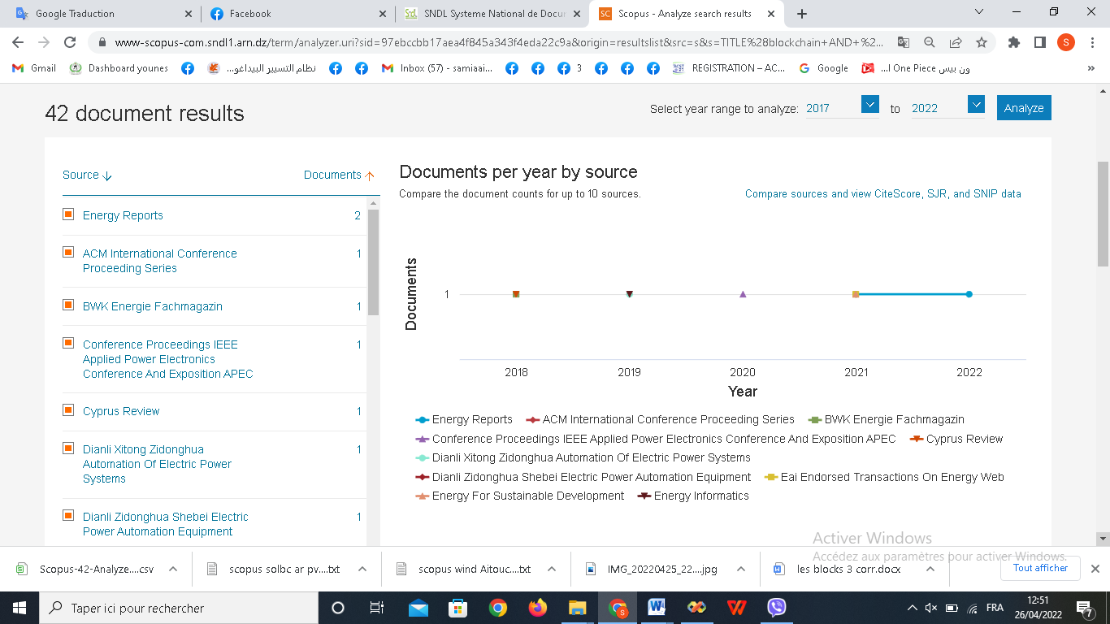
Scientific Production Analysis
Paper by Year of production and source:
The most productive year
2017
2018
2019
2020
2021
The emergence of the idea of integrating the blockchain technology in the energy industry
2019 was the most productive year
(13 papers) year in the number of paperss
The rise of literature productivity after the pandemic
And expectance of another rise in 2022 due the awareness of the world about the importance of digitalization of the citizens sides of life.

Slide 6

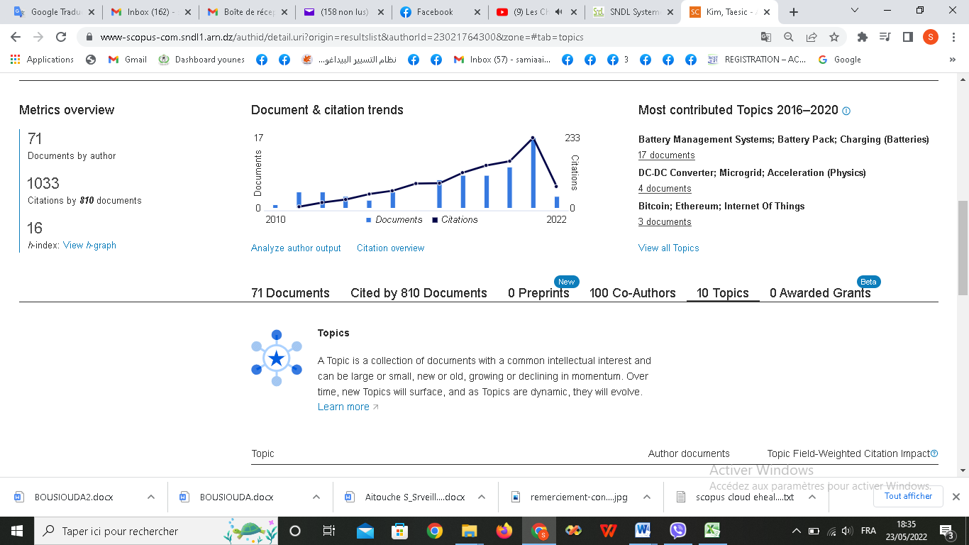
Number of papers by author
the first author in blockchain in PV energy (5 papers) is “Kim Taesic” affiliated to Texas A and M University Kingsville Kingsville, United States” since 2017. His research interests are principally: engineering, energy, computer science and Mathematics.
5
Kim Taesic
4
Hadi .A.A
3
3
3
Bere,G
Pipattanasomporn,M
Rahman,S
2
Hassam-Ouari,K
2
2
2
2
2
2
2
2
2
Nagatsuka,T
Jin,k
Kuzlu,M
Labrunie,A
Park,C,H
Abbes,D
Ahn ,B
Chmaj,G
Faika,T
He has an h-index of 16 and 1033 citations on 71 published papers (Fig. 5), on energy and other domains

Slide 7
Number of papers produced by country
United States
United States is the most productive country with 12 papers among 42
28,5%
China
China published 10 papers among 42 papers
23,8%
India
India published 5 papers among 42 papers
11,9%
Others
Other countries such as Canada, Australia,,,etc published in total 15 papers among 42
35,7%

Slide 8
Number of papers by document type
The conference papers are majority (64,3%), ie 27, followed by journal articles (31%), ie 13 papers. It is remaining 1 paper as a review and 1 paper as a note
2,4%
Note
Article
31%
64,3%
2,4%
Review
Conference paper

Slide 9
Papers by subject area
The papers are divided fairly on the subject areas of energy (27 papers) and Engineering (26 papers), in third position comes the computer science (20 papers). The remaining papers (Fig. 10) are shared on mathematics (8 papers), social science(5papers),environmental science (4 papers)…etc.

Slide 10
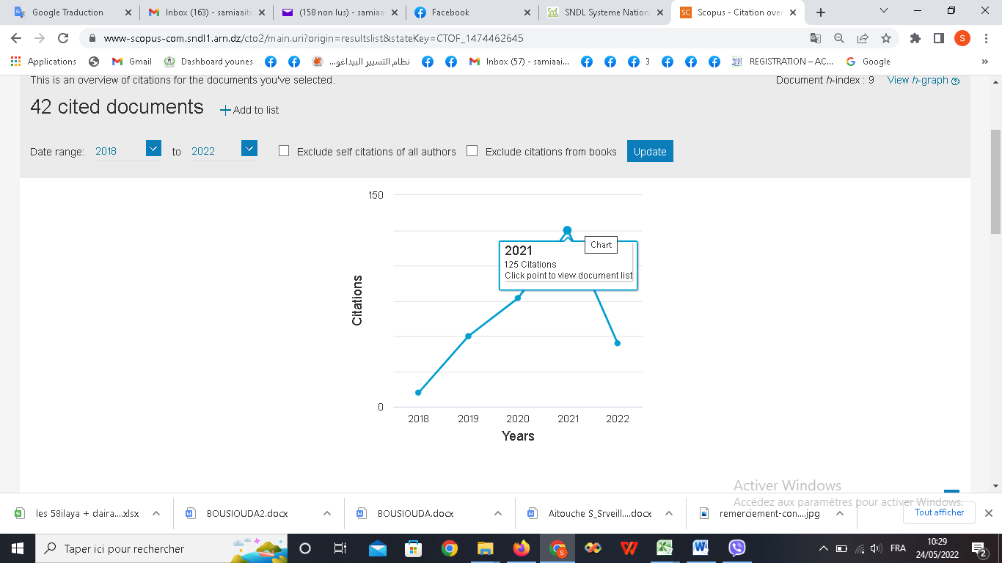
Citation Analysis
The citation analysis is the examination of the frequency and graphs of citations in documents . in this section we’ll show different citation criteria to determine which paper contributed the most and in which year it appeared the most
The figure above shows that the citations are increasing over the years. Showing a growing intreste in strong and valid papers about energy , energy trading and blockchain technology .
Especially in the year 2021 where all eyes where headed towards cryptocurrency and blockchain.

Slide 11
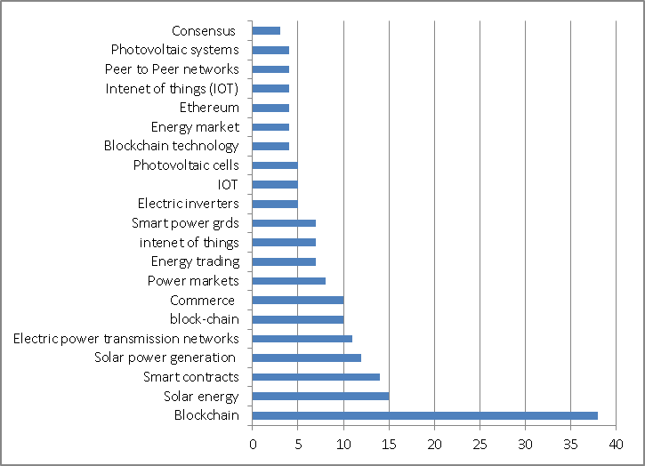

Keywords analysis
keyword | Nbr
Blockchain | 38
Solar energy | 15
Smart contracts | 14
Solar power generation | 12
Electric power Transmission networks | 11
block-chain | 10
Commerce | 10
Power markets | 8
Energy trading | 7
intenet of things | 7
Smart power grds | 7
Electric inverters | 5
IOT | 5
Photovoltaic cells | 5
Blockchain technology | 4
Energy market | 4
Ethereum | 4
Intenet of things (IOT) | 4
Peer to Peer networks | 4
Photovoltaic systems | 4
Consensus | 3
The keyword analysis is a quantitative and qualitative analysis of a paper. The most used words in the titles are “blockchain” and “solar energy”; of course, the request to have these words in the research in SCOPUS database. “block-chain” is appeared 10 times. The remaining keywords are “Smart contracts” to explain the automated rules concerning the generation and trading of the solar energy (Solar power generation, Electric power Transmission networks, power markets,…etc.). The keywords also concern “internet of things”, consensus and the most used cryptocurrency is “ethereum”.

Slide 12


Qualitaive Aspects Of the Analysis
1/ Energy generation or energy trading:
Twenty papers treat the problem of trading solar energy jointed to self-consumption,
The figure here shows the sequence diagram for the energy trading. In the energy trading platform, some participants have superfluous energy that they wish to sell to the platform as sellers, whereas others do not have sufficient energy to meet their demands and must buy the shortfall from the platform as buyers. Specifically, first, the buyer defines and sends Ether and code so that smart contracts can be created.

Slide 13


Solar Energy System 4.0 (IOT and Blockchain)
Establishing a system using IOT (Internet Of Things) devices thet produce the excess of energy. It consists of two parts: energy generation which maximizes the produced energy and energy trading using blockchain trading model ethereum based application. Enegy generation gains 35% [2]. There are 6 papers related to the IOT.

Slide 14
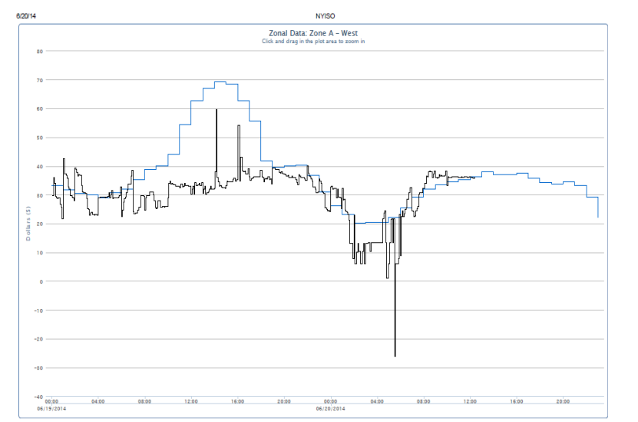

Other treated Ploblematics And Solutions
None of the existing studies a complete Blockchain based multidimensional P2P transaction mechanism fully open P2P trading mode and decentralized electricity price mechanism are adopted in day-ahead market, and P2P pool trading mode and electricity price mechanism based on supply/demand ratio are adopted in real-time market
An example of day-ahead market versus real-time market prices

Slide 15
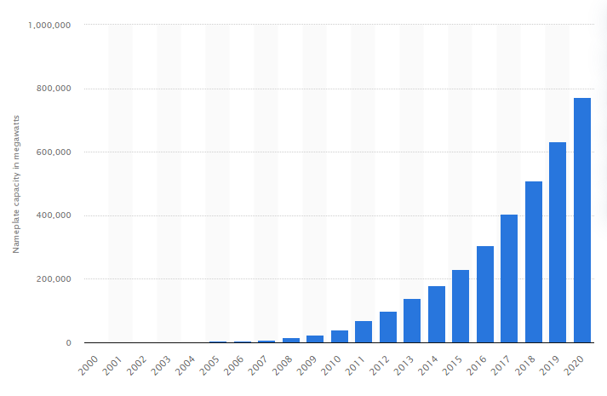
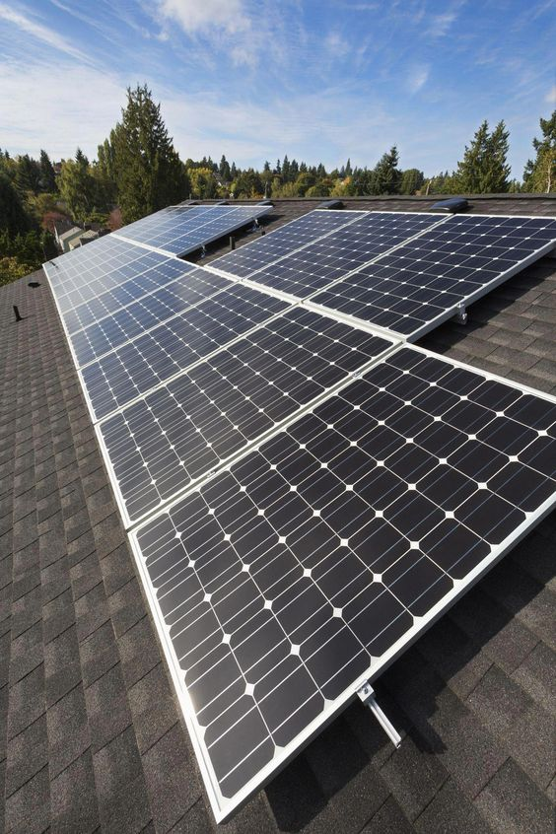

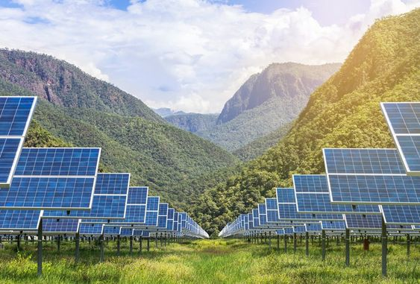
Other treated Ploblematics And Solutions
Abandoning solar energy in rural regions and increasing voltage fluctuation have become more prominent [3]. To increase the local electricity consumption of the photovoltaic generation, the incentive mechanism using an optimal internal electricity price is proposed with blockchain technology. The simulation result shows that the comprehensive revenue is increased, and the local electricity consumption rate of distributed photovoltaic generation is significantly raised.
Global solar pv capacity 2020

Slide 16

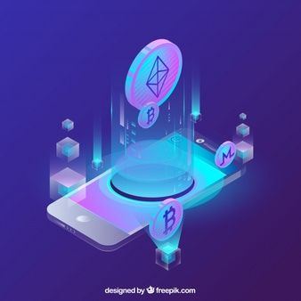


Conclusion
We saw in this presentation how fast intrests in energy are growing. Many papers are published about this topic and many other technologies other than blockchain are integrated, which will lead to a mass distribution of the idea of exchanging excess solar energy with neighbours via a blockchain network using a proper coin. The main barrier here is how to transform a simple consumer to a prosumer. A P2P network is the most adequate architecture to support this platform. A cryptocurrency will make the trading more fluent. The prices of energy generally depend to the rules of offer/demand of the local or metropolitan market of solar energy. Knowing that the blockchain technology itself is a big consumer of energy, it is important to be autonome and a consumer of renewable energy like solar energy. This work may be usefull to developper of blockchain platforms and the producer of energy solar to take benefits both from their combination and to find exactly how to do so since the word blockchain can be difficult to combine with energy production In a future work, we will show other studies aspects from this collection of papers like: used protocols and consensuses, smart contracts, statistical methods, used data in blockchains…etc.

