Slide 1
Quantitative and Qualitative Evaluation of a Navigation Application Adapted to Young People with Intellectual Disabilities
HEALTHINFO 2022
10-16 October 2022
Notes:
Ajd je travaille sur
Je vais profiter de cette présentation pour

Slide 2
Introduction. Context
Mobility of neurodivergent people
700 000 people with disabilities in France.​
Learning
Focus attention
Space and timeperception
Memory
Langage

Slide 3
Introduction. Context
How to help neurodivergent people gain more independence

Slide 4
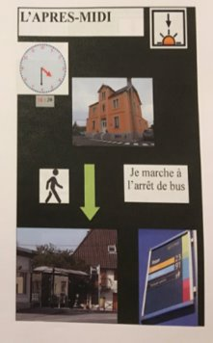
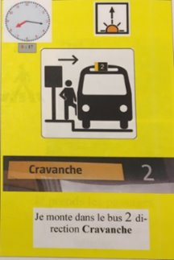
Introduction. Context
How to help neurodivergent people gain more independence
Booklets:
Methodologies developed by healthcare professionals
Tailored for specific users
Time consuming process for caregivers

Slide 5
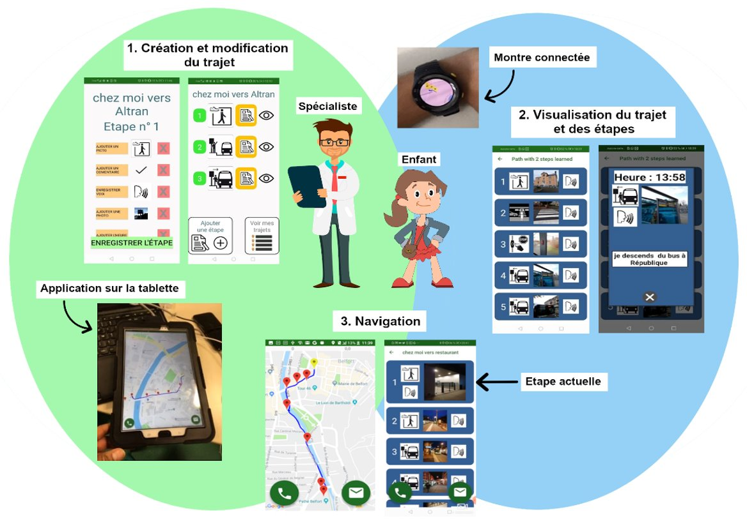
Introduction. Context
Co-development of a transport app adapted to people with disabilities
Application :
Create a journey
Many options to customize (pictograms, text, pictures, voice …)
Visualize/modify a journey
Adapt the journey to gain more independence
Navigate
Additional functionalities compared to booklet (GPS position, emergency call …)

Slide 6
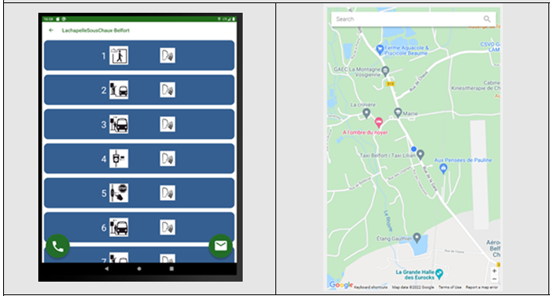
Introduction. Problem statement
Problem statement
Ergonomic design of the app
Clarity of information
Consistency of displayed information

Slide 7
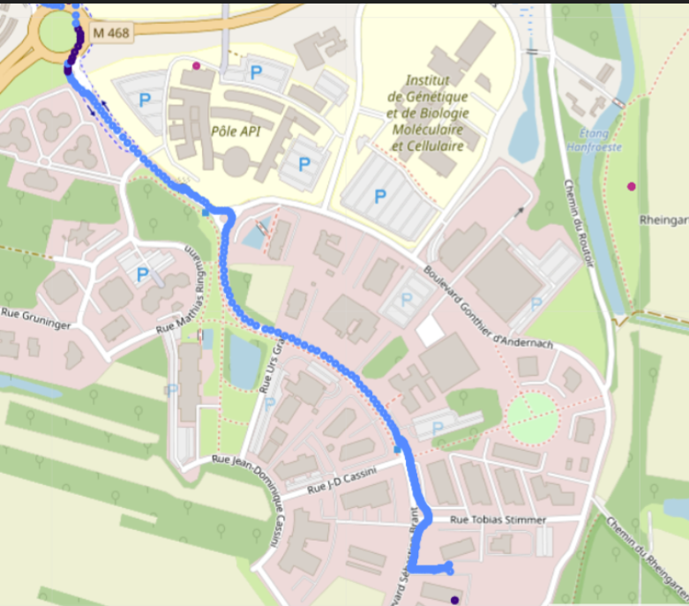
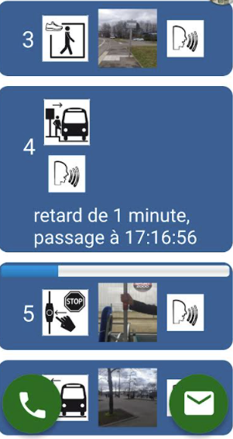
Introduction
Quantitative and Qualitative Evaluation of a Navigation Application
Qualitative
Quantitative
Questionnaire
Journey simulation

Slide 8
Methods
Questionnaire
Inspired from :
N. N. Patel and P. Dalal, “Usability evaluation of mobile applications.” International Journal of Engineering Research & Technology (IJERT), 2(11), pp. 299-302, 2013
R. Alturki and V. Gay, “Usability attributes for mobile applications: a systematic review.” Recent Trends and Advances in Wireless and IoT-Enabled Networks, pp. 53-62, 2019.

Slide 9
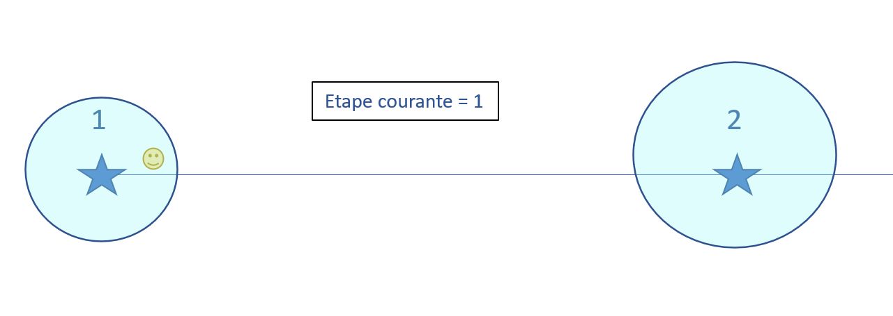
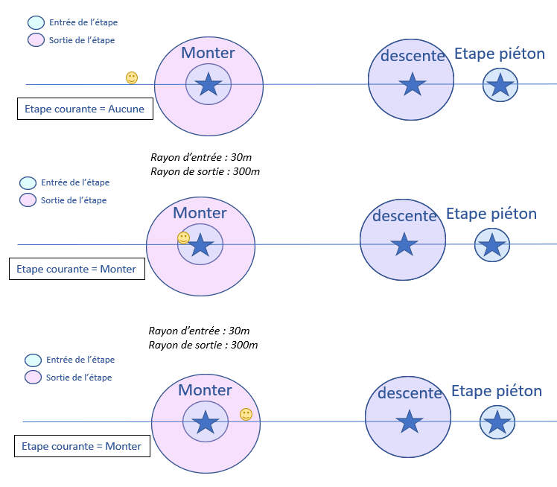
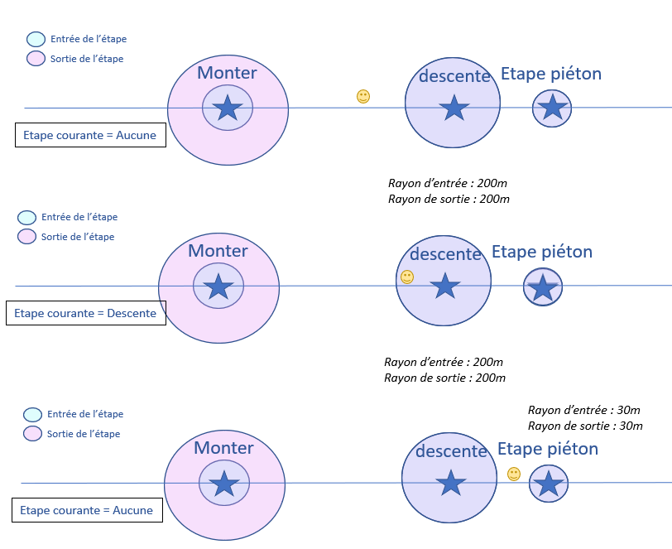
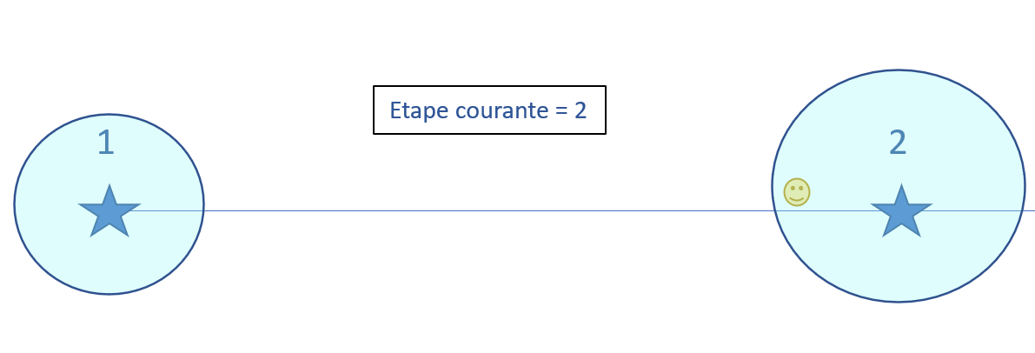
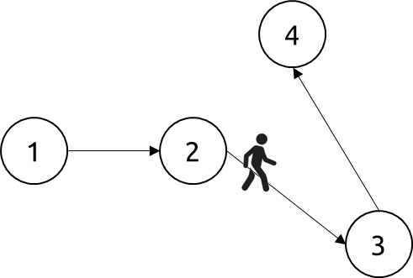
Methods
Navigation by the nearest position of steps vs Navigation by circles of steps
Navigation by the nearest position of steps
Navigation by circles of steps
Step 1
No step
Step 2
Problem: step 4 momentarily appears before step 3
Can be very confusing
Two circles per step, one for entrance and one for exit. In addition to de position, other criteria can be defined to validate a step.
For example: To exit the step “enter the bus”, user must be 200m away from the step AND at a speed greater than 30km/h

Slide 10
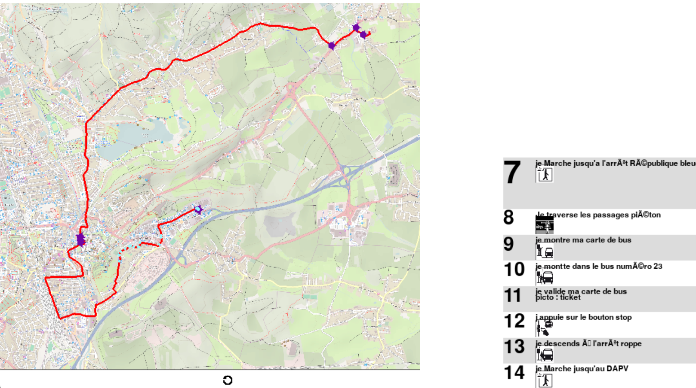
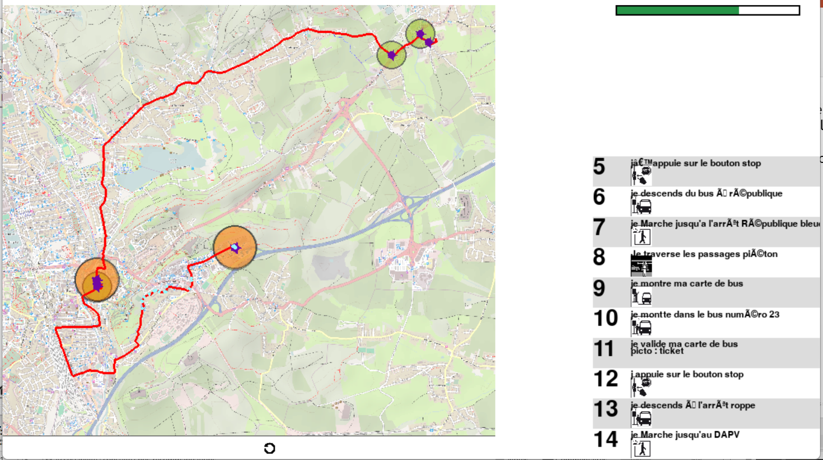
Results
Navigation by the nearest position of steps vs Navigation by circles of steps
Navigation by the nearest position of steps
Navigation by circles of steps
End
End
7
Start
7
Start
6
5
6
5
Steps 5 and 6 are validated because step 7 is closer
This doesn't happen with the navigation by circles of steps

Slide 11
Conslusion
Qualitative evaluation
Test and validation of the process : Allows to get feedback on the behavior of the user and Adapt the app as close as possible to the needs of the users
Test of the application (bugs etc.…)
Quantitative evaluation
Creation of a tool to virtually simulate a journey
Catch bug
Test different algorithms
Prespectives
Smartwatch app developed.
Use additional data from watch and phone (heart rate monitor, accelerometers, gyroscopes etc.…)

Slide 12
Thank you !

