Slide 1




Investigating the Security and Accessibility of Voyage Data Recorder Data using a USB attack
Authors:
Avanthika Vineetha Harish, Kimberly Tam, Kevin Jones
Presenter : Avanthika Vineetha Harish
University of Plymouth, United Kingdom
avanthika.vineethaharish@plymouth.ac.uk

Slide 2
Avanthika Vineetha Harish
Industrial Researcher at Cyber SHIP lab and a PhD candidate at the University of Plymouth, UK.
Focused on vulnerability assessment and security testing for maritime systems.
Masters in Cyber Security from Lancaster University, UK, with full scholarship from the British Council.
Bachelor’s degree in Computer Science and Engineering from Mahatma Gandhi University, India.

Slide 3
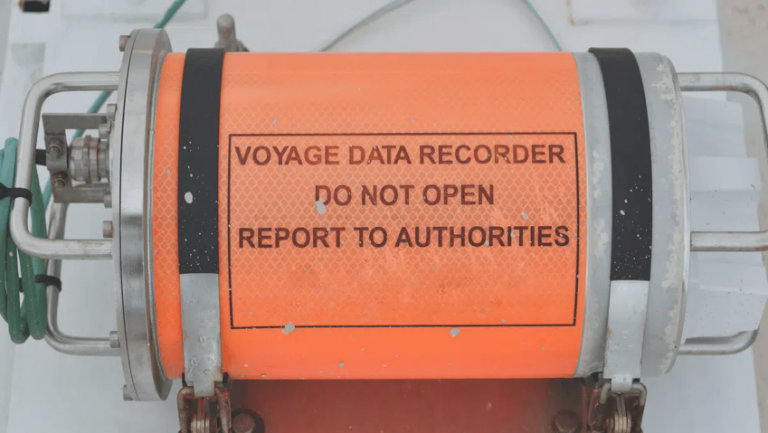
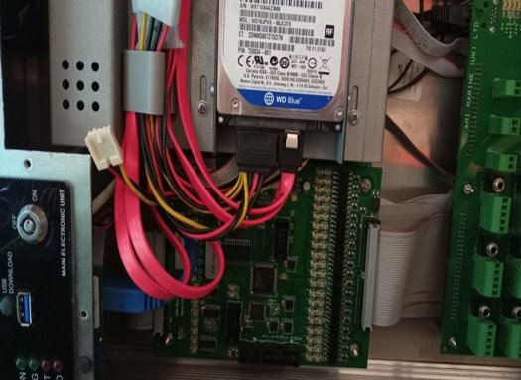
Introduction
Voyage Data Recorder (VDR) - 'black box' for ships
Critical role in accident investigations.
Data need to be secure and tamper proof.
Past cases where evidence data disappeared.
Image source: https://www.marineinsight.com/guidelines/voyage-data-recorder-on-a-ship-explained/

Slide 4
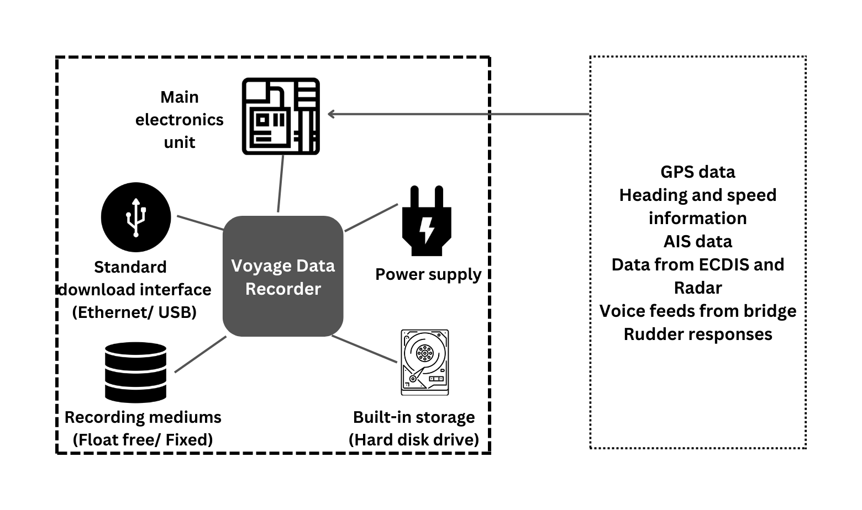
Background
VDR components and features.
International Maritime Organization regulations.
Investigating authorities used VDRs extensively – popular cases like:
Sinking of El Faro [1]
Grounding of Costa Concordia [2]
*All icons from nounproject.com
Notes:
Hard Disk by lastspark from NounProject.com
Storage by Vectorstall from NounProject.com
Share by iconixar from NounProject.com
System Unit by Arthur Shlain from NounProject.com
Power Supply by Mas Dhimas from NounProject.com

Slide 5
Testing
Testing
Data tampering : Manipulating accident investigation data can lead to loosen ends.
Testing on real hardware to see real effects.
Automation of tests.
Threat
Insider threat : Critical evidence stored in VDRs are at sea for months and prone to insider access.
According to a recent data breach report, there were 275 incidents related to data breach by privilege misuse from 2020 to 2021, and all these incidents were caused by insiders [4].
Attack Vector
USB : Top cyber security attack vector, most VDRs use this port for updating, does not need much skill set.
The number of USB threats rose to 52% in 2022 from 37% in 2021 [3].
Aim:
To investigate the possibility of VDR data manipulation by someone with limited technical skills and knowledge and to automate the attacks using USB device.
Notes:
It was reported that 78% of these incidents were motivated by financial gain, 9% by grudge, 8% by espionage, and 6% by convenience.

Slide 6
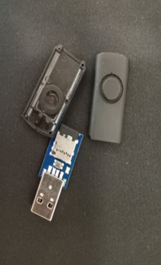
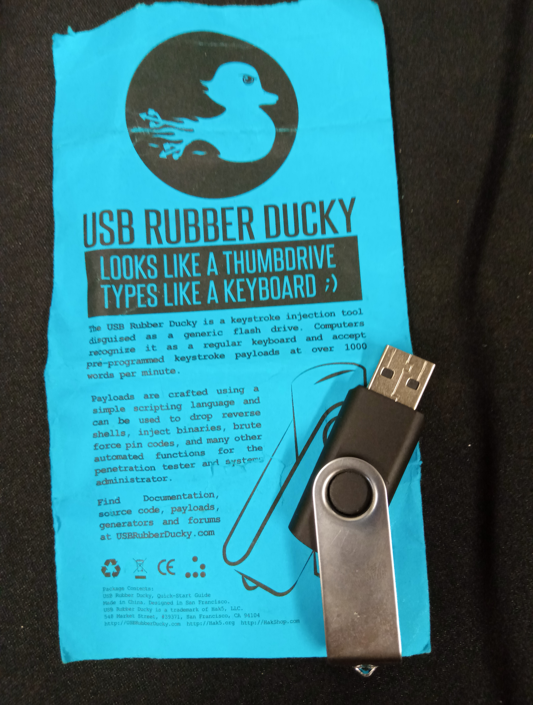
Tools used
System Under Test : Off-the-shelf VDR from a global shipping equipment manufacturer – taken off from a ship – with data from the year 2018.
USB rubber ducky [5] : Injects keystrokes.
Metasploit framework [6]: Powerful pen-testing tool
ShinoLocker [7] : Ransomware simulator developed by a security researcher, Shota Shinogi, for education and training purposes.
Nmap [8]: Network scanning and auditing tool

Slide 7
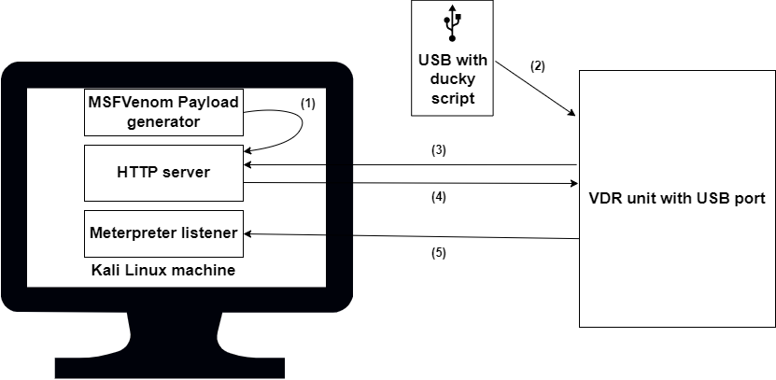
1. Reverse shell
Highlights of the testing
Interactive shell connection from target machine to attack machine
(1) Payload generated (using Msfvenom [9]) and hosted in HTTP server
(2) Ducky Script written with commands to download payload
(3) Once USB blipped in, command to download payload
(4) Payload downloaded from server to VDR PC and executed
(5) Meterpreter listener receives connection from the VDR, and a session is opened.

Slide 8
Results :
Reverse shell session obtained on the attack machine.
VDR system running on Windows embedded standard 7 OS
Privilege escalation.
Retrieved 5 password hashes including that of administrator, captain and engineer accounts.
Three blank passwords and the other two were simple ones.
View, access and tamper files and folders.
View, access and tamper logs and hiding the trace of manipulation.
Affecting the Confidentiality, Integrity and Availability of data.
Suggestions:
Strong password policy as suggested by Cyber security guidelines onboard vessels document.
Integrity checking mechanism.

Slide 9
2. Ransomware
Most common cyberattack these days.
Leading source of cybersecurity threat risk to US ports and terminals [10].
In the last five years, four major global shipping companies (CMA CGM, APM-Maersk, MSC and COSTCO) have been negatively affected by ransomware and their operations have been halted for weeks [11].
Recently, a Singapore-based offshore operator - Swift Pacific Offshore has reported a data breach that experts believe to be a ransomware attack [12].
Changing ransomware motives : Attack on Belarus Railway systems to release fifty 50 high-risk political prisoners in addition to banning Russian soldiers from using Belarusian trains as the ransom [13].

Slide 10
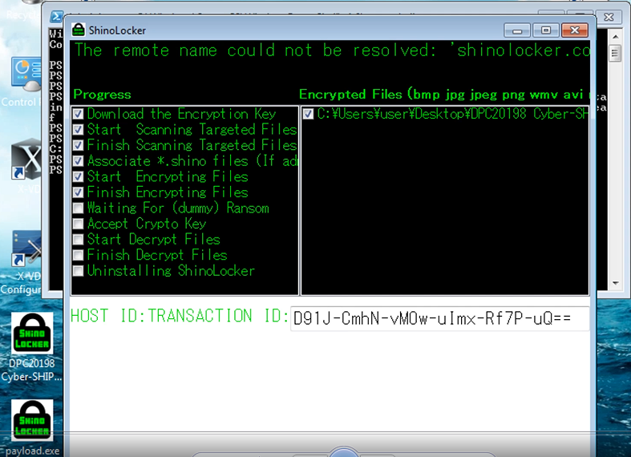
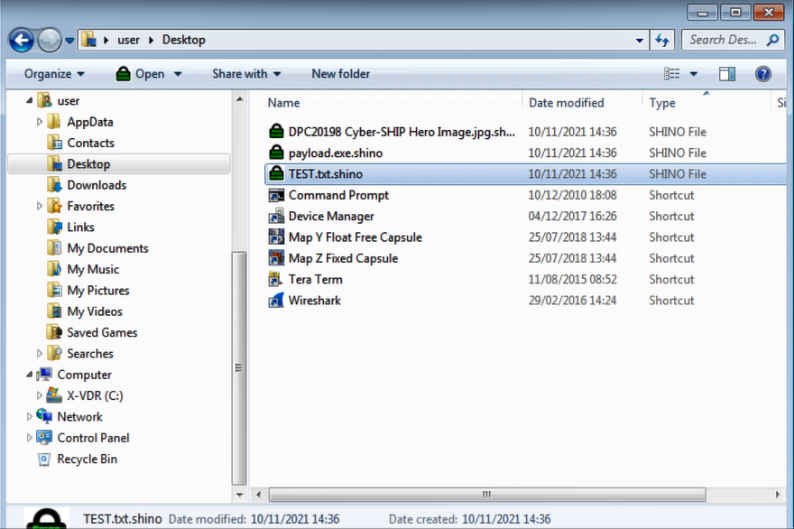
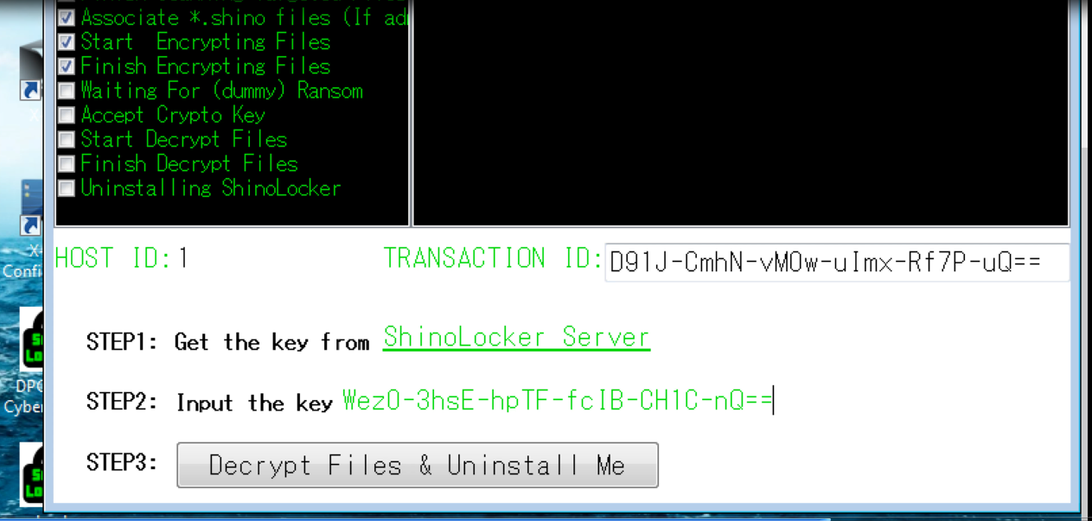
ShinoLocker ransomware : Tool used for training and teaching purposes; appeared to be the most practical option without causing damage to the VDR.
Payload created for png, jpeg, ppt, txt file types.
Ducky script was written to download the payload on to the VDR PC.
When USB with ducky script was plugged in to the VDR system, the ransomware started encrypting the files of the previously mentioned file types.
Affecting the Availability of data.

Slide 11
3. Hard drive erasure
Can be accomplished by few lines of ducky scripting.
Denial of service.
Affecting the Availability of data.
Could be catastrophic and can lead to investigation dead ends.
Enrica Lexi case: In 2012, two Indian fishermen on a fishing boat ‘St.Anthony’ were killed off the coast of Kerala, India in a shooting incident mistaking the fishermen as pirates and India detained two Italian mariners on board the ship ‘Enrica Lexie’, an oil tanker, owned by a Milan-based company. VDR was retrieved, however, captain failed to preserve VDR data after the incident and the second officer of ‘Enrica Lexie’ stated that he did not press the VDR for recording[14].

Slide 12
4. Eternal Blue vulnerability
Windows 7 Embedded standard OS on VDR found to be vulnerable with Eternal Blue exploit.
Remote code execution vulnerability in Microsoft SMBv1 Servers with vulnerability entry of CVE-2017-0143 [12].
CVSS (Common Vulnerability Scoring System) score of 8.1(HIGH) and the famous WannaCry attack used this exploit to spread infection.
The session was not opened, however, VDR crashed with a blue screen of death and the machine needed to be manually rebooted.
Denial of service (Affecting the Availability of data and system).
Keeping the systems up-to-date.

Slide 13
Discussions
Improving information security of VDR data
Raising the standards
Automation and sector specific tools for testing
Best operational practices

Slide 14
Thank you
For any questions contact: avanthika.vineethaharish@plymouth.ac.uk
Avanthika Vineetha Harish, Industrial Researcher and PhD student,
CyberSHIP Lab, University of Plymouth, United Kingdom
For more details, visit: https://www.plymouth.ac.uk/research/cyber-ship-lab

Slide 15
References
[1] National Transportation Safety Board, “Sinking of the US Cargo Vessel El Faro,” 2015, [Online]. Available: https://www.ntsb.gov/investigations/AccidentReports/Reports /SPC1801.pdf (accessed 2022.10.21) [2] M. Piccinelli and P. Gubian, “Modern ships voyage data recorders: A forensics perspective on the Costa Concordia shipwreck,” Proc. Digit. Forensic Res. Conf. DFRWS 2013 USA, pp. S41–S49, 2013, doi: 10.1016/j.diin.2013.06.005.
[3] Honeywell, “Industrial Usb Threat Report 2021,” 2021. Accessed:2022.10.21. [Online]. Available: https://www.honeywellforge.ai/content/dam/forge/en/docume nts/cybersecurity/Industrial-Cybersecurity-USB-ThreatReport-2022.pdf
[4] G. Bassett, D. Hylender, P. Langlois, A. Pinto, and S. Widup, “DBIR Data Breach Investigations Report,” 2022 [Online]. Available: https://www.verizon.com/business/resources/reports/dbir/ (accessed 2022.10.21).
[5] Hak5, “USB Rubber Ducky - Hak5,” 2022. https://shop.hak5.org/products/usb-rubber-ducky-deluxe (accessed 2022.10.21).
[6] Rapid7 Inc., “Metasploit | Penetration Testing Software, Pen Testing Security | Metasploit,” Metasploit.Com, 2019. https://www.metasploit.com/ (accessed 2022.10.21).
[7] “ShinoLocker - The Ransomware Simulator-.” https://shinolocker.com/ (accessed 2022.10.21).
[8] nmap.org, “Nmap: the Network Mapper - Free Security Scanner,” Https://Nmap.Org/, 2021. https://nmap.org/ (accessed 2022.10.21).
[9] Offensive Security, “Msfvenom - Metasploit Unleashed,” 2016. https://www.offensive-security.com/metasploitunleashed/Msfvenom/ (accessed 2022.10.21).
[10] Jones Walker, “Ports and Terminals Cybersecurity Survey,” 2022.Available:https://sitescommunications.joneswalker.com/38/1936/landingpages/2022-cybersecurity-survey---lp.asp (accessed 2022.10.21).
[11] C. Cimpanu, “All four of the world’s largest shipping companies have now been hit by cyber-attacks | ZDNet,” ZDNet, 2020. https://www.zdnet.com/article/all-four-of-theworlds-largest-shipping-companies-have-now-been-hit-bycyber-attacks/ (accessed 2022.10.21).
[12] Maritime Execuritve, “Ransomware Attack on Swire Pacific Offshore Breaches Personnel Data.”2021. https://www.maritime-executive.com/article/ransomwareattack-on-swire-pacific-offshore-breaches-personnel-data (accessed 2022.10.21).
[13] A.Greenberg,“Why the Belarus Railways Hack Marks a First for Ransomware | WIRED ” 2022. https://www.wired.com/story/belarus-railways-ransomwarehack-cyber-partisans/ (accessed 2022.10.21).
[14] H. H. Judge Vladimir Golitsyn Judge Jin-Hyun Paik He Judge Patrick Robinson Professor Francesco Francioni Pemmaraju Sreenivasa Rao Registry, “Pca Case No. 2015-28 In The Matter Of An Arbitration-Before-An Arbitral Tribunal Constituted Under Annex Vii To The 1982 United Nations Convention On The Law Of The Sea The Italian Republic-V.- The Republic Of India-Concerning-The ‘Enrica Lexie’ Incident,” 2020
[15] NIST, “Nvd - Cve-2017-0144,” National Vulnerability Database, 2017. https://nvd.nist.gov/vuln/detail/CVE-2017- 0144 (accessed 2022.10.21).

