Slide 1
The Thirteenth International Conference on Information, Process, and Knowledge Management
eKNOW 2021
July 18, 2021 to July 22, 2021 - Nice, France
Digital
World
2021
Blockchain and Knowledge Management:
An Overview
Samia Aitouche,
Laboratory of Automation and Manufacturing
industrial Engineering department
University Batna 2, Batna, Algeria
s.aitouche@univ-batna2.dz
Notes:
Hi every body, I hope that you are well and healthy, I would like to share with you a speech concerning blockchain in knowledge management, Blockchain as a new way to work via internet more securised and decentralised

Slide 2
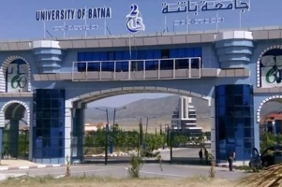
About the Speaker
Samia Aitouche, Algerian lecturer researcher
Laboratory of Automation and Manufacturing
Industrial Engineering Department
University Batna 2, Batna, Algeria
Basically, I am engineer in computer science then I converted to industrial engineering by my Master and Ph.D, my researches include
Intellectual capital measurement and Knowledge management
Decision making and performance measurement
Data mining and knowledge discovery
Business intelligence and decision support
Industry 4.0
Automatic summarization
Blockchain and its applications in industry and knowledge management
Notes:
First I introducce myself, I am Dr Samia Aitouche a lecturer resercher from the laboratory of Automation and Manufacturing, Industrial Engineering Department , University Batna 2, Batna, Algeria, in the east of Algeria
Basically, I am engineer in computer science then I converted to industrial engineering by my Master and Ph.D, my reserch include
Intellectual capital measurement and Knowledge management
Industry 4.0
Blockchain and its applications in industry and knowledge management

Slide 3
PLAN
1- Introduction
2- What is blockchain?
3- What is knowledge management?
4- Problematic
5- Barriers of Knowledge management
6- Why blockchain?
7- Applications of blockchain
8- Part I. Blockchain and knowledge Management by technIc and method (gamification, crowdsourcing, machine learning and correlations, semantic and ontologies)
9- PART II: Blockchain and knowledge Management by technology (industry 4.0, edge computing, cloud computing)
10- PART III: Blockchain and knowledge Management human values
11- Conclusion and trends
12- References
Notes:
During the presentation we have to follow the paln begining by introduction
What is the blockchain, what is the KM, the problem of KM whitch encourage us to use the blockchain,
We will see three parts existing in the literature
8- Part I. Blockchain and knowledge Management by technIc and method
PART II: Blockchain and knowledge Management by technology
PART III: Blockchain and knowledge Management human values

Slide 4
Introduction
After Two years of pandemic situation
The Humanity is not Ready in Technologogy for Such situations
The blockchain is among the emerging solutions witch may help in knowledge capitalization and sharing by secured way
Knowledge
Knowledge
BLOCKCHAIN

Slide 5
The Blockchain
[51]
Notes:
We begin by introducing the blockchain

Slide 6
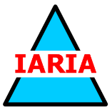
What Is the Blockchain?
[33]

Slide 7
Difference Between a Blockchain and a Database
Criterion | Blockchain | Database
Authority | Decentralized | Centralized
Architecture | Peer-to-peer model | Client-server model
Performance | Relatively slower (crypto) | Quick
Cost | Expensive | Not Expensive
Data processing | Only read and write | Create, read, update, delete
Data integrity | Data integrity | Has no data integrity
Transparency | Transparent | Not transparent
Cryptography | ✓ | ×
Notes:
I choosed to compare blockchain to known other concept the database

Slide 8
[48]
Knowledge Management
Notes:
We will see also what are the aspects of knowledge management?

Slide 9
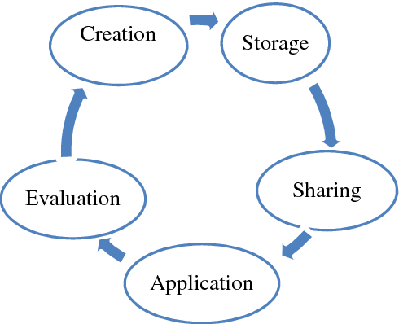
Knowledge Management
«Knowledge is embodied in an individual .. It is the foundation his skills. It represents 80% of the capital of the company.
Knowledge management is an organizational process for creation, storage, sharing, application and evaluation of knowledge of individuals across the organization to provide assistance to work and increase organisational effectiveness.
[49]
Notes:
La connaissance s'incarne dans un individu. C'est le fondement de la compétence de tout individu ». Elle représente 80% du capital de l'entreprise

Slide 10
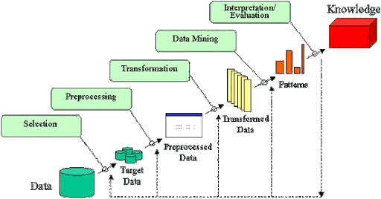
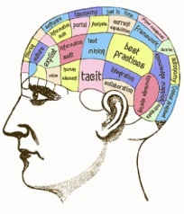
Tacit Knowledge and Explicit Knowledge
Hidden in big data
Explicit
Tacit
[50]
Notes:
Explicit knowledge is codified and accessible, such as plans and procedures. Tacit knowledge calls on the experience and know-how of the person who possesses it ...,The tacit is more important than the explicit, it empowers the company more towards its outsourcing and its safeguard.

Slide 11
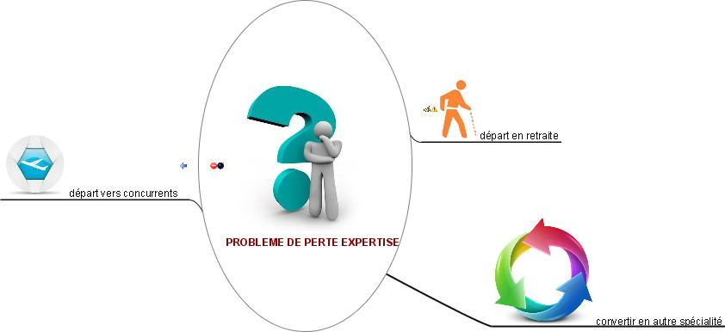
Problematic (1)
Retirement
Departure to competitors
Loss of expertise
Conversion
Notes:
Our problem is related to the loss of expertise when the company's experts retire, or turn to other competitors, or the employee simply converts to other specialties within the same company.

Slide 12
Problematic (2)
World 38,33%
Algeria 13,33%
RETENTION
Explicit-tacit knowledge
No sharing of knowledge
Notes:
The expert can be there, but does not share his experience, it may strengthen his power, but it is not profitable for the company. We found in our survey that this sharing is only 13% in Algeria in a previous survey that we carried out

Slide 13
Problematic (3)
World 29 %
Algeria 0,034 %
Electronic document management
documentation center
No memory
No traceability
Notes:
the absence of a structured corporate memory causes loss of traceability and inconsistencies. There is only 3% of companies with a structured memory in Algeria, according to a survey we have done

Slide 14
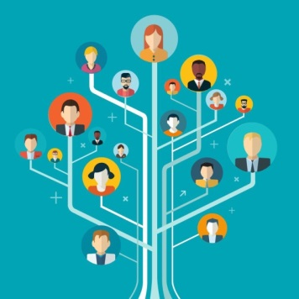
Barriers of Knowledge Management
Related to organization
1- Bureaucracy
2- Lack of incentives.
3- Loss of proprietary knowledge
4- Retention
5- Poor interpersonal skills
6- Fear of failure
Related to knowledge
Related to people
Notes:
1- Bureaucracy that does not encourage change2- Lack of incentives and rewards for new ideas.3- we do not recognize the owner of the knowledge4- Retention of experts they do not share with others5- Poor interpersonal skills6- Fear of failure

Slide 15
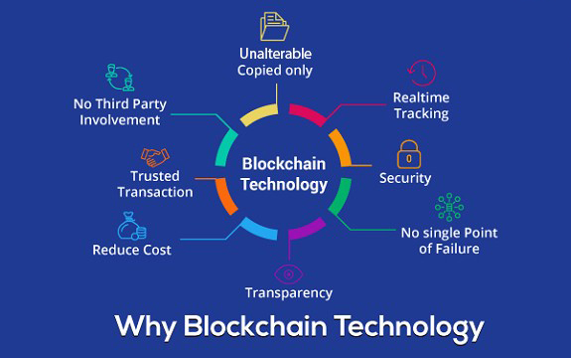
Why Blockchain for Knowledge Management?
[52]
Notes:
The blockchain offers several advantages that helps to success of knowledeg capitalization and sharing like transparency, trusted transaction and unalterability copies

Slide 16
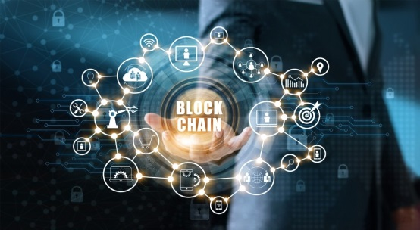
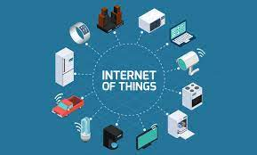
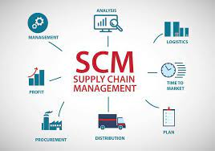
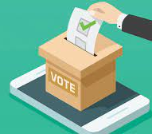
Applications of Blockchain
Monatery use of blockchain (80%)
Non-Monatery use of blockchain (20%)
Bitcoin
Etherium
Applications of Blockchain
How about Blockchain in knowledge management?
Notes:
The blockchain is at 80% used for monatery purposes and at 20% for non monatery purposes
Now blockchain is applied in several domains like internet of things, supply chain management insurance and healthcare
How about blockchain in knowledge management?

Slide 17
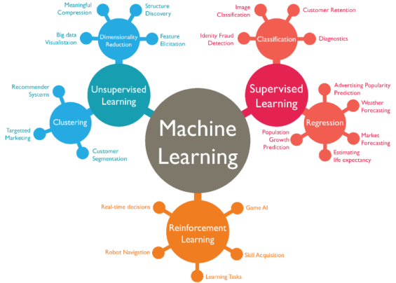
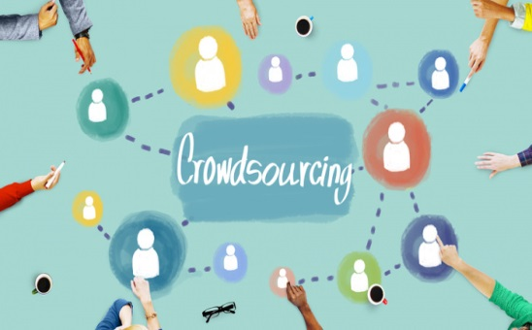
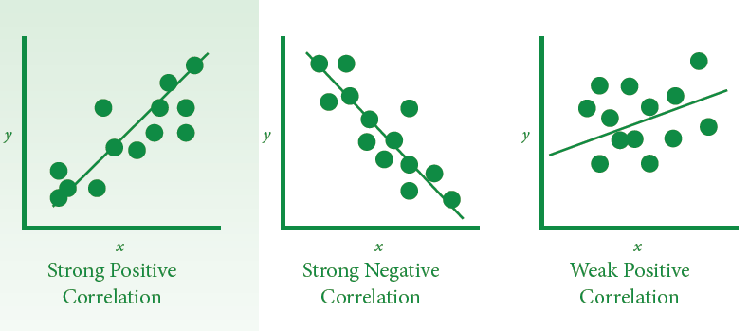
PART I: Blockchain and knowledge
Management by technIc AND METHOD
Gamification
Correlations
Notes:
The presentation is composed by three parts, the first part concerns Blockchain and knowledge Management by technIc AND METHODs gamification crowdsourcing correlations

Slide 18
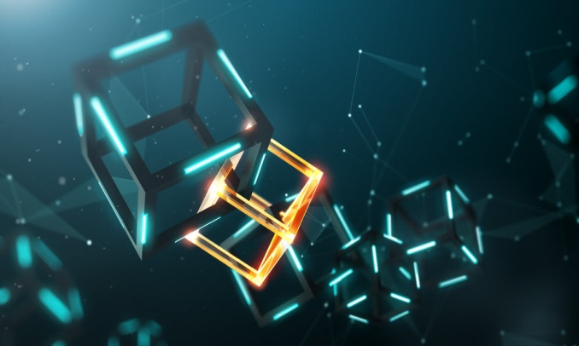
I.1 AQUIRING AND SHARING KNOWLEDGE
BY GAMIFICATION (learning by games) AND
CROWDSOURCING (knowledge from social
medias) USING BLOCKCHAIN
Notes:
Lets begin by gamification and crowdsourcing

Slide 19
The use of Blockchain-supported Reward Systems for Knowledge Transfer between Generations (1)
Current storage of knowledge? [1]
Wiki | 38,81%
Structured online file storage | 32,84%
E-mails | 32,84%
Tools from external service providers | 28,36%
I do not know if we have any knowledge management in the company. | 13,43%
Online-Spreadsheets | 7,46%
Other (please specify) | 1,49%
[1]
Reward System in Knowledge Management
No, where I work there are no rewards for (successful) knowledge management. | 38,81%
Yes, there are incentives in the form of monetary payments for those who pass on knowledge. | 32,84%
We have rewards in the form of gamification, that means in a playful way. The rewards are purely symbolic in character. | 32,84%
We have rewards in the form of gamification, that means in a playful way. The rewards are noncash prizes, such as vouchers. | 28,36%
Yes, there are incentives in the form of monetary payments for those who pass on knowledge and for those who receive it. | 13,43%
We have rewards in the form of gamification, that means in a playful way. But the rewards are ultimately cash prizes. | 7,46%
Other (please specify) | 1,49%
Notes:
The current srorage of knowledge is by wikis and emails
The majority of workers do not have rewards for knowledge management

Slide 20
[1]
The use of Blockchain-supported Reward Systems for Knowledge Transfer between Generations (2)
Knowledge Transfer Process
In a company-wide database | 36,36%
Only verbal (e.g. meetings), no protocols | 22,73%
We have no transfer of knowledge, or it is not recorded whether and how it is carried out | 22,73%
Handwritten and filed in folders | 12,12%
We use external cloud services | 10,61%
In a database that is stored locally | 9,09%
We use Blockchain based solutions | 1,52%
From a technical perspective, the authors have managed to demonstrate that Blockchain technologies can play a role in knowledge management. The initiation of knowledge transfer, particularly between generations, through gamification and nudging is possible and attractive. Securing documents so that they cannot be manipulated is feasible.
Notes:
they use Blockchain based solutions by 1,52%
From a technical perspective, the authors have managed to demonstrate that Blockchain technologies can play a role in knowledge management. The initiation of knowledge transfer, particularly between generations, through gamification and nudging is possible and attractive. Securing documents so that they cannot be manipulated is feasible.

Slide 21
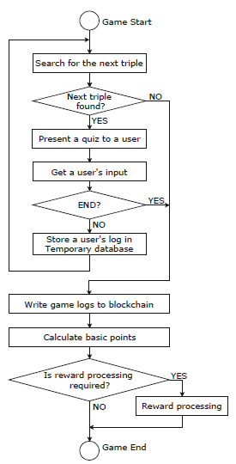
Toward Blockchain-Assisted Gamified Crowdsourcing for Knowledge Refinement
Gamification (enhance systems by involving users by games) could be introduced into crowdsourcing (knowledge from social
Medias or crowds) so that users are given rewards according to their contribution.
blockchains is usefull to ensure transparency of the user reward calculation.
It is extandable to application of blockchains to the process of gathering the knowledge content
[2]
Notes:
Gamification (enhance systems by involving users by games) could be introduced into crowdsourcing so that users are given rewards according to their contribution.
blockchains is usefull to ensure transparency of the user reward calculation.
It is extandable to application of blockchains to the process of gathering the knowledge content

Slide 22
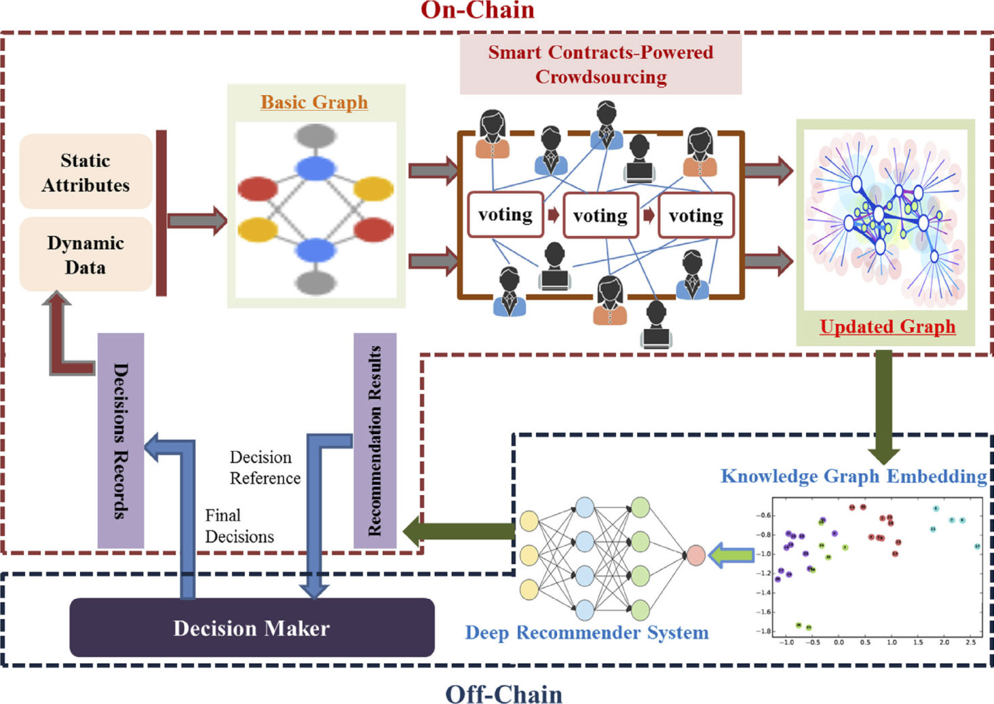
Decentralized Construction of Knowledge Graphs for Deep Recommender Systems Based on Blockchain-Powered Smart Contracts
propose a novel
decentralized knowledge graph construction method by means of crowdsourcing, and the business logic of crowdsourcing is implemented by blockchain-powered smart contracts to guarantee the transparency, integrity, and auditability. On this basis, the decentralized knowledge graph is used for a deep recommender system, and case studies validate the effectiveness of the system.
[3]
Notes:
propose a novel
decentralized knowledge graph construction method by means of crowdsourcing, and the business logic
of crowdsourcing is implemented by blockchain-powered smart contracts to guarantee the transparency, integrity, and auditability. On this basis, the decentralized knowledge graph is used for a deep recommender system, and case studies validate the effectiveness of the system.

Slide 23
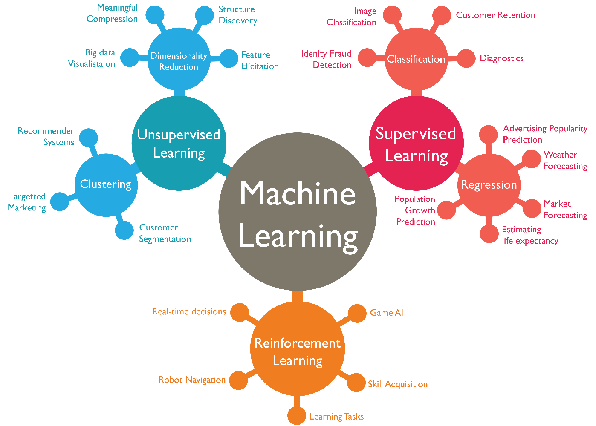
I.2 BLOCKCHAIN AND DISCOVERY OF KNOWLEDGE
USING MACHINE LEARNING AND
DISCOVERING CORRELATIONS
Correlations
[56]
Notes:
BLOCKCHAIN AND DISCOVERY OF KNOWLEDGE USING MACHINE LEARNING AND DISCOVERING CORRELATIONS

Slide 24
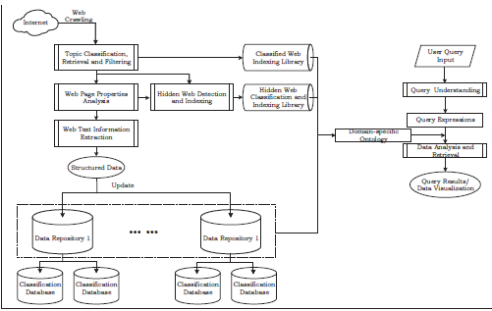
A Novel Blockchain Oracle Implementation Scheme
Based on Application Specific Knowledge Engines
In blockchain ecosystems, an Oracle is a service tool which provides real-world data for smart contracts and other blockchain applications. Application Specific Knowledge Engine (ASKE) is an integrated topic/application-centered knowledge portal that supports effective information retrieval and analysis. Inspired by ASKE. The authors propose a novel Oracle implementation scheme. The proposed scheme can realize multi-source data extraction and analysis, then working prototypes are demonstrated to show the validity of the scheme.
[4]
Notes:
In blockchain ecosystems, an Oracle is a service tool which provides real-world data for smart contracts and other blockchain applications. Application Specific Knowledge Engine (ASKE) is an integrated topic/application-centered knowledge portal that supports effective information retrieval and analysis. Inspired by ASKE. The authors propose a novel Oracle implementation scheme. The proposed scheme can realize multi-source data extraction and analysis, then working prototypes are demonstrated to show the validity of the scheme.

Slide 25
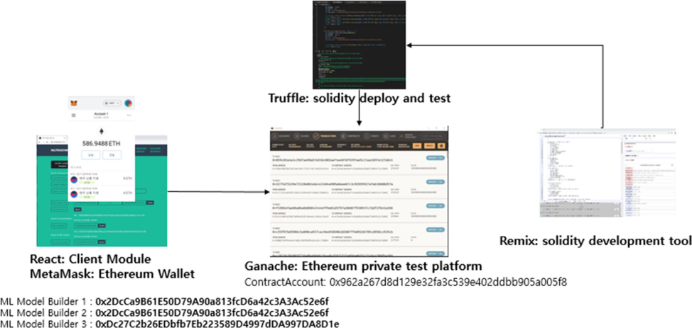
Data Privacy‑Preserving distributed Knowledge Discovery Based on the Blockchain
This work proposes a blockchain based distributed machine learning method which does not disclose the participating parties’ data and gives the penalty to betraying parties. The proposed method makes the participating parties communicate with each other via the smart contract on the blockchain network. It uses a blockchain-based incentive system to establish trust among parties and to improve the quality of discovery knowledge.
[5]
Notes:
This work proposes a blockchain based distributed machine learning method which does not disclose the participating parties’ data and gives the penalty to betraying parties. The proposed method makes the participating parties communicate with each other via the smart contract on the blockchain network. It uses a blockchain-based incentive system to establish trust among parties and to improve the quality of discovery knowledge.

Slide 26
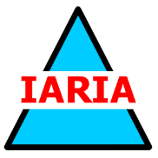
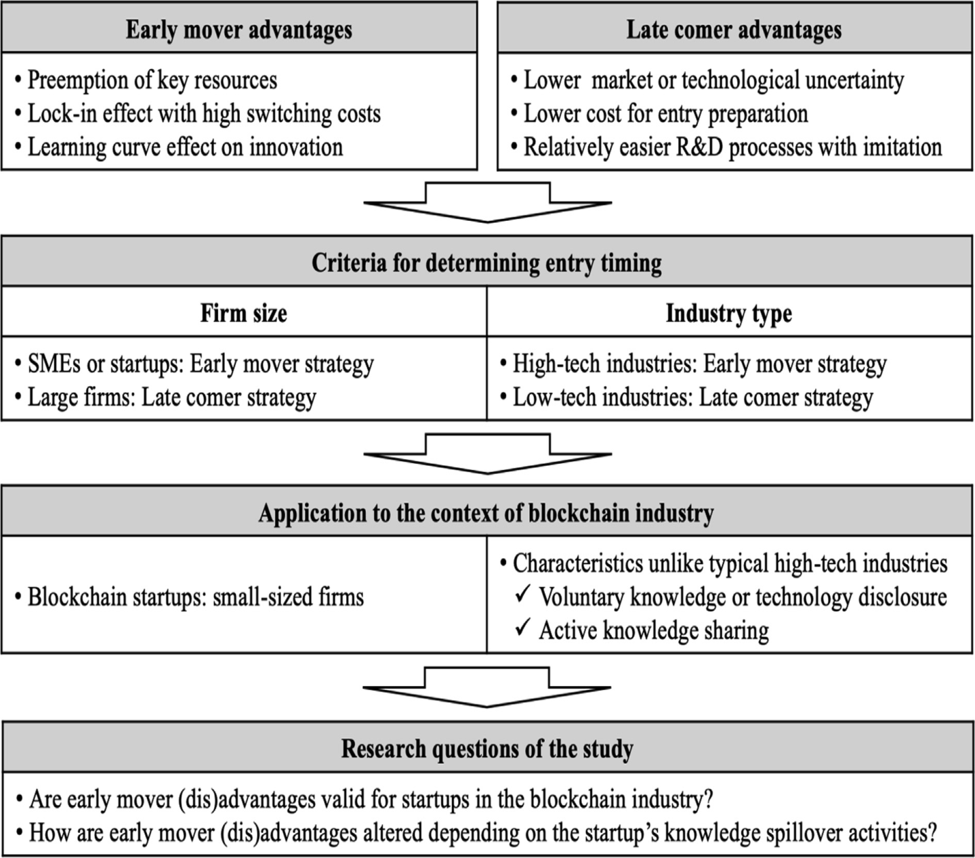
Early mover (dis)advantages and knowledge spillover effects on blockchain startups’ funding and innovation performance
An empirical analysis is conducted on 255 startups in the blockchain industry found between 2007 and 2016. The results show that while early mover advantages exist in terms of funding attraction from venture capitals, the entry timing and innovation performance have an inverted U-shaped relationship, as expected. Knowledge spillover activities of blockchain startups positively moderate the relationship between the entry timing and the venture capital attraction.
[6]
Notes:
An empirical analysis is conducted on 255 startups in the blockchain industry found between 2007 and 2016. The results show that while early mover advantages exist in terms of funding attraction from venture capitals, the entry timing and innovation performance have an inverted U-shaped relationship, as expected. Knowledge spillover activities of blockchain startups positively moderate the relationship between the entry timing and the venture capital attraction.

Slide 27
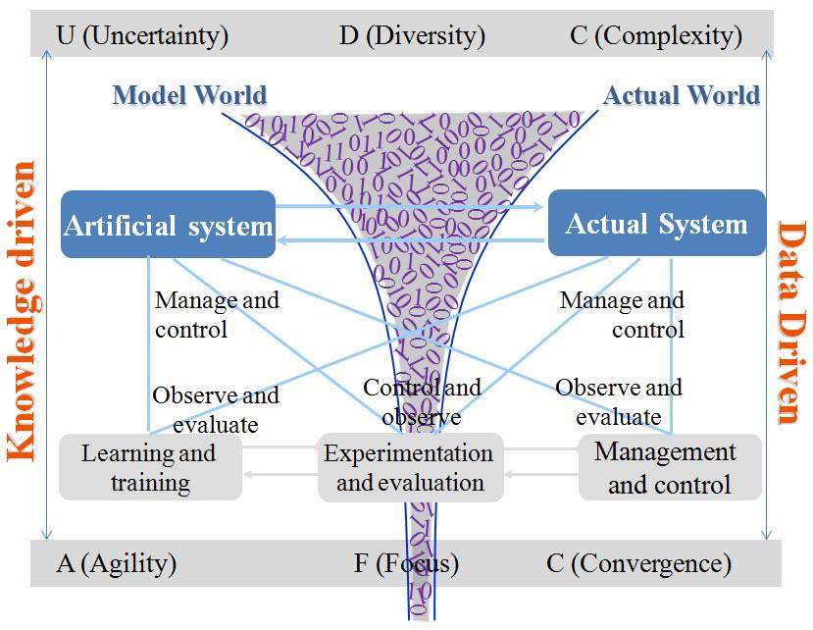
Blockchain-Based Knowledge Automation for
CPSS-Oriented Parallel Management
With the rapidly deepened integration of the real world and the virtual society, cyber–physical–social system (CPSS)-oriented parallel management proves to be an effective and efficient way in solving these problems. In this article, authors utilize blockchain technology and smart contracts in knowledge automation and investigate blockchain-based knowledge automation, which can be used for cyber–physical–social system (CPSS)-oriented parallel management.
[7]
Notes:
With the rapidly deepened integration of the real world and the virtual society, cyber–physical–social system (CPSS)-oriented parallel management proves to be an effective and efficient way in solving these problems. In this work, authors utilize blockchain technology and smart contracts in knowledge automation and investigate blockchain-based knowledge automation, which can be used for CPSS-oriented parallel management. they also propose a management framework based on the smart contract and discuss a case study.

Slide 28
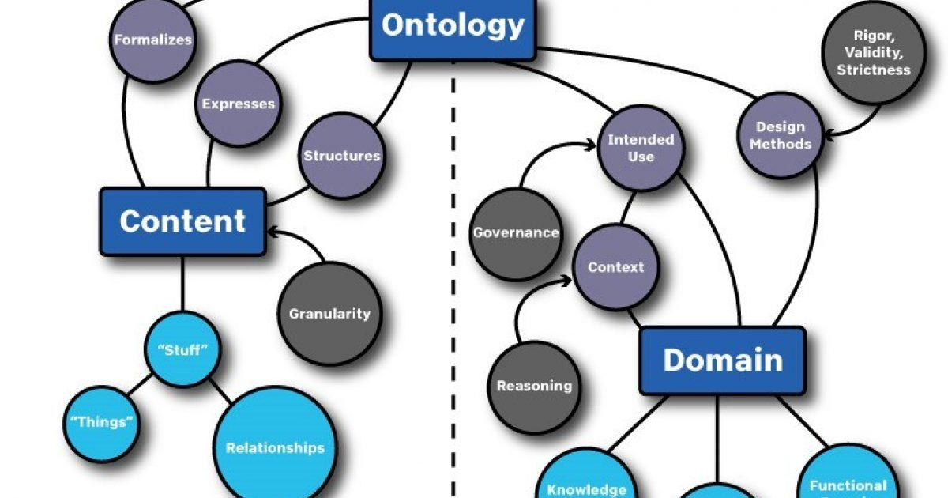
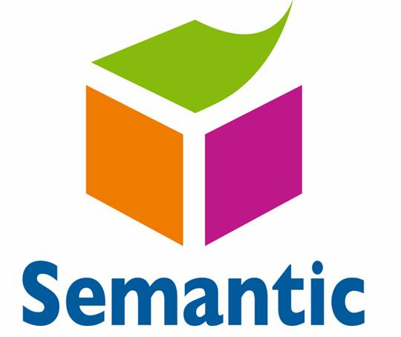
I.3 Semantic S and ontologies
USING BLOCKCHAIN
[53]
[54]

Slide 29
Definition of Ontology
Ontology is a formal knowledge representation is about building models of the world, of a particular domain or a problem, which allow for automatic reasoning and interpretation. Such formal models are called ontologies and can be used to provide formal semantics (i.e., machine-interpretable meaning) to any sort of information: databases, catalogs, documents, web pages, etc.

Slide 30
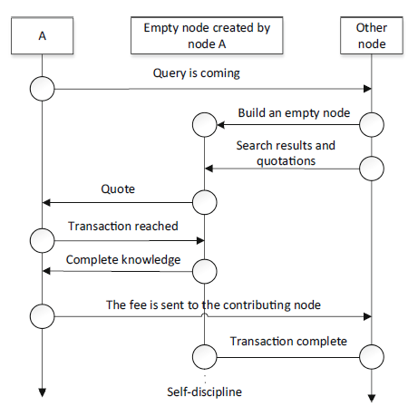
Semantic Knowledge Sharing Mechanism Based on Blockchain
Schematic diagram of query transaction flow.
Combined with blockchain, a
decentralized semantic knowledge sharing mechanism based on blockchain is proposed. The decentralized global knowledge graph is constructed by using the inter-node communication mechanism, and the query mode and transaction flow design based on the mechanism are realized. The experimental results show that the semantic knowledge sharing mechanism based on blockchain proposed is feasible, and compared with the traditional centralized knowledge graph, the construction time and query rate are greatly improved.
[8]
Notes:
Combined with blockchain, a decentralized semantic knowledge sharing mechanism based on blockchain is proposed. The decentralized global knowledge graph is constructed by using the inter-node communication mechanism, and the query mode and transaction flow design based on the mechanism are realized. The experimental results show that the semantic knowledge sharing mechanism based on blockchain proposed is feasible, and compared with the traditional centralized knowledge graph, the construction time and query rate are greatly improved.

Slide 31
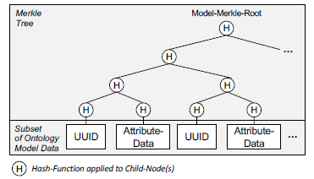
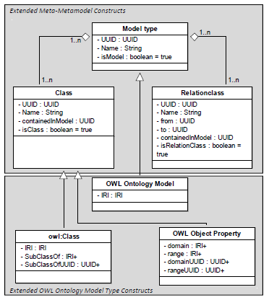
Applying the Concept of Knowledge
Blockchains to Ontologies
Knowledge Blockchains revert to blockchain technologies for enabling a transparent monitoring of knowledge evolution, for tracking the provenance of knowledge, for establishing delegation schemes, and for ensuring the existence of patterns in formal conceptualizations using zero knowledge proofs. Based on their original application to enterprise models,
[9]
Notes:
Knowledge Blockchains revert to blockchain technologies for enabling a transparent monitoring of knowledge evolution, for tracking the provenance of knowledge, for establishing delegation schemes, and for ensuring the existence of patterns in formal conceptualizations using zero knowledge proofs. Based on their original application to enterprise models,

Slide 32
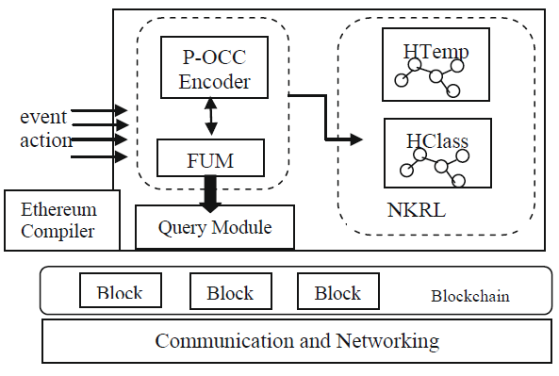
Narrative Knowledge Representation and Blockchain:
A Symbiotic Relationship
Simplified semantic architecture.
Ontologies jointed to blockchain facilitate the understanding and sharing of intrinsic components –smart contracts, transaction, knowledge- and relationship within a Blockchain. The main goal of this approach is to promote common data exchange, the design of decentralized, and the chronological semantic relationships on the Blockchain and Ethereum Smart Contracts making use of the narrative semantic representation foundations allowing therefore the web to survive and Blockchain technology to prosper.
[10]
Notes:
Notwithstanding that the Semantic Web improves the information interoperability, however, the spatio-temporal knowledge representation, the description of relatively complex events – like those that can involve within smart contracts – security, reliability and trust are still difficult to achieve. In
addition, Blockchain technology promotes information sharing and is supplying
secure communication architecture for distributed systems. Therefore, intertwine an ontology language with Blockchain allows information interoperability and provides message-integrity checking and resolve the trust in all kinds of applications (IoT, robotic, industry 4.0, health record, etc.). In fact, ontologies facilitate the understanding and sharing of intrinsic components –smart contracts, transaction, knowledge- and relationship within a Blockchain. The main goal of this approach is to promote common data exchange, the design of decentralized, and the chronological semantic relationships on the Blockchain and Ethereum Smart Contracts making use of the narrative semantic representation foundations allowing therefore the web to survive and Blockchain technology to prosper.

Slide 33
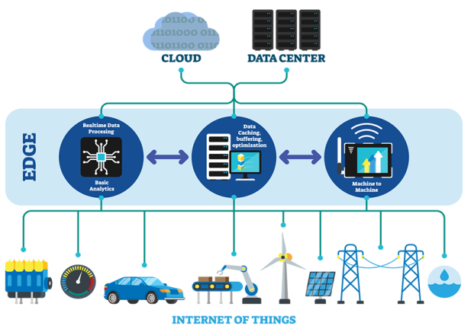
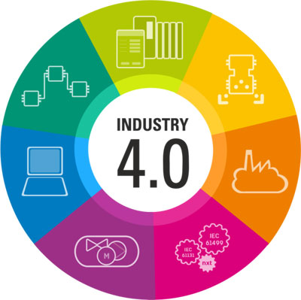
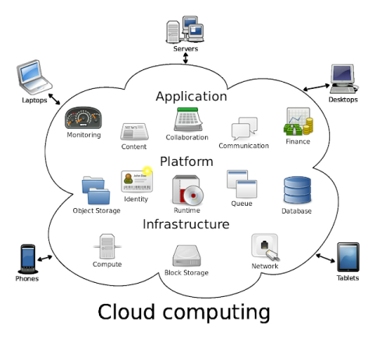
PART II: Blockchain and knowledge
Management by technology
Notes:
PART II concerns Blockchain and knowledge Management by technology

Slide 34
II.1 AQUIRING AND SHARING KNOWLEDGE
BY INDUSTRY 4.0 TECHNOLOGIES
USING BLOCKCHAIN
Notes:
II.1 AQUIRING AND SHARING KNOWLEDGE BY INDUSTRY 4.0 TECHNOLOGIES USING BLOCKCHAIN

Slide 35
Definition of industry 4.0
The scientific term "Industry 4.0" was first introduced in Germany in 2011 at the Hanover fair.
Industry 4.0 includes business processes in industry that envision organizing global production networks based on new information and communication technologies and Internet technologies (Schwab 2017).
?
Personalization of production by the possibility of consumer intervention during the production of the product this by maximum connectivity of objects (IIOT)
Purpose
35

Slide 36
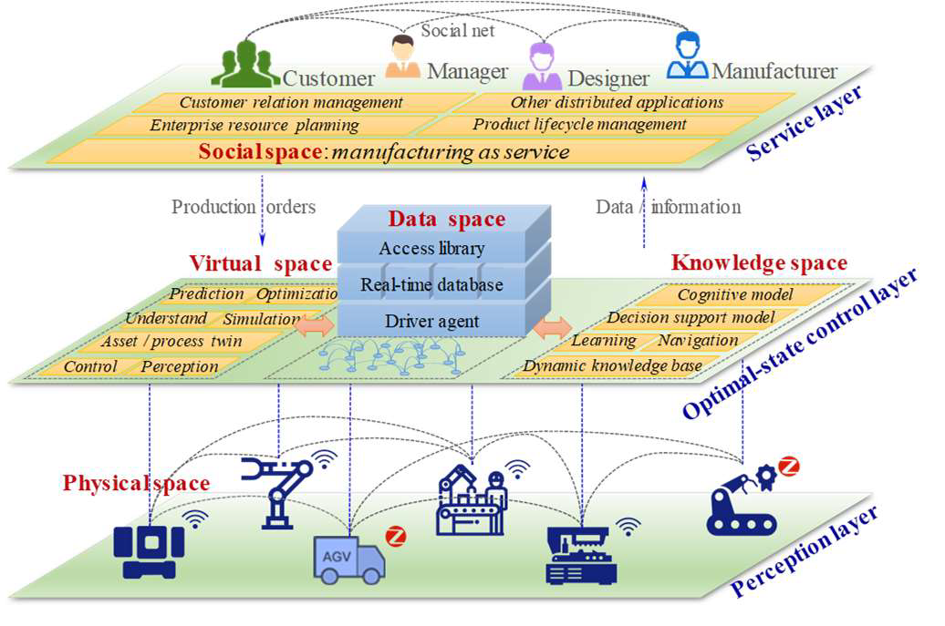
Manufacturing Blockchain of Things for the Configuration of a
Data- and Knowledge-Driven Digital Twin Manufacturing Cell
This work combines IIoT with the permissioned blockchain and proposes a novel manufacturing blockchain of things (MBCoT) architecture for the configuration of a secure, traceable and decentralized intelligent manufacturing systems (IMS). It uses a strong encryption algorithm based on a crash fault tolerant protocol. MBCoT equips IMS with a secure, traceable, stable and decentralized operating environment, while achieving competitive throughput and latency performance.
[11]
Notes:
This paper combines IIoT with the permissioned blockchain and proposes a novel manufacturing blockchain of things (MBCoT) architecture for the configuration of a secure, traceable and decentralized IMS. Then, hardware infrastructures and software-defined components of MBCoT are designed to provide an insight into the industrial implementation of IMS. Furthermore, the consensus-orientedBtransaction logic of MBCoT is presented based on a crash fault tolerant protocol, which empowers MBCoT with a strong but resource-efficient encryption mechanism to support autonomous manufacturing process. Finally, the implementation of a MBCoT prototype system and its application examples justify that the proposed approach is practical and sound. The evaluation experiment demonstrates that MBCoT equips IMS with a secure, traceable, stable and decentralized operating environment, while achieving competitive throughput and latency performance.

Slide 37
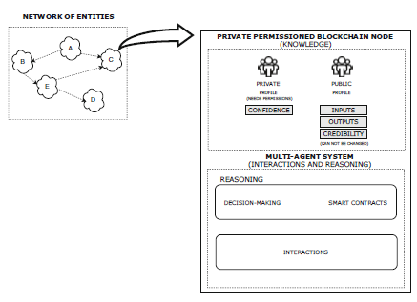
Improving Collaboration in Industry 4.0: The Usage of
Blockchain For Knowledge Representation
A model that uses blockchain and multi-agent systems to help represent an organization in a network of entities, as well to create a system that is capable of handling entity transactions and provide a way of improving decision-making by enabling decisions to be done faster in a rapidly changing environment.
[12]
Notes:
A model that uses blockchain and multi-agent systems to help represent an organisation in a network of entities, as well to create a system that is capable of handling entity transactions and provide a way of improving decision-making by enabling decisions to be done faster in a rapidly changing environment.

Slide 38
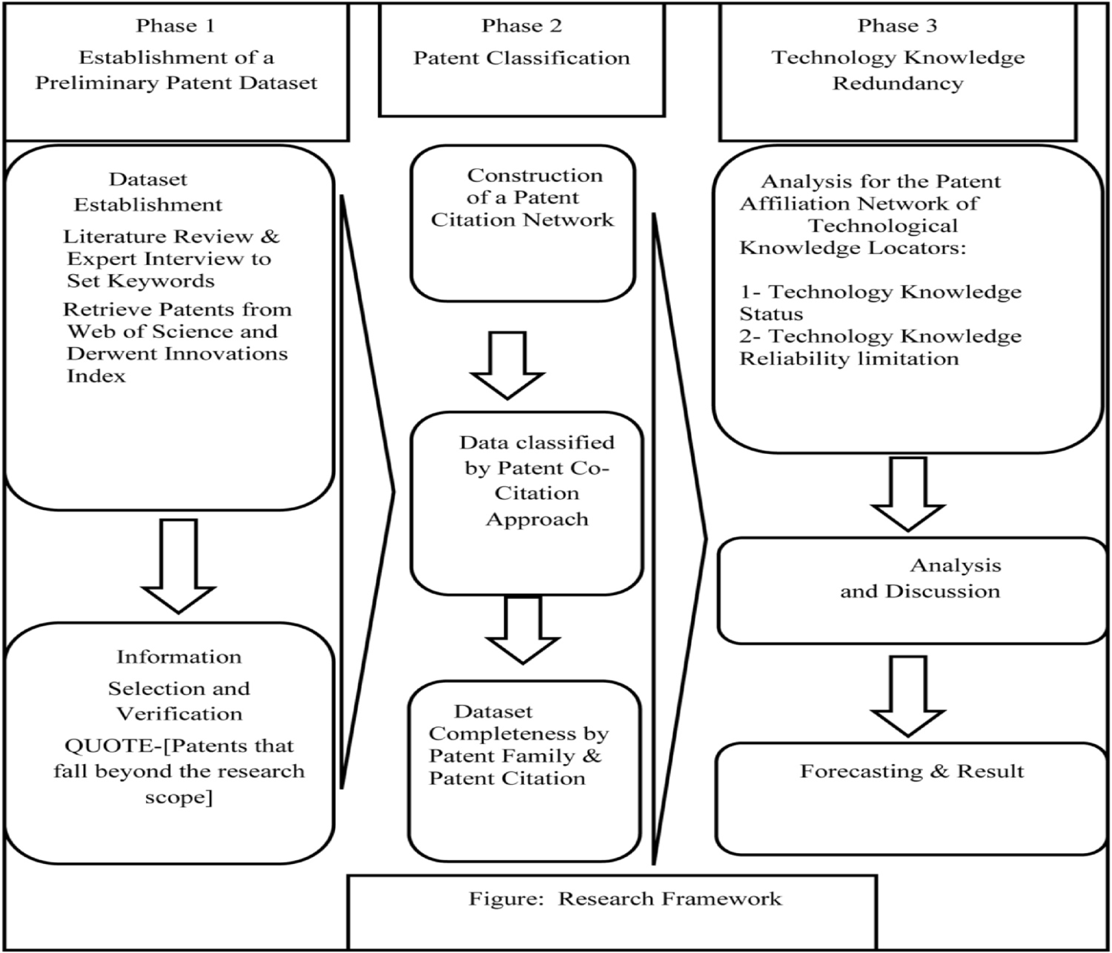
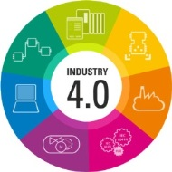
Forecasting technological positioning through technology knowledge redundancy: Patent citation analysis of IoT, cybersecurity, and Blockchain
This research approaches the relative locations of a company in the technological network based on patent citations of the IoT cybersecurity and blockchain. Authors applied the Technology Knowledge Redundancy method for the patent citation network, used the main two indicators TKS (Technology Knowledge Status) and TKR (Technology Knowledge Reliability) for the analysis, and then used the Derwent Innovations Index patent data.
[13]
Notes:
This research approaches the relative locations of a company in the technological network based on patent citations of the IoT cybersecurity and blockchain. Authors applied the Technology Knowledge Redundancy method for the patent citation network, used the main two indicators
TKS (Technology Knowledge Status) and TKR (Technology Knowledge Reliability for the analysis, and then used
the Derwent Innovations Index patent data.

Slide 39
II.2 BLOCKCHAIN AND KM USING EDGE
COMPUTING TECHNOLOGY
Notes:
II.2 BLOCKCHAIN AND KM USING EDGE COMPUTING TECHNOLOGY

Slide 40
Definition of EDGE COMPUTING
It is a computer that resides near your sensors, collects data, and can do data processing. That way, instead of transporting all that data to the cloud or to your data center, you process it locally first.
[29]

Slide 41
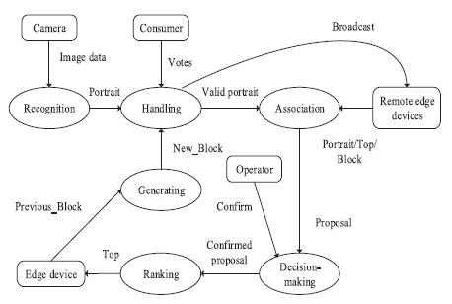
Preserving Edge Knowledge Sharing Among IoT
Services: A Blockchain-Based Approach
In this work, an user-centric blockchain (UCB) framework is proposed for preserving edge knowledge sharing in IoT. Significant superiorities of UCB benefit from the proof of popularity (PoP) consensus mechanism, which is more energy-efficient and fast. Security analysis and experiments based on Raspberry Pi 3 Model B demonstrate its feasibility with low block generating delay and complexity.
[14]
Notes:
Edge computational intelligence, integrating artificial intelligence (AI) and edge computing into Internet of Things (IoT), will generate many scattered knowledge. To enable auditable and delay-sensitive IoT services, these knowledge will be shared among decentralized intelligent network edges (DINEs), end users, and supervisors frequently. Blockchain has a promising ability to provide a traceable, privacy-preserving and tamper-resistant ledger for sharing edge knowledge. However, due to the complicated environments of network edges, knowledge sharing among DINEs still faces many challenges. Firstly, the resource limitation and mobility
of DINEs impede the applicability of existing consensus tricks (e.g.,
Poof of Work, Proof of Stake, and Paxos) of blockchain. Secondly,
the adversaries may eavesdrop the content of edge knowledge or
entice the blockchain to forks using some attacking models (like
man-in-the-middle attack, denial of services, etc.). In this article,
an user-centric blockchain (UCB) framework is proposed for preserving
edge knowledge sharing in IoT. Significant superiorities of
UCB benefit from the proof of popularity (PoP) consensus mechanism,
which is more energy-efficient and fast. Security analysis
and experiments based on Raspberry Pi 3 Model B demonstrate its
feasibility with low block generating delay and complexity.

Slide 42
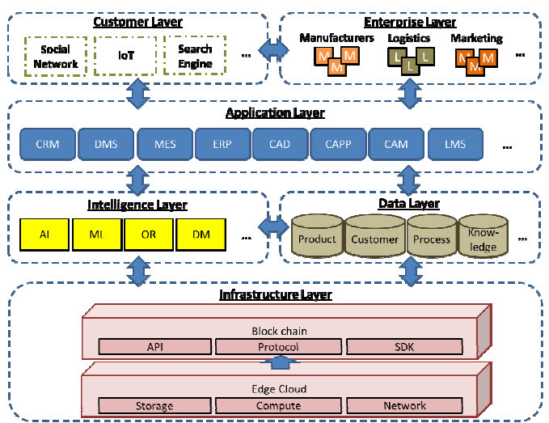
Towards Open Manufacturing: A Cross-Enterprises Knowledge and Services
Exchange Framework based on Blockchain and Edge Computing
The proposed framework incorporates the recent development in edge computing technologies to achieve a flexible and distributed network. With the blockchain technology, it provides standards and protocols for implementing the framework and ensures the security issues. Not only information can be shared, the framework also supports the exchange of knowledge and services so that the parties can contribute their parts.
[15]
Notes:
The purpose of this paper is to propose a cross enterprises framework to achieve a higher level of sharing of knowledge and services in manufacturing ecosystems.
The proposed framework incorporates the recent development in edge computing technologies to achieve a flexible and distributed network. With the blockchain technology, it provides standards and protocols for implementing the framework and ensures the security issues. Not only information can be shared, the framework but also supports the exchange of knowledge and services so that the parties can contribute their parts.

Slide 43
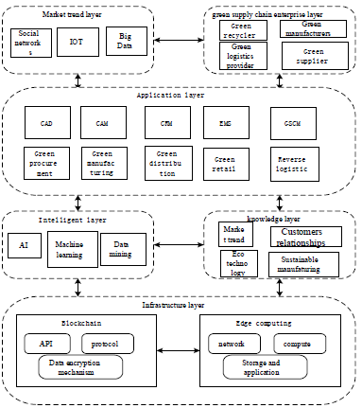
A Knowledge Sharing Framework for Green Supply Chain
Management Based on Blockchain and Edge computing
Authors propose a decentralized knowledge sharing framework based on blockchain and edge computing technologies. The
security and reliability of the knowledge sharing framework are guaranteed by the
security encryption, non-tamperability of the blockchain. Edge computing that provides edge intelligence services is integrated into the framework to meet the needs of the blockchain for distributed networks.
[16]
Notes:
Authors propose a decentralized knowledge
sharing framework based on blockchain and edge computing technologies. The
security and reliability of the knowledge sharing framework are guaranteed by the
security encryption, non-tamperability of the blockchain. Edge computing that provides edge intelligence services is integrated into the framework to meet the needs of the blockchain for distributed networks.

Slide 44
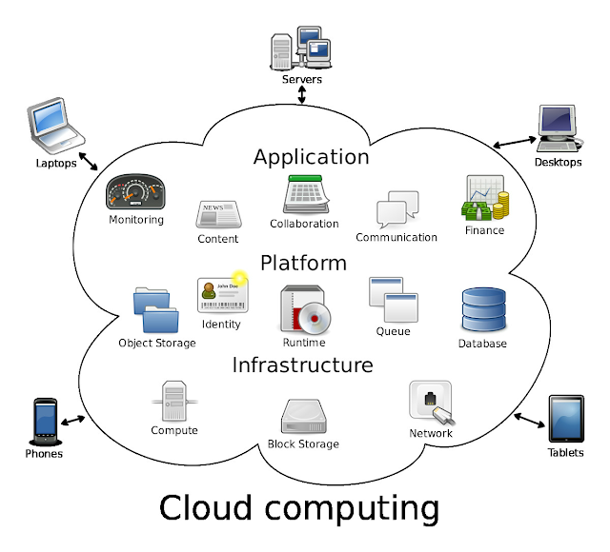
II.3 BLOCKCHAIN AND KM USING CLOUD COMPUTING TECHNOLOGY

Slide 45
Definition of the Cloud Computing
It provides the infrastructure to collect data and deliver information to the Internet. Rather than a personal computer or a local server, it uses a multitude of remote servers to manage and process such large volumes of data. It provides the platform to share applications to run programs. The term Cloud in which the Internet refers to a platform for storing data and running applications.
Notes:
It provides the infrastructure to collect data and deliver information to the Internet. Rather than a personal computer or a local server, it uses a multitude of remote servers to manage and process such large volumes of data. It provides the platform to share applications to run programs. The term Cloud in which the Internet refers to a platform for storing data and running applications.

Slide 46
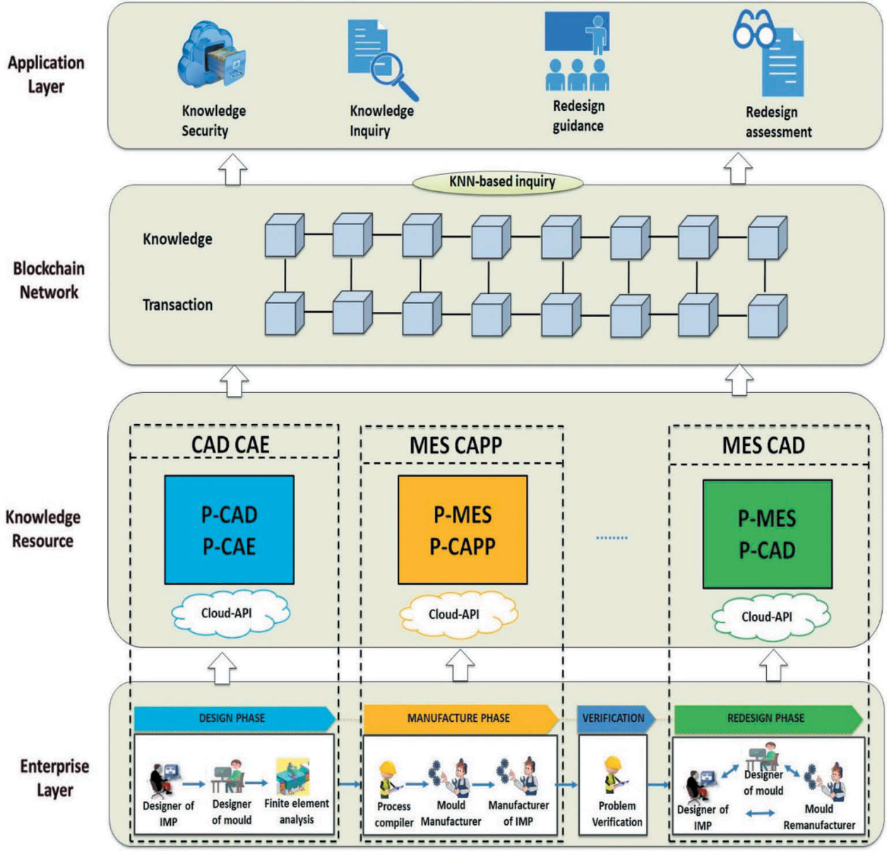
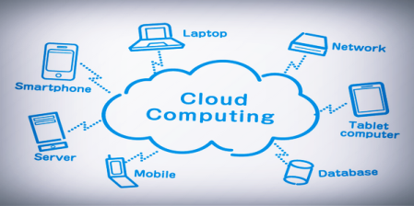
CKshare: secured cloud-based knowledge-sharing
blockchain for injection mold redesign
A trustable mold redesign knowledge-sharing platform, known as CKshare, based on private cloud and blockchain
technology. The private cloud to store the mold redesign knowledge of each party to meet its own privacy and data format requirements. The blockchain network is used for recording the knowledge and its transactions to ensure security and trustfulness.
[17]
Notes:
A trustable mold redesign knowledge-sharing platform, known as CKshare, based on private cloud and blockchain
technology. Firstly, we use private cloud to store the mold redesign knowledge of each party to meet its own privacy and data format requirements. Secondly, a blockchain network is used for recording the knowledge and its transactions to ensure security and trustfulness. Thirdly, a simple retrieval mechanism is developed based on k-nearest neighbors for retrieving the codified knowledge on the platform.

Slide 47
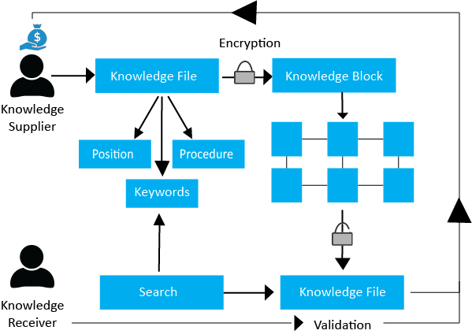
Knowledge Decentralization in the age of Blockchain. Developing a Knowledge-Transfer System Using Digital Assets.
The aim of this work is to challenge the traditional ways to perceive organizational knowledge by creating a model that allows the application of private blockchains to knowledge evolution, ownership and transfer. Moreover, intellectual property rights need to be well established and properly upheld in all organizations in order to create an environment that is open to knowledge sharing. However, with the development of the blockchain technology, both the trust and intellectual property issue can be easily overcome especially integrating the cloud services.
[19]
Notes:
Disruptive technologies have reshaped the way governance, regulations and businesses plan their medium to long-term development strategies, affecting our socio-economic and cultural environments in a number of ways. Blockchain in general, and its applications in corporations, medical services, archiving or investment, in particular, is a phenomenon whose significance is yet to be fully explored. Big corporations like Microsoft and Walmart are already integrating blockchain for cloud services, smart contracts or food chain databases. As the adoption of the blockchain is increasing, we will witness the discovery of more ways to make organizational processes run even more smoothly. The aim of our paper is to challenge the traditional ways to perceive organizational knowledge by creating a model that allows the application of private Blockchains to knowledge evolution, ownership and transfer. Socio-economic and cultural aspects of integrating blockchain in the knowledge transfer systems would be discussed and our focus will be to explore the effectiveness of such a system and its impact on intellectual capital.

Slide 48
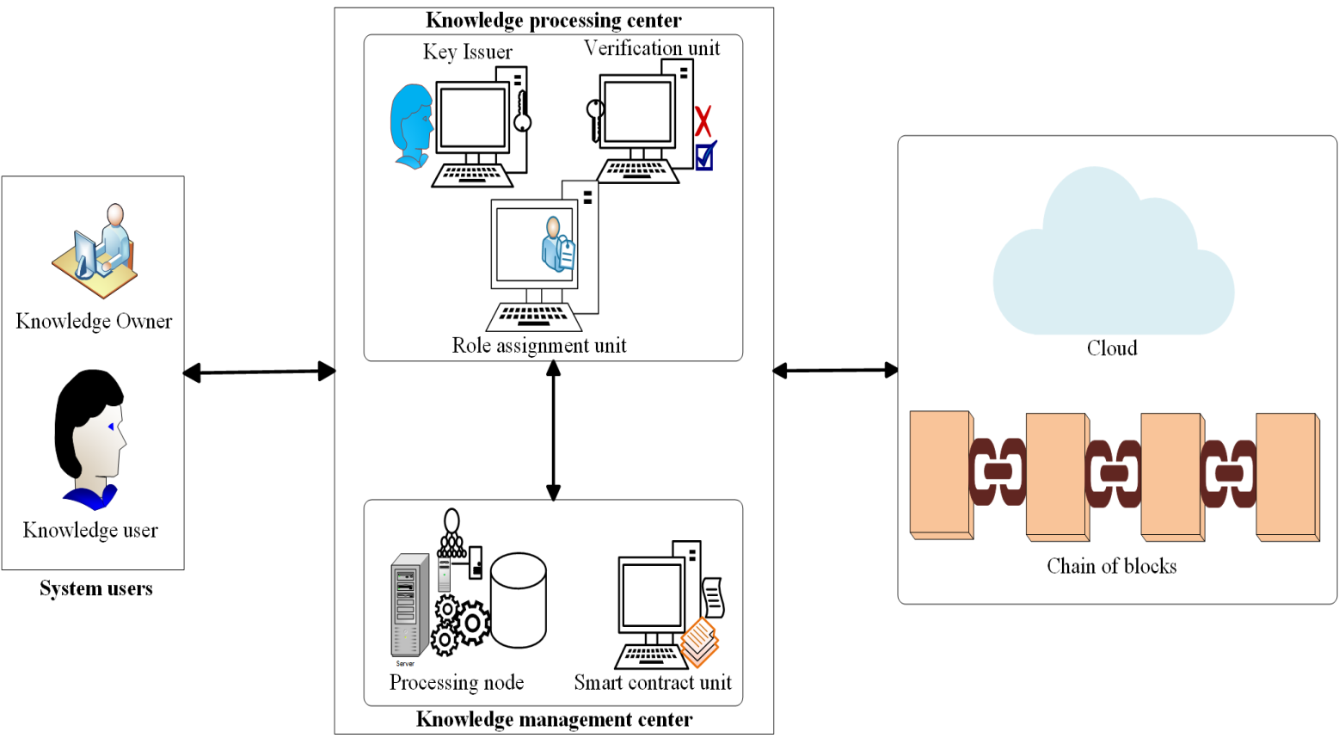
An ECDSA Approach to Access Control in
Knowledge Management Systems Using Blockchain
In this work, a role-based access control RBAC model based on blockchain technology is presented, to enhance user authentication before knowledge is accessed and utilized in a knowledge management system (KMS). The blockchain-based system model and the smart contract ensure that transparency and knowledge resource immutability are achieved. As an essential part of RBAC model applied to KMS environment, trust is ensured in the network.
[20]
Notes:
In this work, however, a role-based access control RBAC model based on blockchain technology is presented, to enhance user authentication before knowledge is accessed and utilized in a knowledge management system (KMS). The blockchain-based system model and the smart contract ensure that transparency and knowledge resource immutability are achieved. As an essential part of RBAC model applied to KMS environment, trust is ensured in the network.

Slide 49
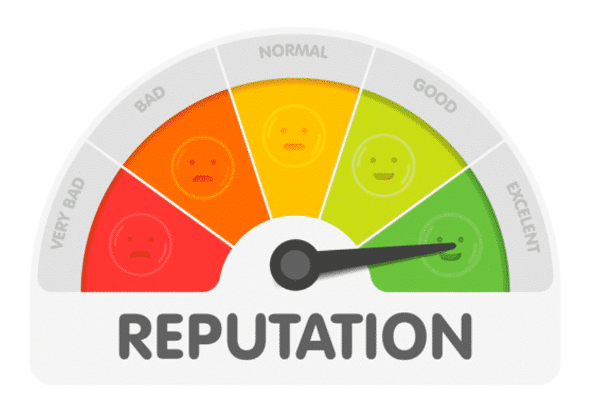
PART III: Blockchain and Knowledge
Management for Human Values

Slide 50
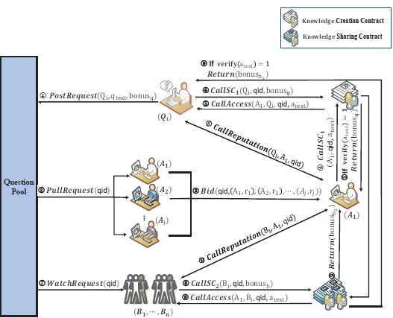
III. 1 Reputation-based Distributed Knowledge Sharing System in Blockchain
users’ reputation
represents users’ credibility and the eligibility of providing
valid answers.
Authors proposed Reputation Based
Knowledge Sharing system in blockchain, called RBKS, to exploit the copyright protection of the knowledge owner to achieve the paid-for content service which allows bystanders who are interested in the shared knowledge to pay a small fee for the access.
[21]
Notes:
users’ reputation
represents users’ credibility and the eligibility of providing
valid answers.
Authors proposed Reputation Based
Knowledge Sharing system in blockchain, called RBKS, to exploit the copyright protection of the knowledge owner to achieve the paid-for content service which allows bystanders who are interested in the shared knowledge to pay a small fee for the access.

Slide 51
III. 2 Do you have confidence in how your rolling stock has been maintained? A blockchain-led knowledge-sharing platform for building trust between stakeholders
A business network archive is developed for the maintenance management of the sliding step of the train door system. The archive encompasses the business logic and transactional data required to enhance trust among stakeholders in the quality of performed maintenance. The developed archive is deployed on Hyperledger Fabric and effective. The results show that the developed business network, deployed on a customized Hyperledger Fabric consensus protocol, enhanced trust among the stakeholders involved.
[22]
Notes:
A business network archive is developed for the maintenance management of the sliding step of the train door system. The archive encompasses the business logic and transactional data required to enhance trust among stakeholders in the quality of performed maintenance. The developed archive is deployed on Hyperledger Fabric and the effectiveness of the solution is evaluated through a survey. The results show that the developed business network, deployed on a customized Hyperledger Fabric consensus protocol, enhanced trust among the stakeholders involved.

Slide 52
III. 3 Managing Knowledge Provenance using Blockchain
The proposed model for managing knowledge provenance leverages the benefits of a blockchain to provide a solution which is decentralized, immutable and easy to update. By presenting knowledge statements in this form, it provides a data structure which overcomes many of the problems presented by the “post-fact” world without fundamentally changing the nature of academic discourse itself. This model is extendable to be used in accountability.
[23]
Notes:
The emergence of a “post-fact” world has seen knowledge being misinterpreted and manipulated to suit diverse purposes. Information from credible sources is often drowned out by ‘facts’ with dubious provenance. It is not enough to simply establish knowledge provenance if this meta-data can be changed afterwards. This paper presents a possible solution using blockchains to manage knowledge provenance. The solution is modelled using a concrete example of knowledge institutions. Variations and extensions to suit other domains are suggested. Particularly, a graph based variation of the blockchain is outlined. We also discuss the impact of our model beyond technology.

Slide 53
CONCLUSION AND TRENDS
Even its advantages (only for the high cost), the blockchain is still not used by goverments, not enough known and it needs laws to support it.
The trends of blockchain are
1- Further R&D direction for cryptography will more focus on the capability in fast big data processing.
2- Hardware blockchain technology will lead the spread of big data market by reinforcing fast speed and data security.
3- The future technologies related to the applications will be developed closely with encryption technologies which are essential part for artificial intelligence and IoT.
4- The exchange related technologies will focus on solving the problems in cryptocurrency transactions.
5- The further directions of the digital transaction technologies will focus on the big data processing.
[24]
Notes:
1- Further R&D direction for cryptography will more focus on the capability in fast big data processing.
2- Hardware blockchain technology will lead the spread of big data market by reinforcing fast speed and data security.
3- The future technologies related to the applications will be developed closely with encryption technologies which are essential part for artificial intelligence and IoT.
4- The exchange related technologies will focus on solving the problems in cryptocurrency transactions.
5- The further directions of the digital transaction technologies will focus on the big data processing

Slide 54
DISCUSSION
s.aitouche@univ-batna2.dz
samiaaitouche@gmail.fr

Slide 55
[1] Alexander Pfeiffer et al., 2020, The use of Blockchain-supported Reward Systems for Knowledge Transfer between Generations, ECKM 2020 conference.
[2] Bu H., Kuwabara K. (2020) Toward Blockchain-Assisted Gamified Crowdsourcing for Knowledge Refinement. In: Nguyen N., Jearanaitanakij K., Selamat A., Trawiński B., Chittayasothorn S. (eds) Intelligent Information and Database Systems. ACIIDS 2020. Lecture Notes in Computer Science, vol 12033. Springer, Cham. https://doi.org/10.1007/978-3-030-41964-6_1
[3] S. Wang, C. Huang, J. Li, Y. Yuan and F. Wang, "Decentralized Construction of Knowledge Graphs for Deep Recommender Systems Based on Blockchain-Powered Smart Contracts," in IEEE Access, vol. 7, pp. 136951-136961, 2019, doi: 10.1109/ACCESS.2019.2942338.
[4] S. Wang, H. Lu, X. Sun, Y. Yuan and F. Wang, "A Novel Blockchain Oracle Implementation Scheme Based on Application Specific Knowledge Engines," 2019 IEEE International Conference on Service Operations and Logistics, and Informatics (SOLI), 2019, pp. 258-262, doi: 10.1109/SOLI48380.2019.8955107.

Slide 56
[5] Lee, K.M., Ra, I. Data privacy-preserving distributed knowledge discovery based on the blockchain. Inf Technol Manag 21, 191–204 (2020). https://doi.org/10.1007/s10799-020-00317-1
[6] unno Park, Seungryul Ryan Shin, Minkyung Choy, Early mover (dis)advantages and knowledge spillover effects on blockchain startups’ funding and innovation performance, Journal of Business Research, Volume 109, 2020,
[7] R. Qin, Y. Yuan and F. -Y. Wang, "Blockchain-Based Knowledge Automation for CPSS-Oriented Parallel Management," in IEEE Transactions on Computational Social Systems, vol. 7, no. 5, pp. 1180-1188, Oct. 2020, doi: 10.1109/TCSS.2020.3023046.
[8] Zhang B., Li X., Ren H., Gu J. (2020) Semantic Knowledge Sharing Mechanism Based on Blockchain. In: Liu Y., Wang L., Zhao L., Yu Z. (eds) Advances in Natural Computation, Fuzzy Systems and Knowledge Discovery. ICNC-FSKD 2019. Advances in Intelligent Systems and Computing, vol 1075. Springer, Cham. https://doi.org/10.1007/978-3-030-32591-6_13
[9] A. Martin, K. Hinkelmann, A. Gerber, D. Lenat, F. van Harmelen, P. Clark (Eds.), Proceedings of the AAAI 2019 Spring Symposium on Combining Machine Learning with Knowledge Engineering (AAAI-MAKE 2019). Stanford University, Palo Alto, California, USA, March 25-27, 2019.

Slide 57
[10] Sabri L., Boubetra A. (2020) Narrative Knowledge Representation and Blockchain: A Symbiotic Relationship. In: Barolli L., Amato F., Moscato F., Enokido T., Takizawa M. (eds) Advanced Information Networking and Applications. AINA 2020. Advances in Intelligent Systems and Computing, vol 1151. Springer, Cham. https://doi.org/10.1007/978-3-030-44041-1_30.
[11] C. Zhang, G. Zhou, H. Li and Y. Cao, "Manufacturing Blockchain of Things for the Configuration of a Data- and Knowledge-Driven Digital Twin Manufacturing Cell," in IEEE Internet of Things Journal, vol. 7, no. 12, pp. 11884-11894, Dec. 2020, doi: 10.1109/JIOT.2020.3005729.
[12] Pinheiro P., Santos R., Barbosa R. (2020) Improving Collaboration in Industry 4.0: The Usage of Blockchain for Knowledge Representation. In: De La Prieta F. et al. (eds) Highlights in Practical Applications of Agents, Multi-Agent Systems, and Trust-worthiness. The PAAMS Collection. PAAMS 2020. Communications in Computer and Information Science, vol 1233. Springer, Cham. https://doi.org/10.1007/978-3-030-51999-5_19
[13] Ugrul Daim, Kuei Kuei Lai, Haydar Yalcin, Fayez Alsoubie, Vimal Kumar, Forecasting technological positioning through technology knowledge redundancy: Patent citation analysis of IoT, cybersecurity, and Blockchain, Technological Forecasting and Social Change, Volume 161, 2020, https://doi.org/10.1016/j.techfore.2020.120329.

Slide 58
[14] G. Li, M. Dong, L. T. Yang, K. Ota, J. Wu and J. Li, "Preserving Edge Knowledge Sharing Among IoT Services: A Blockchain-Based Approach," in IEEE Transactions on Emerging Topics in Computational Intelligence, vol. 4, no. 5, pp. 653-665, Oct. 2020, doi: 10.1109/TETCI.2019.2952587.
[15] Li, Z., Wang, W.M., Liu, G., Liu, L., He, J. and Huang, G.Q. (2018), "Toward open manufacturing: A cross-enterprises knowledge and services exchange framework based on blockchain and edge computing", Industrial Management & Data Systems, Vol. 118 No. 1, pp. 303-320. https://doi.org/10.1108/IMDS-04-2017-0142
[16] Zhang H., Li S., Yan W., Jiang Z., Wei W. (2019) A Knowledge Sharing Framework for Green Supply Chain Management Based on Blockchain and Edge Computing. In: Ball P., Huaccho Huatuco L., Howlett R., Setchi R. (eds) Sustainable Design and Manufacturing 2019. KES-SDM 2019. Smart Innovation, Systems and Technologies, vol 155. Springer, Singapore. https://doi.org/10.1007/978-981-13-9271-9_34
[17] Zhi Li, Xinlai Liu, W. M. Wang, Ali Vatankhah Barenji & George Q. Huang (2019) CKshare: secured cloud-based knowledge-sharing blockchain for injection mold redesign, Enterprise Information Systems, 13:1, 1-33, DOI: 10.1080/17517575.2018.1539774

Slide 59
[18] Zhi Li, Layne Liu, Ali Vatankhah Barenji, Waiming Wang, Cloud-based Manufacturing Blockchain: Secure Knowledge Sharing for Injection Mould Redesign, Procedia CIRP, Volume 72, 2018, Pages 961-966, https://doi.org/10.1016/j.procir.2018.03.004.
[19] Suciu M.C., Năsulea C., Năsulea D. (2020) Knowledge Decentralization in the Age of Blockchain: Developing a Knowledge-Transfer System Using Digital Assets. In: Matos F., Vairinhos V., Salavisa I., Edvinsson L., Massaro M. (eds) Knowledge, People, and Digital Transformation. Contributions to Management Science. Springer, Cham. https://doi.org/10.1007/978-3-030-40390-4_17
[20] Shuang Hu, Lin Hou, Gongliang Chen, Jian Weng, Jianhua Li, MobiQuitous '18: Proceedings of the 15th EAI International Conference on Mobile and Ubiquitous Systems: Computing, Networking and Services, 2018, pp. 476–481, https://doi.org/10.1145/3286978.3286981
[21] U. Mittal, T. Gedeon and S. Caldwell, "Managing Knowledge Provenance using Blockchain," 2018 9th IEEE International Conference on Cognitive Infocommunications (CogInfoCom), 2018, pp. 000241-000246, doi: 10.1109/CogInfoCom.2018.8639889.
[22] Yawar Abbas, Alberto Martinetti, Jan-Jaap Moerman, Ton Hamberg, Leo A.M. van Dongen,Do you have confidence in how your rolling stock has been maintained? A blockchain-led knowledge-sharing platform for building trust between stakeholders, International Journal of Information Management, Volume 55, 2020. https://doi.org/10.1016/j.ijinfomgt.2020.102228.

Slide 60
[23] U. Mittal, T. Gedeon and S. Caldwell, "Managing Knowledge Provenance using Blockchain," 2018 9th IEEE International Conference on Cognitive Infocommunications (CogInfoCom), 2018, pp. 000241-000246, doi: 10.1109/CogInfoCom.2018.8639889.
[24] S. Kim, S. Yoon, N. Raghavan, N. -T. Le and H. Park, "Developmental Trajectories in Blockchain Technology Using Patent-Based Knowledge Network Analysis," in IEEE Access, vol. 9, pp. 44704-44717, 2021, doi: 10.1109/ACCESS.2021.3066573.
[25] Yu, D., Sheng, L. Knowledge diffusion paths of blockchain domain: the main path analysis. Scientometrics 125, 471–497 (2020). https://doi.org/10.1007/s11192-020-03650-y
[26] https://www.mysearchglobalrewards.com/service/Block-Chain-Development-Technology
[27] https://www.lafabriquedunet.fr/blog/definition-blockchain
[28] https://aicanime.com/cat-commentaires/base-de-donnees-relationnelle-blockchain-vs-quelle/
[29] https://forum.huawei.com/enterprise/fr/edge-computing-une-technologie-de-pointe/thread/744473-100379

Slide 61
[30] https://www.automate.org/editorials/industry-4-0-key-design-principles
[31] https://www.netaawy.com/2018/11/Cloud-computing.html
[32] https://streamshare.com.au/semantic-web/
[33] https://www.process.st/introduction-to-blockchain/
[34] https://www.welivesecurity.com/fr/2018/10/09/blockchain-definition-fonctionnement-utilisations/
[35] https://forum.huawei.com/enterprise/fr/edge-computing-une-technologie-de-pointe/thread/744473-100379
[36] https://waytolearnx.com/2018/09/difference-entre-big-data-et-cloud-computing.html
[37] https://www.ontotext.com/blog/meaning-ontology/
[38] https://www.edureka.co/blog/what-is-cryptography/
[39] https://medium.com/hackernoon/how-blockchain-and-big-data-complement-each-other-92a1b9f8b38d

Slide 62
[40]https://www.google.dz/search?q=iot&sxsrf=ALeKk03K2Ro5nlbyTqAfNIVnHKWeitkcHQ:1624804338052&source=lnms&tbm=isch&sa=X&ved=2ahUKEwiQopjrg7jxAhUScBQKHcy0CnUQ_AUoAXoECAIQAw&biw=1366&bih=569#imgrc=WB9hI529meg8aM
[41] https://www.breezyscroll.com/money/how-to-make-your-own-cryptocurrency/
[42] https://taxguru.in/income-tax/taxation-digital-transaction-equalisation-levy.html
[43] https://about.swip.world/en/crowdsourcing-value-organizations/
[44] https://www.themantic-education.com/ibpsych/2017/08/15/lesson-idea-thinking-critically-about-correlations/
[45] https://maxwebmarketing.com/principaux-conseils-pour-batir-une-reputation-en-ligne/
[46] https://4dhealth.ca/do-you-trust-me/
[47] https://www.shoutmeloud.com/blogging-credibility.html
[48] https://www.elearnagency.com/knowledge-management-et-plateforme-e-learning/
[49]https://www.researchgate.net/publication/280802892_A_Managerial_model_for_knowledge_management_in_Algerian_Organizations/figures?lo=1&utm_source=google&utm_medium=organic

Slide 63
[50] https://www.quora.com/What-is-data-mining
[51] https://www.bernardmarr.com/default.asp?contentID=1786
[52] https://www.mysearchglobalrewards.com/service/Block-Chain-Development-Technology
[53] https://riffyn.com/blog/the-importance-of-controlled-ontology
[54] https://vanseodesign.com/web-design/semantic-html/
[55] Samia Aitouche, Developpement of an application for e-knowledge management to improve the performance of a production system, Ph.D thesis , defended in industrial engineering department, university Batna 2, (2013)
[56] https://medium.com/@redouanechafi/data-science-0-0-quest-ce-que-le-machine-learning-fde2b3c5f19f

