Slide 1




Scientific Data Management at Exascale
John Wu
Lawrence Berkeley National Laboratory
Notes:
Thanks Petre Dini and DBKDA organizing committee for the invitation.

Slide 2
Scientific Data Management at Exascale
Outline
Introduction
Examples of Scientific Data Management
Deep Dive: FastBit Indexing
Deep Dive: FasTensor Automatic Parallelization Engine
Summary
John Wu
Notes:
outline

Slide 3

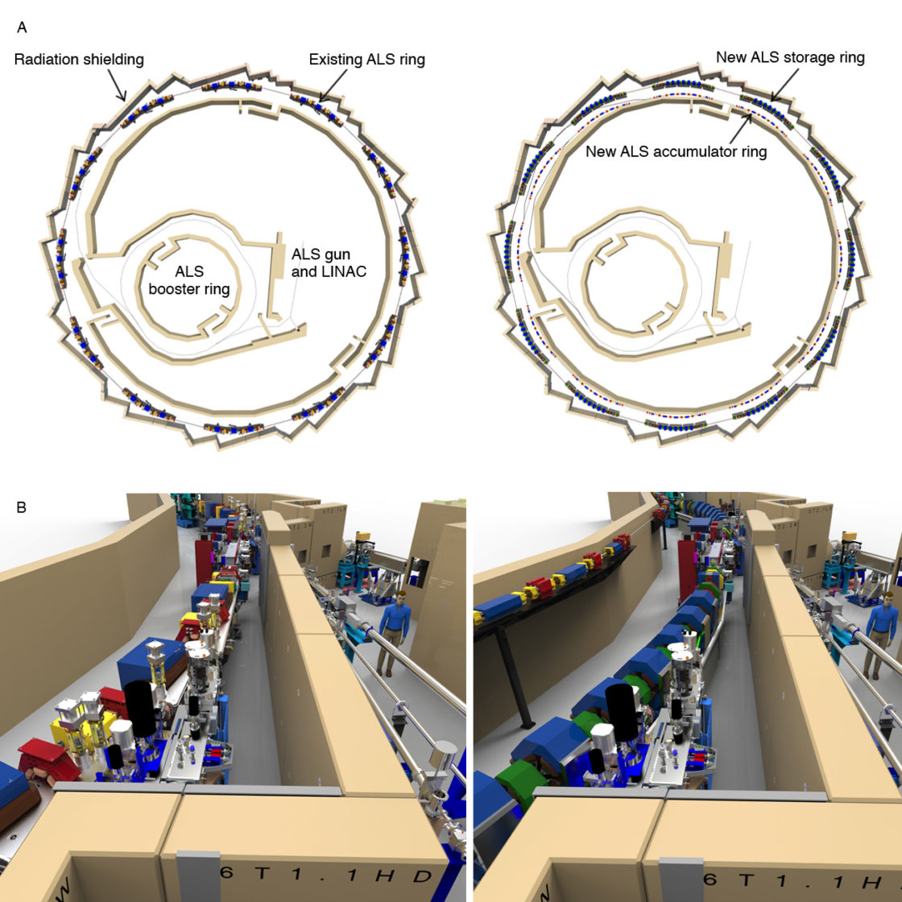
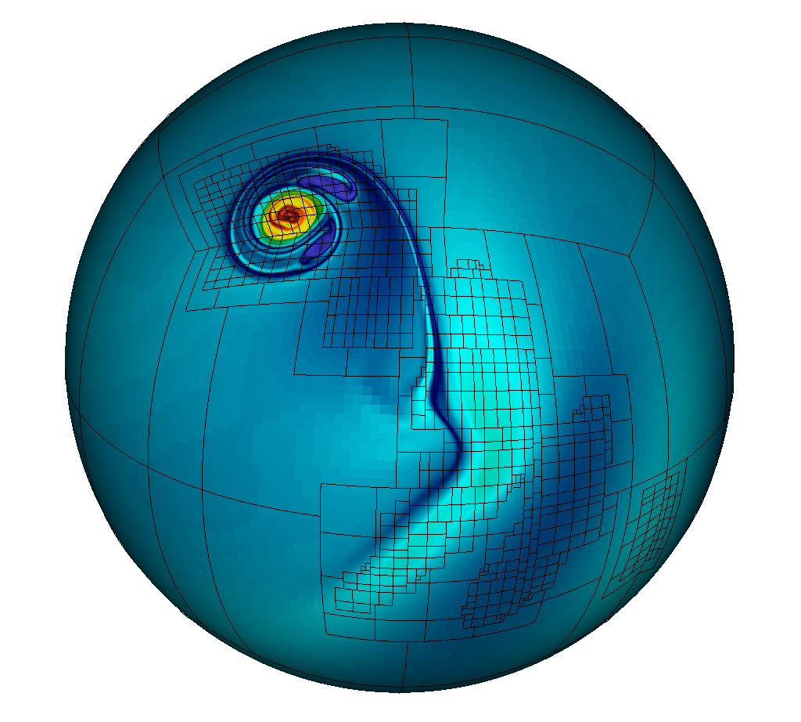
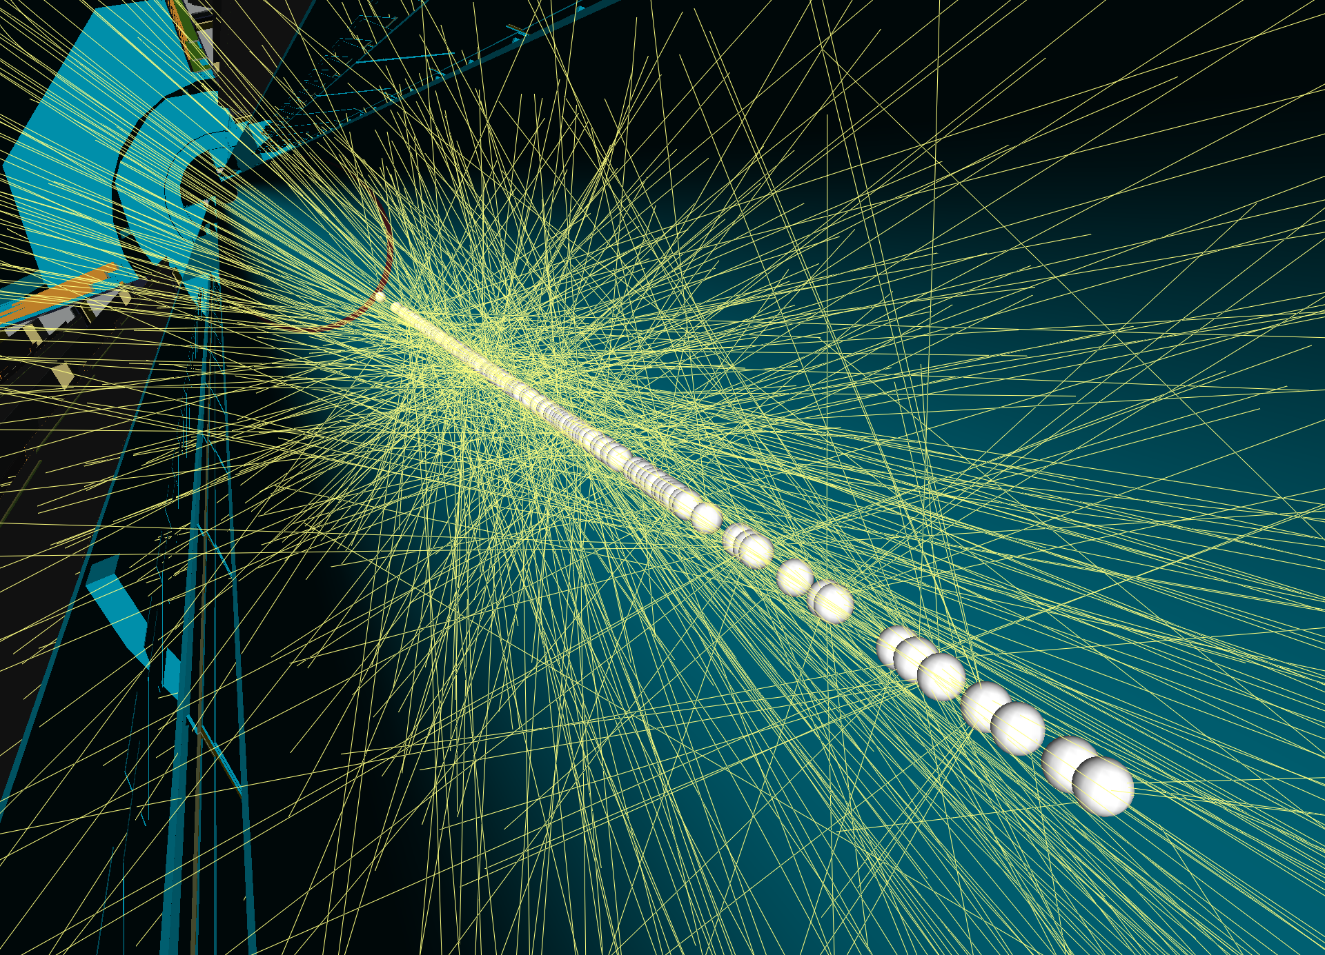
Mountains of Scientific Data Wait for Analysis
Light Source
180 PB/year
(ALS-U at Berkeley Lab )
Genomics
10 PB/year
Climate
100 EB/year
High Energy Physics
200 PB/year
Data and Picture source: L. Nowell, D., Ushizima, JGI and ALS at LBNL, etc.
Notes:
Here are a few examples of scientific research activities producing a large amounts of data

Slide 4
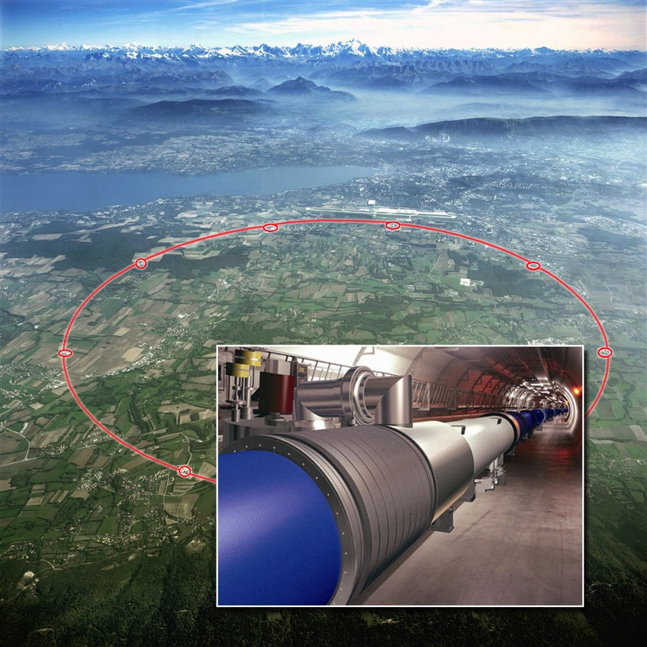
Example of Big Data in Science
Large Hadron Collider: to find the god particle
15 PB per year kept – sensors capable of 140PB/s
27 km tunnel
~10,000 superconducting magnets
Operating temperature 1.9 Kevin
Construction cost:
  US$9Billion
Power consumption:
~120 MW
Notes:
Here is more information about a specific high-energy physics experiment

Slide 5
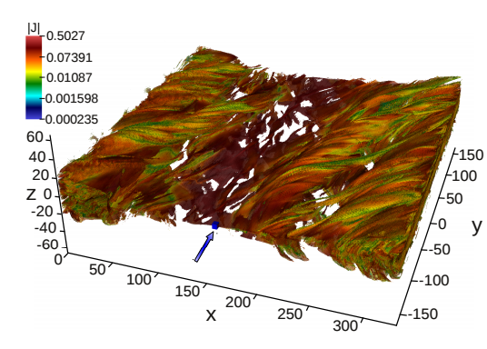
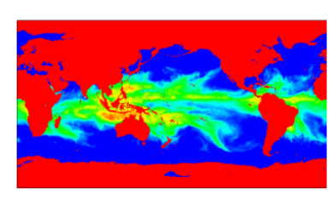
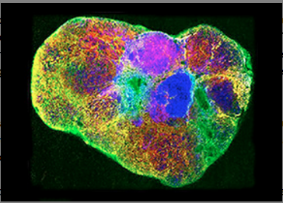
Example: Small Amount of Data Often Holds Key
Physics: 3D magnetic field reconnection
  Energy > 10 && 157.654 < x < 1652.441 && −165 < y < −160.025 && −2.5607 < z < 2.5607
Climate: atmospheric river
  spatial constraint (north America) and attribute constraints (Integrated Water Vapor > 2cm))
Life sciences: Mass Spectrometry Imaging
  spectra selection (x_{min}:x_{max}, y_{min}:y_{max}, m/z)
How to locate and retrieve these records?
Notes:
Scientific data analyses often need to look for the most relevant data, e.g., X-line in magnetic reconnection, atmospheric event (e.g., atmospheric rivers) from climate models and so on.

Slide 6
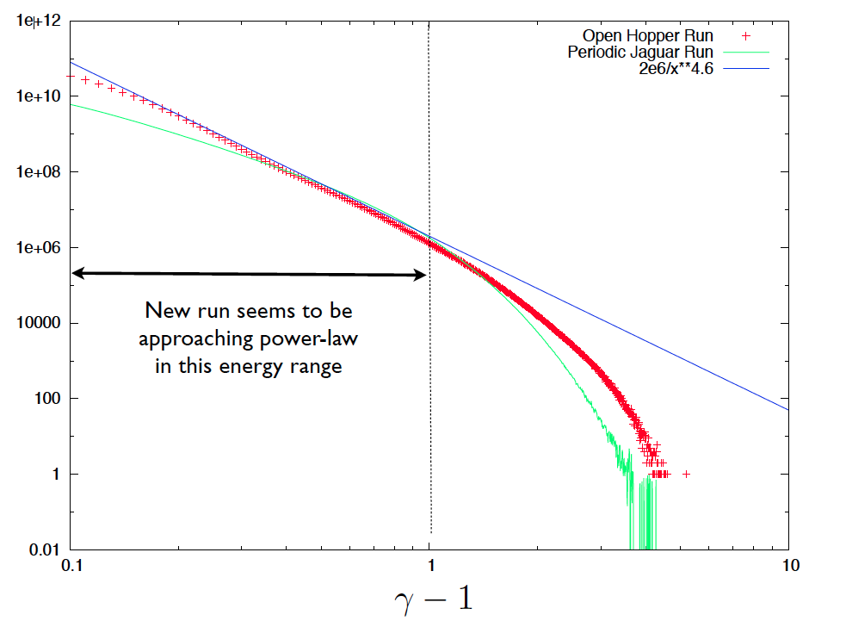
Example: Feature Extraction from Large Data
  Magnetic reconnection
  Applications: magnetic confinement fusion, solar wind
  Data from simulation of trillions of ions and electrons
Example: space weather simulation on 120,000 hopper cores @NERSC
  20,000 MPI tasks * 6 OpenMP threads
~35TB per timestep
Total ~350TB
Example science result
  Histogram of particle energy distribution appear following the power law
Challenge
How to quickly and easily compute the power spectrum from 350TB of raw data?
Byna et al SC2012
Notes:
Next task compute some global statistics, e.g., power spectrum

Slide 7
Example: Online Comparative Analytics
Simulation Site
Experiment/observation Site
Exascale Simulation Machine + analysis
Perform some data analysis on exascale machine
(e.g. in situ pattern identification)
Experiment/observation Processing Machine
Parallel Storage
(Parallel) Storage
Archive
Archive
Analysis Sites
Analysis
Machines
Indexed subsets
Need to reduce EBs and PBs of data, and move only TBs from simulation sites
Indexed subsets
Analysis
Machine
Analysis
Machine
Reduce and prepare data for further exploratory
analysis
(e.g., data mining)
Shared
storage
Shared
storage
Shared
storage
Notes:
Comparative analysis is a prototypical use case of data from multiple sources – the requirement to perform the analysis online, i.e., in real-time, is required to help making decision regarding some aspects of data collection or is required because the simulation data is too large to store
Emphases:
Data analysis/reduction at the exascale is very very important. But some people need to move it to an analysis machine and that also has similar requirements
The different sites might share the same physical resources, but data movement is necessary

Slide 8
Scientific Data Management at Exascale
Outline
Introduction
Examples of Scientific Data Management
Deep Dive: FastBit Indexing
Deep Dive: FasTensor Automatic Parallelization Engine
Summary
John Wu
Notes:
Current work

Slide 9
Scientific Data Management in Computer Science
User-facing applications/services
Automated data reorganization
Intelligent data movement
Vertical storage management
Performance analysis
Algorithms
Scientific Data Management Research
Indexing/Querying
Tensor based operators for analysis
Data transformation
Distributed workflows
Motifs
Optimized runtime
File formats: ExaHDF5, ADIOS
Storage API: GPUDirect, Object Store
Hardware abstraction and hardware
Notes:
Where does scientific data management fits in computer science research?
More specific examples will follow

Slide 10
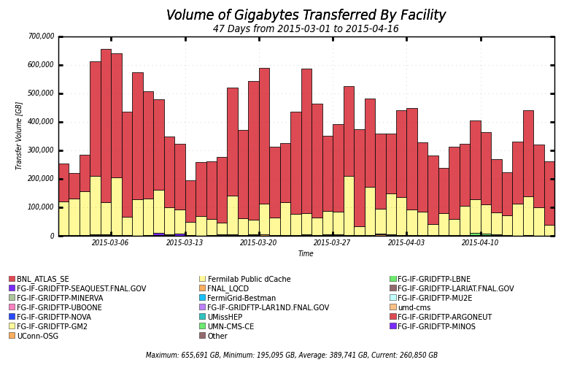
Berkeley Storage Manager (BeStMan)
-- Unified API for Many Storage Systems
What BeStMan does
  Unified API for accessing many storage systems
  Supports multiple transfer protocols and load balancing for multiple transfer servers
Implements Storage Resource Management (SRM) interface v2.2, and compatible and interoperable with other 4 SRM implementations in WLCG
Accomplishments
Open source under BSD license, distributed with OSG software
Scalable performance on many file systems and storages, such as Xrootd and Hadoop
Organized an international standard through OFG - GFD.129, 2008
US Patent 8,705,342 B2, 2014. Co-scheduling of network resource provisioning and host-to-host bandwidth reservation on high-performance network and storage systems
Impacts
Improve user productivity with a unified API for many storage systems
43 BeStMan deployments worldwide and 5 backend deployments for CERN EOS system, as of 2015
Being used in scientific collaborations such as ESGF, OSG, and WLCG
Daily data transfer volume in OSG from 3/1/2015 to 4/15/2015. BeStMan is used to transfer 100s TB/day in OSG.
Notes:
Provide uniform interface for storage systems(following SRM standard)
Dozens of deployments
100s TB data moved per day

Slide 11
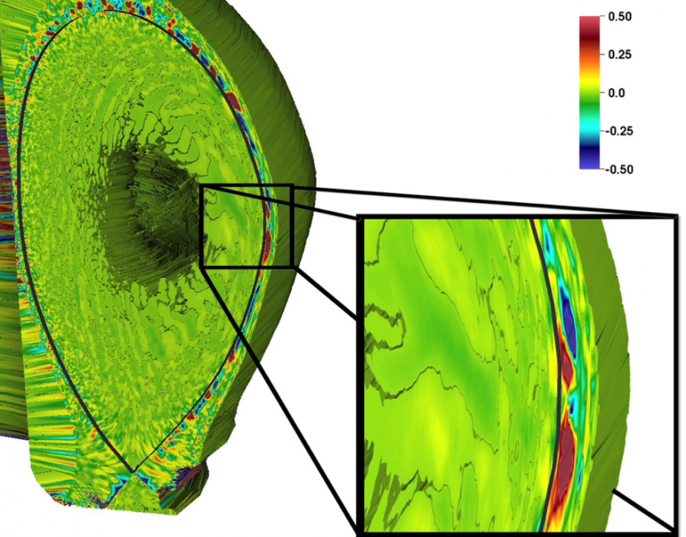
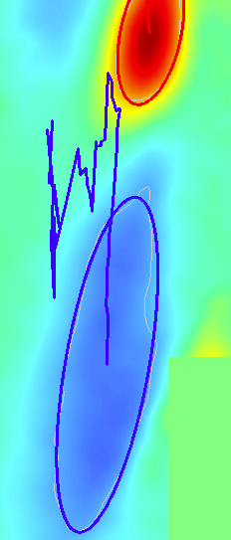
Feature Extraction: Near Real Time Detection of Blobs
Fusion plasma blobs
  Lead to loss of energy from tokamak plasmas
  Could damage multi-billion tokamak
Experimental facility may not have enough computing power for necessary data processing
Distributed in transient processing
  Make more processing power available
  Allow more scientists to participate in data analysis and monitor the experiment remotely
  Enable scientists to share knowledge and expertise
Lingfei Wu, Alex Sim, Jong Choi, M. Churchill, K Wu, S Klasky, CS Chang
10.1109/TBDATA.2016.2599929
Blob trajectory
Blobs in fusion reaction
(Source: EPSI project)
Notes:
End-to-end process
Near-real-time decision
Simulated data

Slide 12



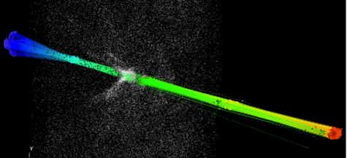
FastBit Indexing
Problem: given a large data collection, quickly find records satisfying user-specified conditions
  Example: in billions of high-energy collision events, find a few thousand based on energy level, number of particles and so on
Solutions
  Algorithmic research: developed new indexing techniques, achieved 10-100 fold speedup compared with existing methods
  Efficient software: open source (2008), received R&D 100 award
Science use cases
  Laser Wakefield Particle Accelerator: FastBit acts as an efficient back-end for identifying and tracking particles (lower left figure)
  Combustion: FastBit identifies ignition kernels based on user specified conditions and tracks evolution of the regions
Testimonial “FastBit is at least 10x, in many situations 100x, faster than current commercial database technologies” – Senior Software Engineer, Yahoo!
1999
Start
research
2001
WAH
published
2004
WAH
patented
2006
- Query Driven Vis
- Published theory
2007
- FastBit released
- BioSolveIT TrixX
2008
- R&D100 Award
- Yahoo! began use
[Wu, et al. 2009]
Notes:
>15,000 downloads
Extensively used by IMG and other DOE applications
Used in commercial products and commercial applications
Grateful for the luxury of spending an decade to work on this technology!
Graphics:
-- top left: LBNL logo
-- top right: FastBit logo
-- bottom left: progression of a selected particle bunch, the color of dots varying from blue to red according to the momentum of the particles, as time progresses from left to right, the momentum of each particle in the bunch increases; the gray cloud of points are other particles in the simulation (not selected). FastBit selects the particles from each step according to the particle identifiers it has previously located through an interactive selection process.
-- bottom right: an abbreviated time line of FastBit development. A fuller version is available upon request. Here are some explanation of the items listed
1999: start research work
2001: 1st publication of WAH compression shown it significantly improve the speed of answering queries
2004: WAH patent granted by US patent office
2006: Query Driven Visualization began to take shape with FastBit as the backbone. This builds upon a number of earlier collaborations between the Scientific Data Management group and the Visualization group of LBNL. This year we also published a major theoretical analysis of the compression algorithm (WAH) used in FastBit.
2007: FastBit officially released to the public in August of 2007. A Germany company BioSolveIT started to explore using it for a new technique for molecular docking, a virtual screening tool used by many pharmaceutical companies for select useful molecule for developing new drugs.
2008: Won R&D 100 Award. Yahoo! Research started exploring using FastBit for management of advertisements. The quote was from a engineer on this project.
Techniques
-- new compression method: Word-Aligned Hybrid (WAH) compression, (1) WAH compressed equality index is 14X faster than a similar indexing method in ORACLE database system, (2) analysis shows that WAH compressed index is theoretically optimal, which places it among the best of database indexing methods
-- new bitmap indexing methods: multi-level bitmap indexes, particularly, the two-level interval-equality index and the range-equality index are not much larger than the commonly used equality index, but can answer queries as much as 10X faster (both in theory and in practice)
-- new binning techniques for bitmap indexes: binning the data to a lower resolution, augment bitmaps with order-preserving bin-based clustering (OrBiC). Since most of the user queries use constants of relatively lower precision, commonly one- or two-digit precision, such as 1,000,000 (=10⁶, which has 1-digit precision) and 25,000 (=2.5x10⁴, which has 2-digit precision), the indexes with one- or two-digit precision can answer these queries accurately. Even when the binned index is not able to give a precise answer, the OrBiC data structure can significantly reduce the amount of data needed to be accessed in order to answer a query
Applications:
Laser Wakefield Particle Accelerator: Our work with this group is more recent, FastBit is used as the back-end of a visual analytics engine for identifying and tracking particles. This capability is used by the application scientists for identifying the coherent groups of accelerated particles (which are the desired output from such an accelerator) and track their formation process. Details of the work can be found in Proc. SciDAC 2009 and SC08.
Combustion data analysis: in this application, the objects of interest are ignition kernels, i.e., the regions where burning started. The application scientists first explore different ways of defining these ignition kernels. In this process, it is critical to be able to find ignition kernels quickly and provide preliminary statistics about them. FastBit’s efficient search capability is critical in this process. Additionally, we worked on grouping the points in space efficiently into connected regions.
FastBit has been used in a number of commercial applications. For example, Jochen Schlosser and Matthias Rarey developed a new virtual drug screening tool named TrixX-BMI, and showed that it can screen libraries of ligands 140--250 times faster than the state of art screening tools (see page 18 of their presentation at ACS Fall 2007 meeting, full article in J. Chem. Inf. Model., Article ASAP, DOI: 10.1021/ci9000212). TrixX-BMI is to be marketed by BioSolveIT of Germany. Yahoo! Inc. is also using FastBit to handle some advertisement related data. The quote in the last bullet is from a Senior Software Engineer working on the project.

Slide 13
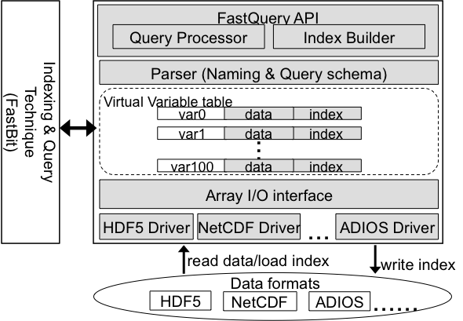
FastQuery: Parallel Queries on Science Files
Key Ideas
  Provide uniform array interface for scientific data in commonly used file formats, e.g., HDF5, ADIOS, and NetCDF
  Provide efficient searching functionality on top of existing user analysis frameworks while expand data handling capability and improve user productivity
Results
Indexed and queried a trillion particle dataset for studying magnetic reconnection (or “space weather”)
  Built index in 10 minutes
  Located highly energetic particles in seconds
“This is the first time anyone has ever queried and visualized 3D particle datasets of this size.” -- Homa Karimabadi, Physicist from UCSD
  Particle distribution of highly energetic particles around the region of magnetic reconnection. The off-centered and oblong distribution confirms the existence of a previously speculated property known as agyrotropy.
Notes:
HDF5, ADIOS-BP and netCDF are three of the most frequently used file formats in all three DOE leadership-class-facilities. A recent survey of NERSC usage statistics confirmed this observation. These formats are well-known to be used by many user communities world-wide (e.g. NetCDF used by Climate communities, HDF5 by astrophysics communities)
FastQuery enables the users to query and index their data files without putting their data into a database management system or loading their data into another system. These systems typically produce a second copy of the data files. Since the scientific data sets are usually very large, avoiding making the second copy can significantly reduce the cost of analysis operations. FastQuery can be incrementally introduced into an existing data analysis workflow and seamlessly increases the analysis capability. In many cases, as demonstrated in this use case involving magnetic reconnection simulation data, FastQuery provides a new way to accessing large data files.
FastQuery developers are directly working with HDF5 developers to improve the accesses to HDF5 files (through the ExaHDF5 project). The particular example given on this slide is using HDF5. We have modified VPIC code to output HDF5 files to significantly simplify the files produced by the VPIC code. A number of commonly used simulation codes, including S3D and Chombo are producing HDF5 outputs.
Magnetic reconnection also known under a couple of other names such as X-point, magnetic portal, or electron diffusion region, is a key mechanism for creating the aurora in the polar regions. It could also cause severe disruptions of satellite communication systems. Studying magnetic reconnection is a critical part of understanding “Space Weather.”
Agyrotropy is postulated as an important measurable feature of magnetic reconnection. A satellite mission designed to measure agyrotropy has been planned for 2014. However, due to lack of tools for handling the large amounts of particle data produced from simulations, this feature has not be observed in the simulation data. Without FastQuery, Homa's team was using summary statistics to do their analyses, NOT using the particle data. The set of tools we have developed (together with ExaHDF5 project) enabled Homa to directly work with the particle data. We are the first to provide direct evidence from simulations.
We are able to produce FastBit index for more than 1 trillion particles in about 10 minutes. This is an impressive speed because in 10 minutes some database systems may only index a few million data records. We are able to locate the high energy particles used for producing the agyrotropy plot in about 3 seconds. Without proper indexes on the data, the data management system would have to read data at more than ten terabytes per second in order to complete the same task in the same amount of time. The file system we used has a peak theoretic I/O rate of about 35 GB/s. Clearly, indexing is essential in reducing the data access time.

Slide 14
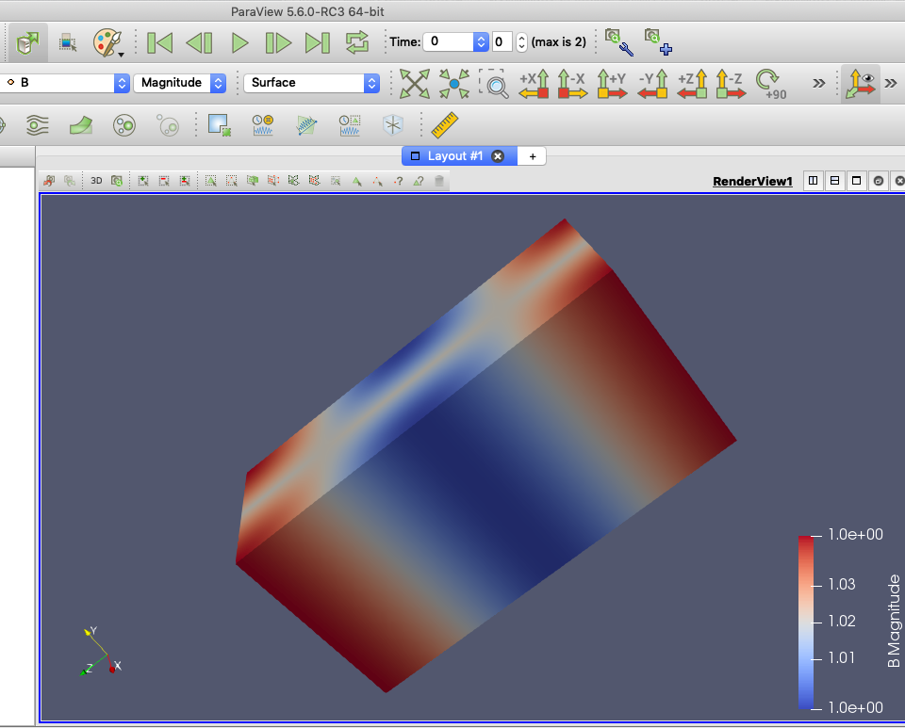
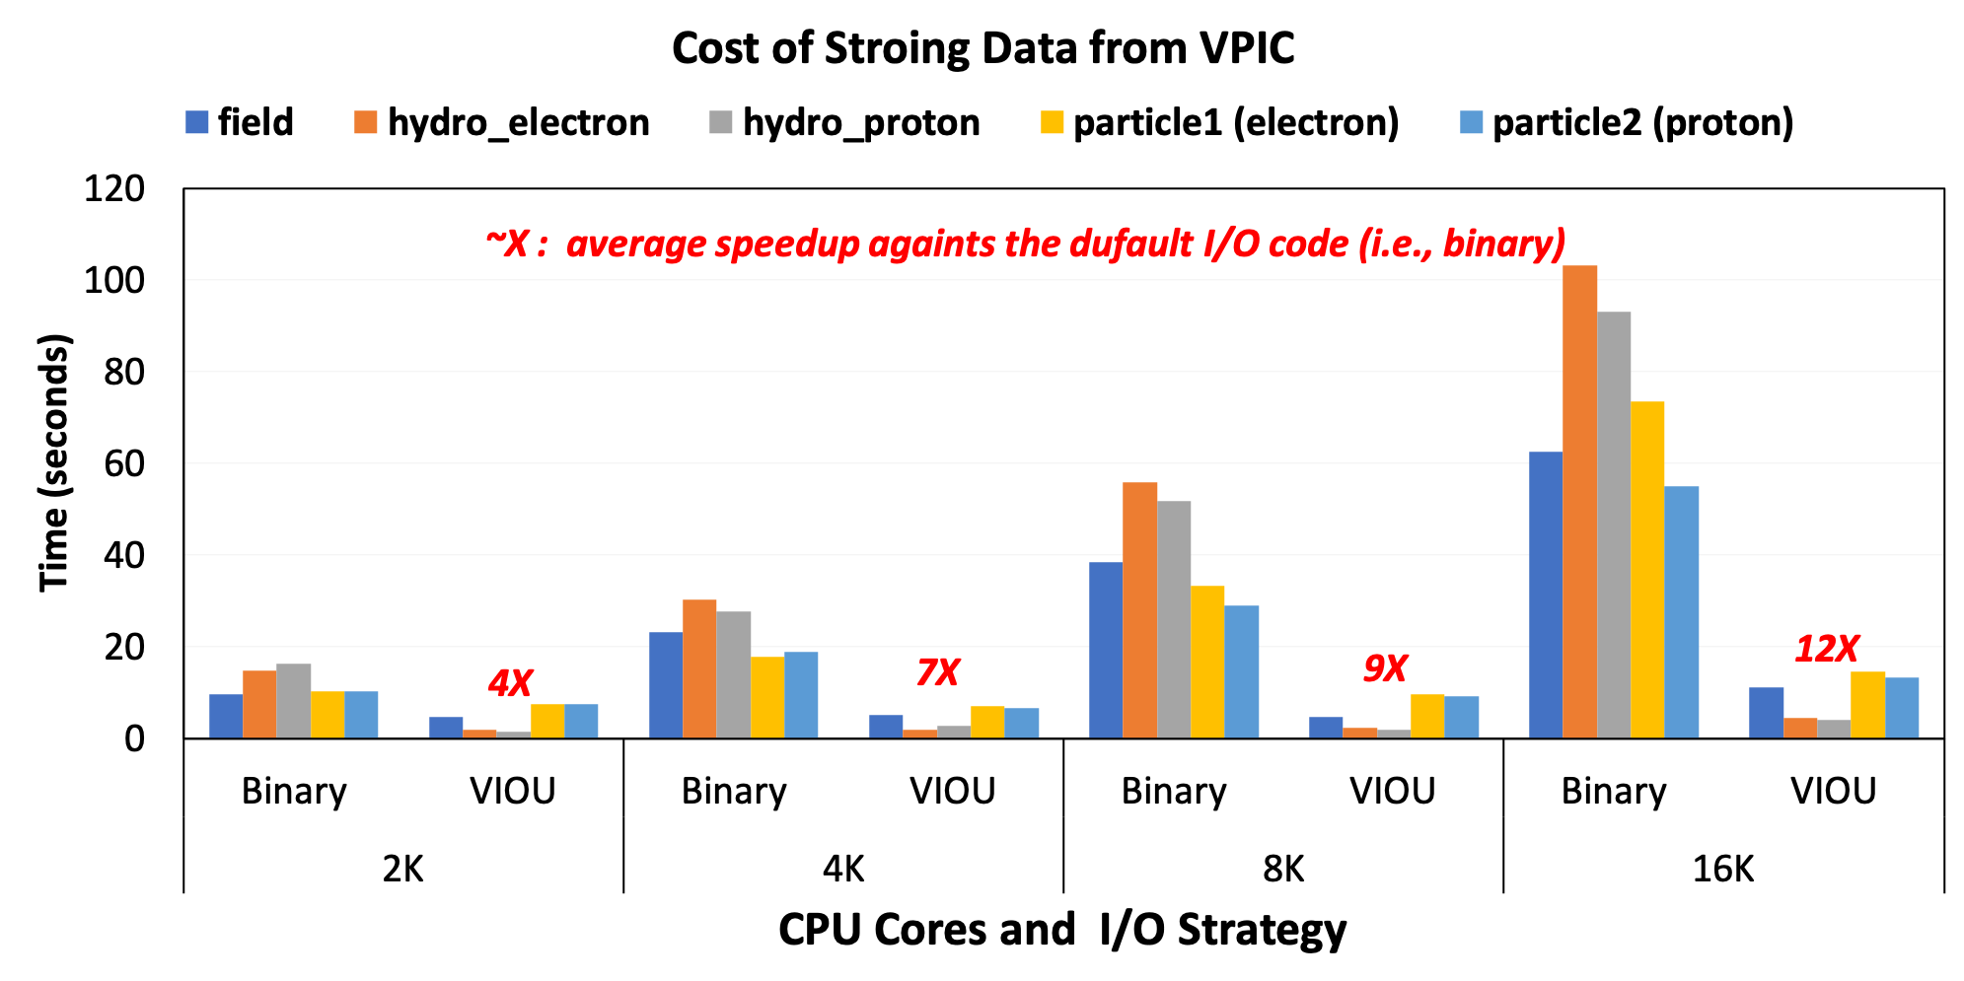
VPIC IO Utilities(VIOU) for Fast Output
Scientific Achievement
Reduce the cost of producing output files from a popular general purpose particle-in-cell simulation code VPIC for modeling kinetics of charged plasmas in magnetic fields. Due to the large number of particles need to represent plasma in magnetic field, the checkpointing files are very large. This utility leverages HDF5 to reduce I/O cost and generate portable self-describing output files.
Significance and Impact
The VIOU is going to be merged into the main VPIC repo at github by LANL
The VPIC has wide applications in particle accelerators, space weather, and so on.
Research Details
Explore parameter space for I/O operations: collective I/O, stripe size, number of OSTs, multiple (sub-)files, compound data structure, async I/O, and so on.
Find the parameter combinations to optimize I/O performance
XDMF based Visual Inspection in ParaView and others
Developer : Bin Dong, Suren Byna, Kesheng Wu (LBNL)
Other Collaborator: Patrick Kilian, Borb Bird, Fan Guo, Qile Zhang (LANL),Scot Breitenfeld (HDF5)

Slide 15
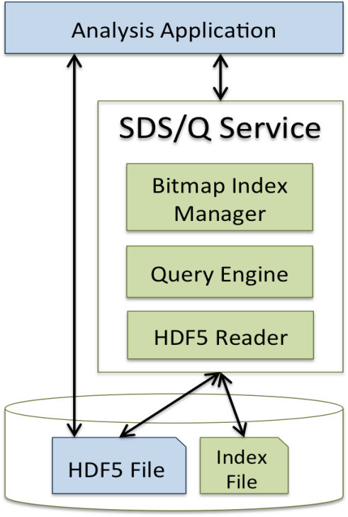
Working Directly with Scientific Data Files is Good for Performance
IMD
Problem
Key Ideas
  Astronomy project Palomar Transient Factory (PTF) produces ~10GB image every 45 minutes
  Currently, data is loaded into a PostgreSQL database system
  Loading takes nearly 45 minutes, thus preventing real-time data analysis
  Parallel query processing directly on data files
  Avoid costly loading of data to database management systems
  Leverage efficient FastBit indexes
  Implement database techniques to answer queries
Results
  Answering complex queries directly on scientific data files
Complete the PTF query 40X faster than PostgreSQL, and 10X faster than Hive, the Hadoop database system
Reduce the data loading time from 45 minutes to about 1 minute
Direct access of files is preserved for applications that need it
SDS query service combines advanced indexes with query planning to accelerate data access
[Blanas, et al. SIGMOD 2014]
Notes:
Introduction
Scientific data is often stored in array data formats such as HDF5, NetCDF, and ADIOS BP
often a small part of large datasets holds the most important information, querying is the term to describe the request to locate these selected data records from a data management system
Support for querying from scientific data files is still in research stage
Complex querying functions such as join operations (which requires a cross product of two or more data tables) need database management systems, such as SciDB, SciQL, ArrayStore, etc.
Using databases requires a costly conversion of data
Results produced by databases need another costly conversion to a format that scientific analysis pipeline, e.g. visualization, understands
We develop a Querying component in the Scientific Data Services (SDS/Q) to support in situ (i.e. ability to query data directly in their native form) parallel analysis of data stored in the HDF5 file format.
We test SDS/Q for detecting supernovae using a real cosmology dataset from Palomar Transient Factory (PTF)
Technical Challenges
SDS/Q has to rely on the HDF5 library for fast data access, which needs tuning depending on the hardware and parallel I/O stack available on a large-scale system
SDS/Q does not have the opportunity to reorganize the original data because legacy applications may manipulate the HDF5 file directly
SDS/Q needs to leverage the abundant parallelism of large-scale supercomputers, which is exposed through a batch processing execution environment
Solutions and Results
Implementation of SDS/Q leveraged on the chunking feature of HDF5 to optimize data accesses
SDS/Q uses FastBit bitmap indexes to speed up highly selective queries
Considering end-to-end time including data conversion, indexing, and querying times, SDS/Q completes the 1st PTF query 40x faster than PostgreSQL
Compared to Hive, a Map-Reduce data analysis framework that can directly work on scientific file formats, SDS/Q completes the 1st PTF query 10X faster

Slide 16
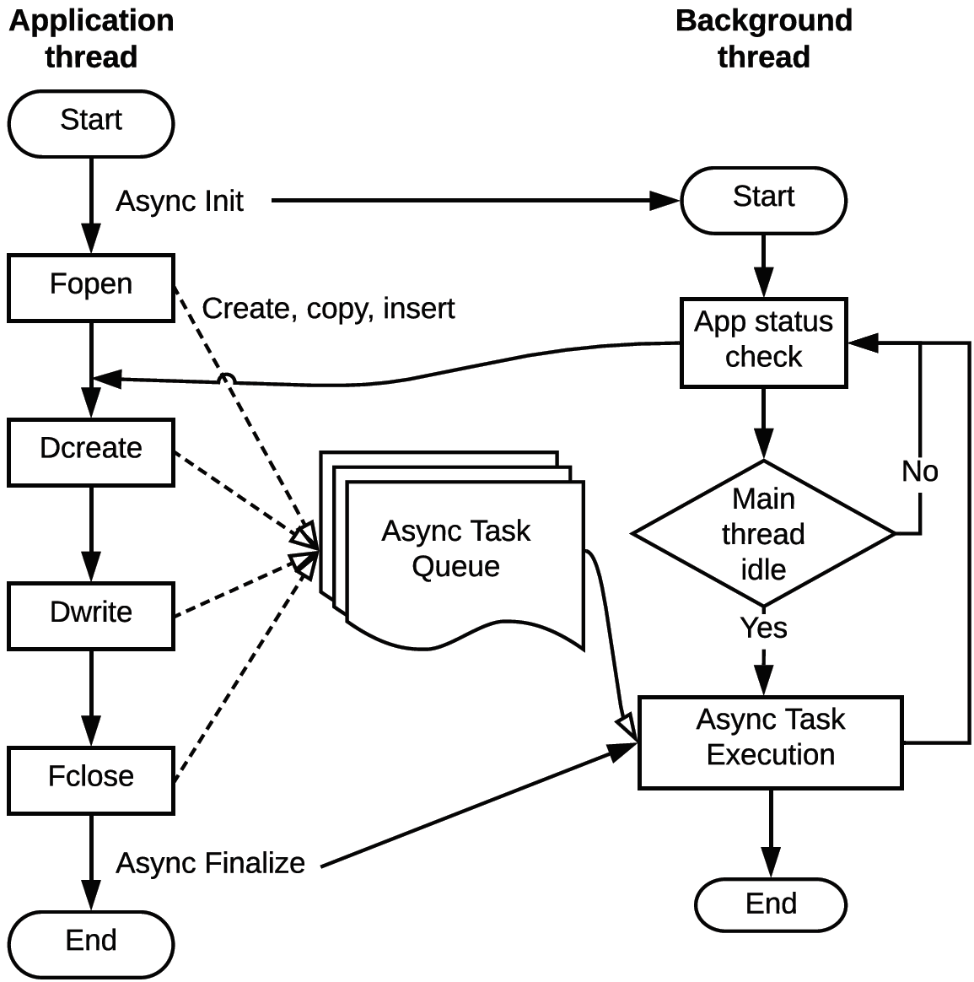
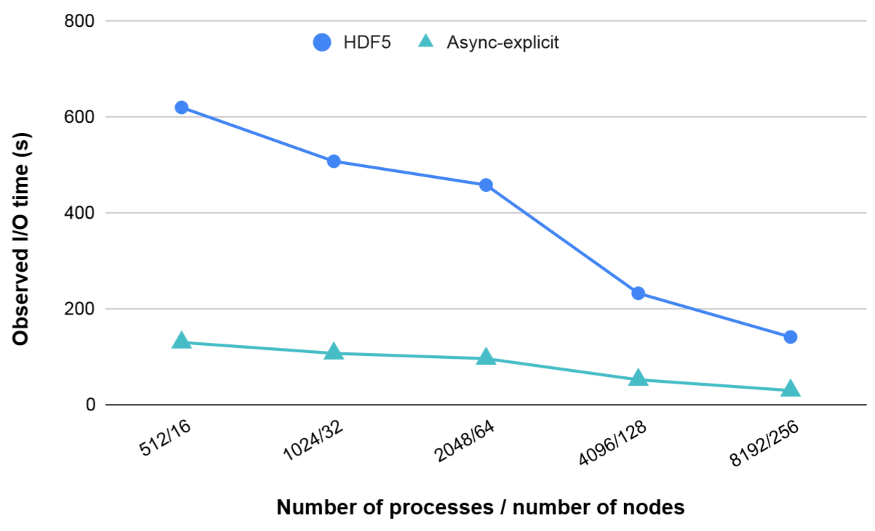

Asynchronous HDF5 Reduce Output Latency
Scientific Achievement
I/O latency can slow down applications and waste precious computing resources while they wait to move data between storage and memory. Asynchronous I/O in HDF5 hides data movement costs by executing I/O operations in the background.
Significance and Impact
Applications can use asynchronous I/O without major code changes
Performance evaluation demonstrates multi-fold speedup for applications that read/write data periodically
Research Details
Asynchronous I/O, developed as an HDF5 VOL connector, uses background threads to execute I/O operations asynchronously
Two modes are supported:
  Implicit mode for unmodified applications, but less performance benefit
  Explicit mode for applications that want more control of I/O operations to fully benefit from asynchronous operations
Asynchronous I/O can hide the majority of application I/O time by overlapping it with time spent computing or communicating, making I/O visible only at the last time step for write or the first step for read
Castro/AMReX performance on Cori between the default synchronous 5 asynchronous (explicit mode) writing 5 timesteps of data . Observed I/O time includes the last timestep's write time and the overhead of the asynchronous I/O framework for all timesteps. 2-4x improvement seen in observed I/O performance.
H. Tang, Q. Koziol, S. Byna, J. Ravi, "Transparent Asynchronous Parallel I/O using Background Threads", IEEE TPDS Special Section on Innovative R&D toward the Exascale Era, 2021.
Notes:
TALKING POINTS:
Approaching exascale computing, accessing data across the storage hierarchy can take longer than the data generation or analysis.
Asynchronous I/O can reduce the I/O impact, as it allows applications to schedule I/O as early as possible and to check their status later.
POSIX and MPI-I/O provide asynchronous read and write operations but lack support for non-data operations such as file open and close. Users also have to manually manage data dependencies and use low-level byte offsets, which requires significant effort and expertise to adopt.
The proposed asynchronous I/O framework supports all types of I/O operations, manages data dependencies transparently and automatically, provides implicit and explicit modes for application flexibility, and allows error information retrieval.
Our asynchronous I/O framework is highly effective and has a very low overhead for managing asynchronous tasks. It achieves up to 4.9X speedup when reading or writing 5 timesteps of data by I/O kernels and real application workloads.
METADATA:
Name of the associated awarded project: ECP-ExaIO: Delivering efficient parallel I/O with HDF5 and UnifyFS
PI name(s): Suren Byna (LBNL)
Name of the program manager / project lead: Doug Kothe
Award number (or FWP if known):
CITATIONS:
H. Tang, Q. Koziol, S. Byna, J. Ravi, "Transparent Asynchronous Parallel I/O using Background Threads", Accepted for publication in IEEE TPDS Special Section on Innovative R&D toward the Exascale Era, 2021.
Houjun Tang, Quincey Koziol, Suren Byna, John Mainzer, and Tonglin Li. "Enabling Transparent Asynchronous I/O using Background Threads." In 2019 IEEE/ACM Fourth International Parallel Data Systems Workshop (PDSW), pp. 11-19. IEEE, 2019.

Slide 17
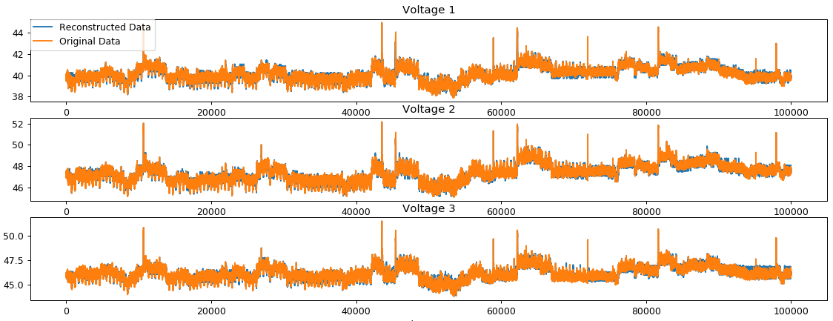
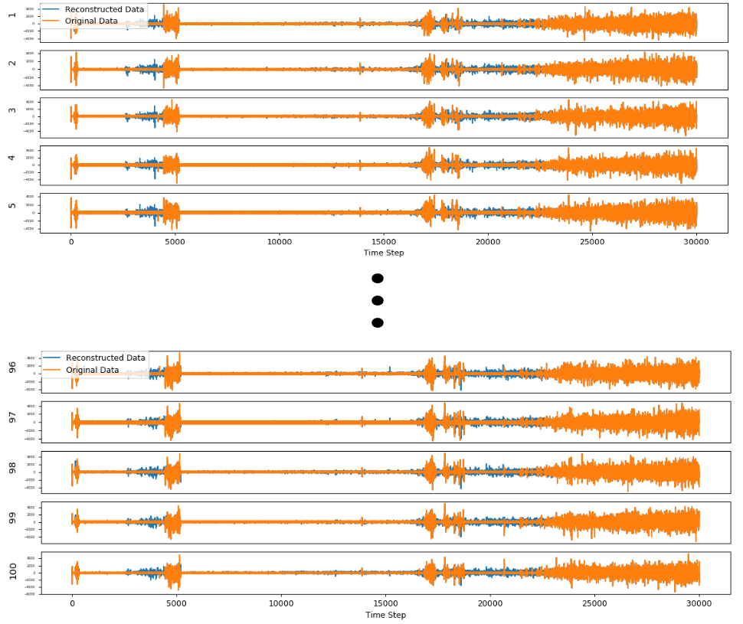




Similarity-based Compression with Multidimensional Pattern Matching
Scientific Achievement
  Newly extended the IDEALEM (Implementation of Dynamic Extensible Adaptive Locally Exchangeable Measures) algorithm to support 2D and N-dimensional data with multidimensional similarity features
Significance and Impact
  We developed extended approaches in statistical similarity based data compression algorithm with multidimensional pattern matching, which is a promising alternative to leading lossy compression algorithms.
Research Details
  Our study extended the algorithm to support multi-dimensional measures with Dynamic Time Warp (DTW) and Minimum Jump Cost (MJC).
  IDEALEM also offers transforming non-stationary data such as phase angle of electricity data into locally stationary block to promote exchangeability/similarity
  IDEALEM method supports event/feature detection directly on the compressed data.
  IDEALEM can be applied to photos and videos, in addition to scientific multidimensional floating point data.
  U.S. Patent No. 10,366,078, 2019
(a)
(b)
(c)
(d)
CR=7.71
original
CR=19.61
CR=57.65
(a) Compression on 3-dimensional power grid measurements
(b) Compression on the distributed acoustic sensing measurement dataset with 100 dimensions
(c) Compression on the phase angle of electricity measurement data, with CR= 56.56
(d) Photo compression sample: Original photo (2560x1440). Each of ~3.68 million pixels has three dimensions of color (RGB).
O. Del Guercio, R. Orozco, A. Sim, K. Wu, "Similarity-based Compression with Multidimensional Pattern Matching", the 2nd International Workshop on Systems and Network Telemetry and Analytics (SNTA 2019), 2019. doi: 10.1145/3322798.3329252
Notes:
We at LBNL have developed two new approaches to support 2D and N-dimensional data with multidimensional similarity features in IDEALEM.
IDEALEM stands for Implementation of Dynamic Extensible Adaptive Locally Exchangeable Measures, and previously we had publications in SSDBM2016, SSDBM2017, BigData2018, and DCC2019.
It is a dictionary based compression method with alternative statistical measures of distance, such as distributional distance/similarity of two random variables. It can achieve as much as 200+ times of compression ratio.
Original IDEALEM algorithm only supports one dimensional data with K-S test. This work is about extending the algorithm to support 2D and N-dimensional data.
From many alternative similarity measures, we selected Dynamic Time Warp (DTW) and Minimum Jump Cost (MJC).
DTW performs nonlinear “warping” on the sequences where differences in time are not penalized. For time series of length n, it is necessary to do n² computations (through dynamic programming)
MJC works by accumulating the cost of jumping forward from one time series data point to the nearest data point in the other time series. Instead of calculating all n² distance values of between x and y, only the distance between points of index greater than the recursive starting point are calculated. We expect reduced runtime.
IDEALEM also supports transformation of the non-stationary data such as phase angle of electricity data into locally stationary block to promote exchangeability or similarity, which would work with our statistical methods.
IDEALAM supports event or feature detection directly on the compressed data without decompression, which most of the compression methods require.
Now, IDEALEM method can be applied to photos and videos, in addition to scientific multi-dimensional floating point data, which shows a sample in figure (d),
US Patent was achieved for this method in 2019.
Figure (a) shows our compression example on 3-dimensional power grid measurement data.
Figure (b) shows another example of IDEALEM compression on 100-dimensional, distributed acoustic sensing measurement dataset, which uses underground dark fiber.
Figure (c) shows a compression example with IDEALEM on the phase angle of electricity measurement showing the compression ratio of 56.56.
Figure (d) shows a compression example with IDEALEM on photo images (image courtesy by Nina Fox from Hawaii). Original photo has 3.68million pixels, each pixel having 3-dimensional (RGB) color. With the compression ratio of 57.65, the compressed photo shows slight distortions in the sky area. To the human eyes, the compression ratio of about 20 doesn’t make much differences from the original photo.
The work has been published in the SNTA workshop in 2019.
Contact: K. John Wu <KWu@LBL.Gov>
Contributions: K. John Wu, Alex Sim, Lawrence Berkeley National Laboratory

Slide 18
Scientific Data Management at Exascale
Outline
Introduction
Examples of Scientific Data Management
Deep Dive: FastBit Indexing
Deep Dive: FasTensor Automatic Parallelization Engine
Summary
John Wu
Notes:
Current work

Slide 19
Basic Bitmap Index
First commercial version
  Model 204, P. O’Neil, 1987
Easy to build: faster than building B-trees
Efficient for querying: only bitwise logical operations
  A < 2 → b₀ OR b₁
  A > 2 → b₃ OR b₄ OR b₅
Efficient for multi-dimensional queries
  Use bitwise operations to combine the partial results
Size: one bit per distinct value per row
  Definition: Cardinality == number of distinct values
  Compact for low cardinality attributes, say, cardinality < 100
  Worst case: cardinality = N, number of rows; index size: N*N bits
Data
values
b₀
b₁
b₂
b₃
b₄
b₅
=0
=1
=2
=3
=4
=5
0
1
5
3
1
2
0
4
1
1
0
0
0
0
0
1
0
0
0
1
0
0
1
0
0
0
1
0
0
0
0
0
1
0
0
0
0
0
0
1
0
0
0
0
0
0
0
0
0
0
0
0
1
0
0
0
1
0
0
0
0
0
0
A < 2
2 < A
Notes:
Cardinality is the number of distinct values, in this example it is 6.

Slide 20
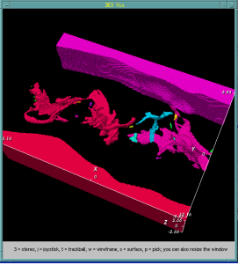
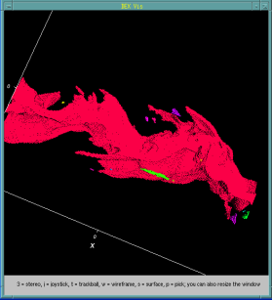
However, There is a Catch
The efficiency of bitmap indexes decreases as the number of distinct values increases!
Definition: column cardinality = number of distinct values of a column in a dataset
As column cardinality increase,
  The index size increases
  The query responses time increases
Some restrictions on using the bitmap index include: The indexed columns must be of low cardinality—usually with less than 300 distinct values.
  How and when to use Oracle9i bitmap join indexes, Donald Burleson, November 12, 2002
A value-based bitmap for processing queries on low-cardinality data. (Recommended for up to 1,000 distinct values …
  Introduction to Adaptive Server IQ, Ch 5, Sybase

Slide 21
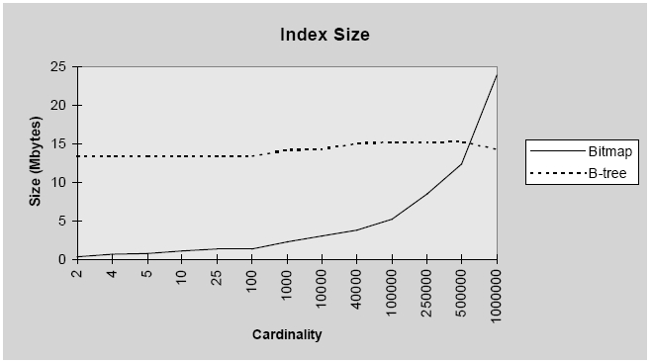
Curse of Cardinality: Evidences
Curse of
Cardinality
Index sides, adapted from a presentation by Hakan Jakobsson, ORACLE, 1997 (Stanford Database Seminar)
1 million rows (bitmap index compressed with BBC)
Sizes of compressed bitmap indexes increase with column cardinality – this is generally the case, not just in ORACLE, see formula below (VLDB’06)
Notes:
Emphasis added on the product terms

Slide 22
Ways to Improve Bitmap Indexes
Compression
  Byte-aligned Bitmap Code (BBC), used in ORACLE
  Word-Aligned Hybrid (WAH) code, used in FastBit, produce optimal bitmap indexes [Wu, et al. TODS 2006]
  In the worst cases, the index sizes are still larger than B-trees
Encoding [Wu, et al. TODS 2010]
  Many bitmap encoding schemes exist, the most compact is the binary encoding
  The binary encoded index (bit-slice index) is slower than the projection index in the worst case
Binning
  Designed to handle high-cardinality data, but needs to scan raw data, which makes it slower than the projection index
  Solution: Order-preserving Bin-based Clustering (OrBiC) [Wu, et al, 2008]

Slide 23
FastBit Technology 1: Compression
[Wu, Otoo, and Shoshani 2006]
Example: 2015 bits
10000000000000000000011100000000000000000000000000000……………….00000000000000000000000000000001111111111111111111111111
Main Idea: Use run-length-encoding, but...
partition bits into 31-bit groups [not 32 bit] on 32-bit machines
31 bits
31 bits
(62 groups skipped) …
31 bits
Merge neighboring groups with identical bits
0
31 literal bits
1
0
31-bit count=63
0
31 literal bits
32 bits
Encode each group using one 32-bit word
Name: Word-Aligned Hybrid (WAH) code (US patent)
Key features: WAH is compute-efficient
  Uses the run-length encoding (simple)
  Allows operations directly on compressed bitmaps
  Never breaks any words into smaller pieces during operations
  Worst case index size 4N words, not N*N (without compression)
Notes:
To minimize compressed size, one should work on the bit-level to have the maximum flexibility – slow.
To improve speed, most common strategies work on byte or word level. On a machine with 32-bit words, one would organize the bit sequence into 32-bit groups.
The key idea of WAH is to group raw bits into 31-bit groups instead of 32-bit groups.
Run-length encoding
Using one bit as flag, use the results of the bits in the word to encode counts.
Here is an example
The efficient compression schemes for bitmap indexes are based on run-length encoding
Break a bitmap into literal groups and counts
Thing don’t align properly, during operations, have to be broken into pieces which are slow to operate on
Reserve on bit for a flag, count in 31-bit groups. Every logical operation will only access whole words, which provide very efficient operations, 10-fold speed than best known compression method.

Slide 24
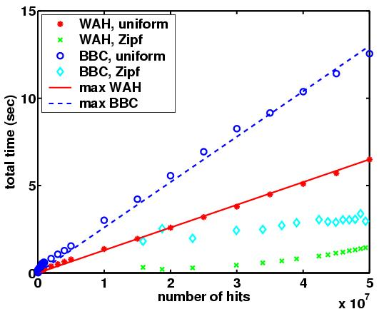
WAH Compressed Index Is Optimal
In the worst case, query response time is a linear function of the number of hits, H
WAH Compressed indexes are optimal for one-dimensional range queries, search time O(H)
Optimality
means
straight line
Better
BBC
WAH
Pentium 4, 2.8 GHz
40 MB/s disk array
100 M synthetic records
Expand this area

Slide 25
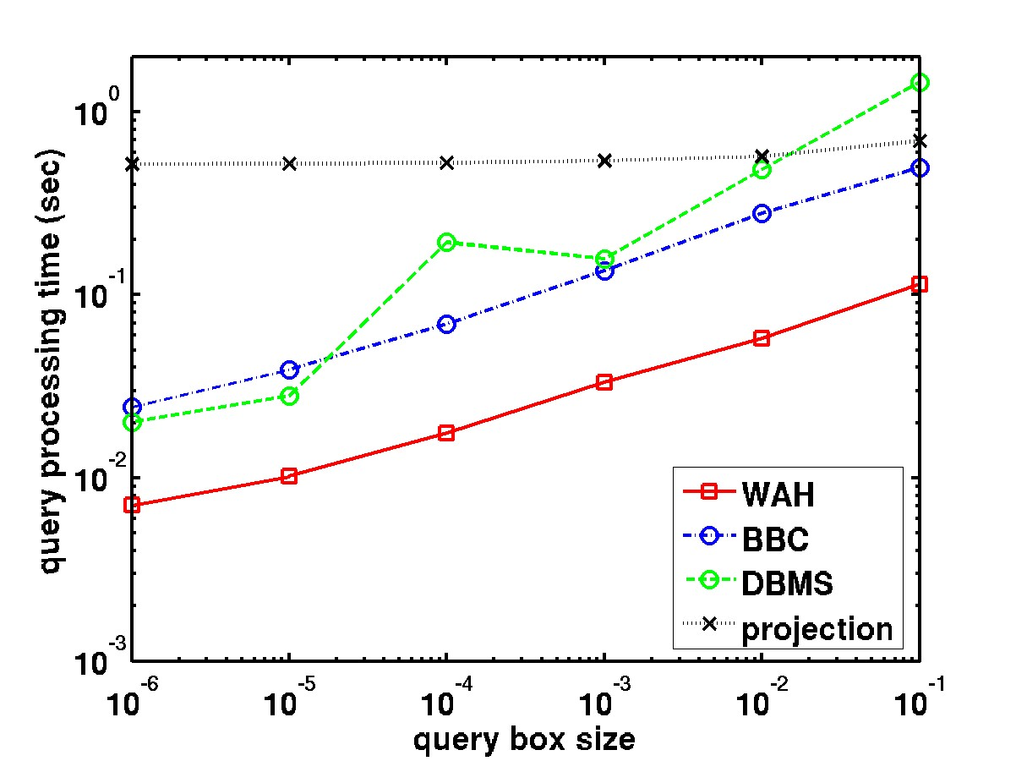
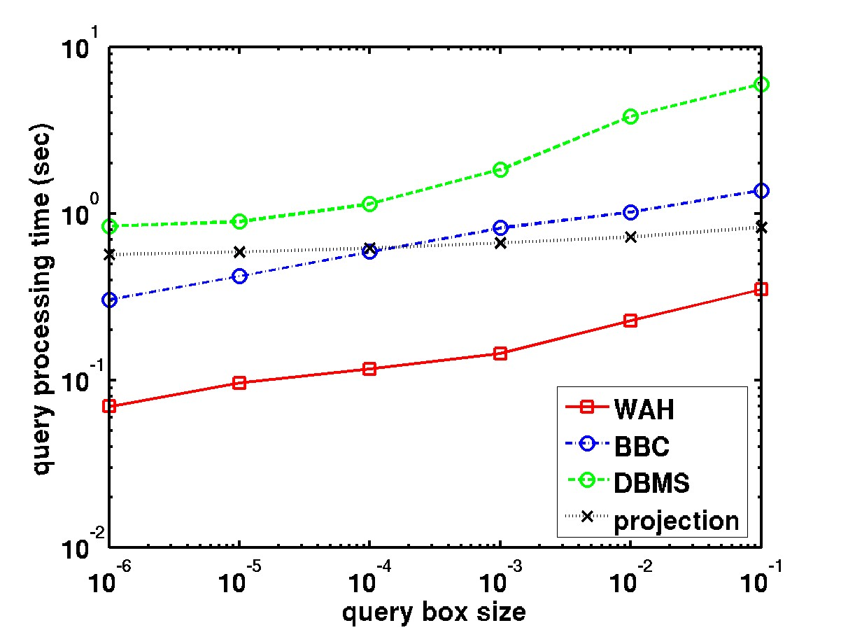
Compressed Index Performance
2-attribute queries
5-attribute queries
WAH compressed indexes are 10X faster than DBMS,
5X faster than our own version of BBC
Based on 12 most queried variables from a STAR dataset with 2.2 million rows, average column cardinality 222,000
Notes:
People believed bitmap indices don’t work well for high cardinality attributes

Slide 26
FastBit Technology 2: Binning
Binning reduce the number of bitmaps used in an index, which reduces index size and query processing time
Binning is also useful for building multi-level indexes (to be described next)
Challenge: if query falls in the middle of edge bins
Solution: Order-preserving Bin-based Clustering (OrBiC)
5x speedup for searching bins
edge
bin
range query
edge
bin
5 –1000
0-2
3-7
980-1007
0
1
0
0
0
0
.
.
.
coarse bins
1
0
1
0
1
1
.
.
.
0
0
0
0
0
0
.
.
.
.
.
.
.
.
.
.
.
0
0
0
0
0
0
.
.
.
0
0
0
0
0
0
.
.
.
0
0
0
1
0
0
.
.
.
0
1
2
3
fine level
0
0
1
0
0
1
.
.
.
1
0
0
0
1
0
.
.
.
0
0
0
0
0
0
.
.
.
0
1
0
0
0
0
.
.
.
0
0
0
0
0
0
.
.
.
0
0
0
1
0
0
.
.
.
…
only edge bins need
to be resolved at fine level
Notes:
Explain multi-level binning
Compression to be discussed later

Slide 27
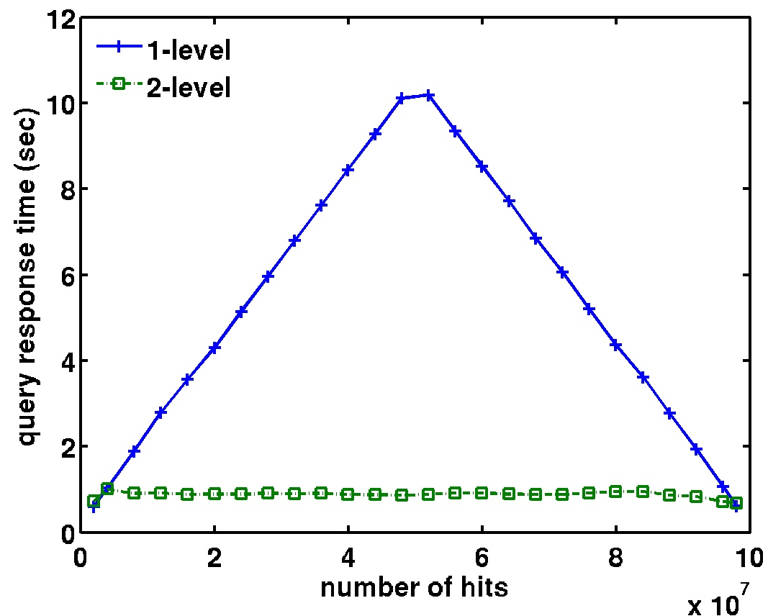
FastBit Technology 3: Multi-Level Encoding
Prove theoretically that the second level needs only a small number of bins (15 ~ 50 depending on the skewness of the data)
Only two levels are needed
Result: 5X speedup on average
Combined with WAH, could achieve 50X speedup
10X faster
[Wu, Shoshani and Stockinger 2010]
Notes:
TODS 2010, LBNL-60891

Slide 28
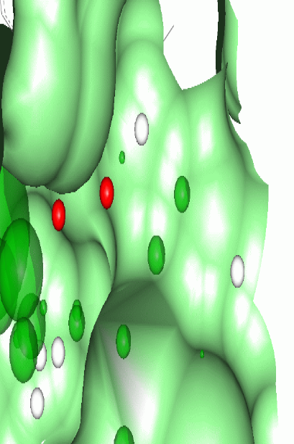
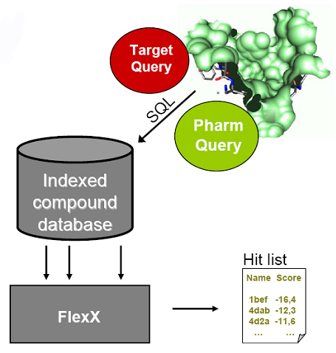
FastBit Application Example:
Molecular Docking
From: Jochen Schlosser [schlosser@zbh.uni-hamburg.de]
University of Hamburg
Application: Structure-based virtual screening (J. Chem. Infor. Mod., 2009)
Specification of the descriptor as triangle geometry
  Types of interaction centers
  Triangle side lengths
  Interaction directions
  80 bulk dimensions
Receptors
  Receptor descriptors are generated similarly
  Using complementary information where necessary
Use of pharmacophore constraints on receptor triangles
  Reduces number of queries
  Improved query selectivity because the pharmacophore tends to be inside the protein cavity
  250X faster than previous docking software

Slide 29
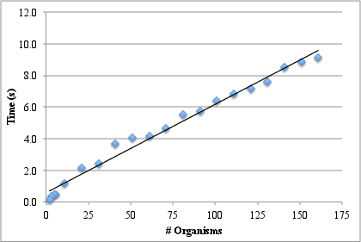
Gene Context Analysis Query Processing:
Timed out with DBMS; but <10 s with FastBit
Concentrate on maximal matches only
  Don’t list small matches
Progressively match more organisms
  Build up answers gradually, eliminate empty combinations
Performance
  Match 161 organisms in 10 seconds on 8000 genomes and 3.3 million cassettes
Available in IMG <https://img.jgi.doe.gov/> (Romosan et al.)
C1.1
1000111000000010
Step1: only 2 out of 6 combinations qualify
C1.2
1000001000000100
C1.3
1000000001100000
1000111000000000
C1.1
C2.1
0000001000000100
C1.2
C2.1
C2.1
1111111000000100
C2.2
0000000000111000
Step 2: only one combination qualifies
C3.2
0000001000000100
0000001000000100
C1.2
C2.1
C3.2

Slide 30
Scientific Data Management at Exascale
Outline
Introduction
Examples of Scientific Data Management
Deep Dive: FastBit Indexing
Deep Dive: FasTensor Automatic Parallelization Engine
Summary
John Wu
Notes:
Current work

Slide 31
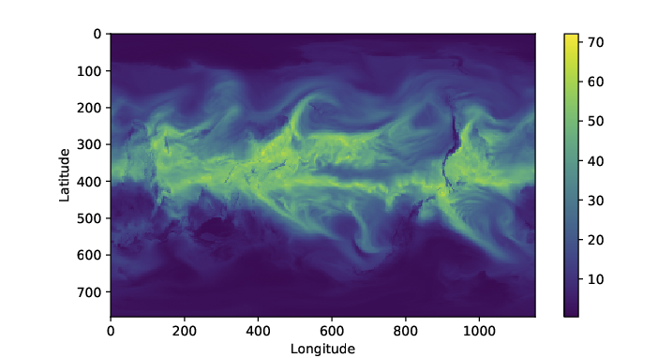
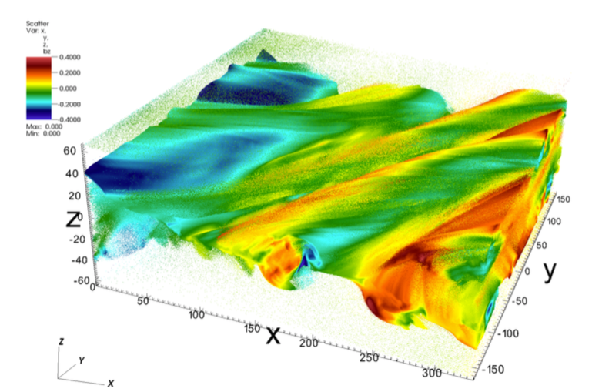
Parallelizing Scientific Data Analysis is Difficult
Myriad Analysis Operations
Data Management Tasks
Parallelization
Insight
… ...
HDF5/NetCDF/ADIOS/ ...
Deep Software Stack
MPI / MPI-IO / ...
Lustre / PVFS / ...
Linux / Ext4 / ..
Data in Storage System
Many Computing Nodes

Slide 32


Commercial Big Data Systems Simplify Parallel Computing
Data Parallel Programming: generic programming abstraction for various data analysis operations + execution engine to hide complex data management tasks
User-defined Operations
E.g., Searching, PageRank, SVD, Sorting, TF-IDF, BFS, ...
Generic Operators
e.g.,
Map, Reduce
Programming Model
e.g., MapReduce
Abstract Data Type
e.g.,
Key-value Tuple
Hardware and Software
e.g., desktop, grids, multi-cluster, volunteer computing environments, cloud environments, mobile environment, ...

Slide 33
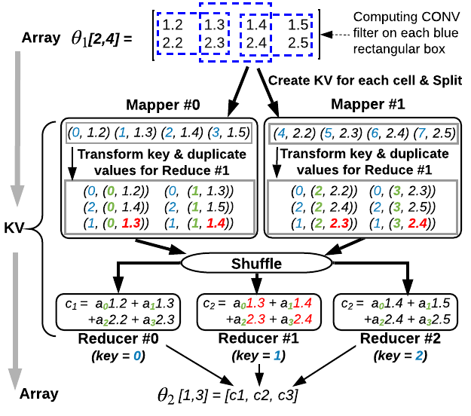
Challenge: Many Operations are Hard in MapReduce
Example:
Convolution on a 2 by 4 2D Tensor
Kernel is 2 by 2
1. Mismatched Data Model
-- Convert Tensor to KV list at Map stage
2. Expensive reduce operations
-- Duplicate KV for Reduce stage
Additional examples for Connected Component Labeling (CCL), gradient computing, and interpolation are available in Dong et al 2019

Slide 34
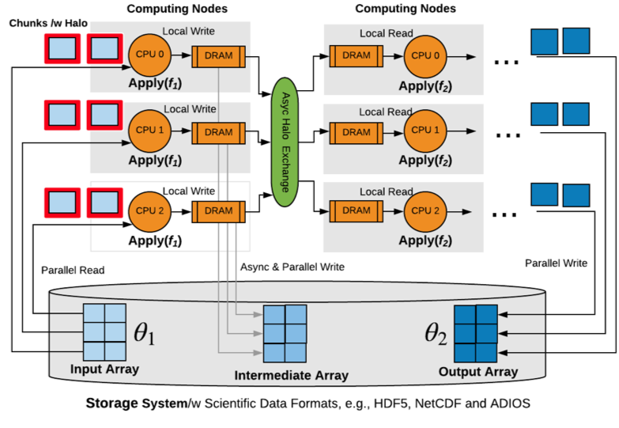
SLOPE Execution Engine in FasTensor
1. MPI based Single Program Multiple Data (SPMD) Pattern
2. Directly on Scientific Data Formats, e.g., HDF5
3. Manual/auto-chunking & ghost zone building
4. Efficient Parallel I/O

Slide 35

Evaluations
1. Cori Supercomputer at NERSC* with over 2400 nodes
2. Peer systems for comparison
Apache Spark, TensorFlow, C++ Imp (hand optimized)
3. Workload
Synthetic Workloads: 2 layers CNN with forward steps
Real Applications Workloads: CAMR5, VPIC, BISICLES
*National Energy Research Scientific Computing Center https://www.nersc.gov/systems/cori/

Slide 36
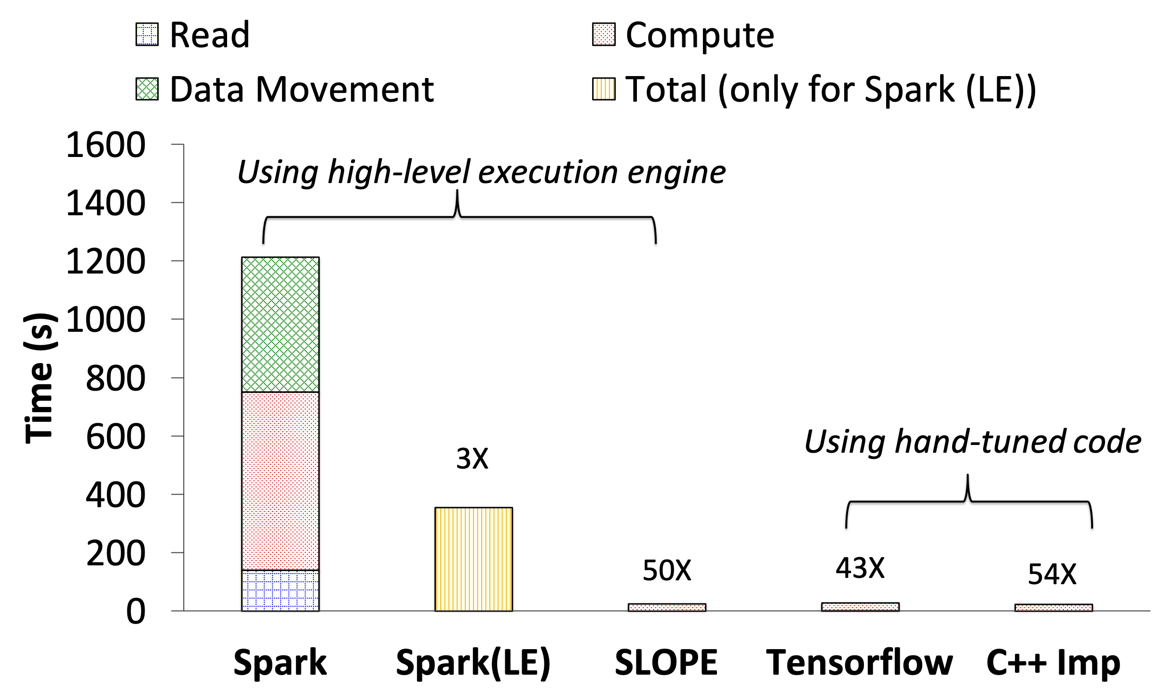
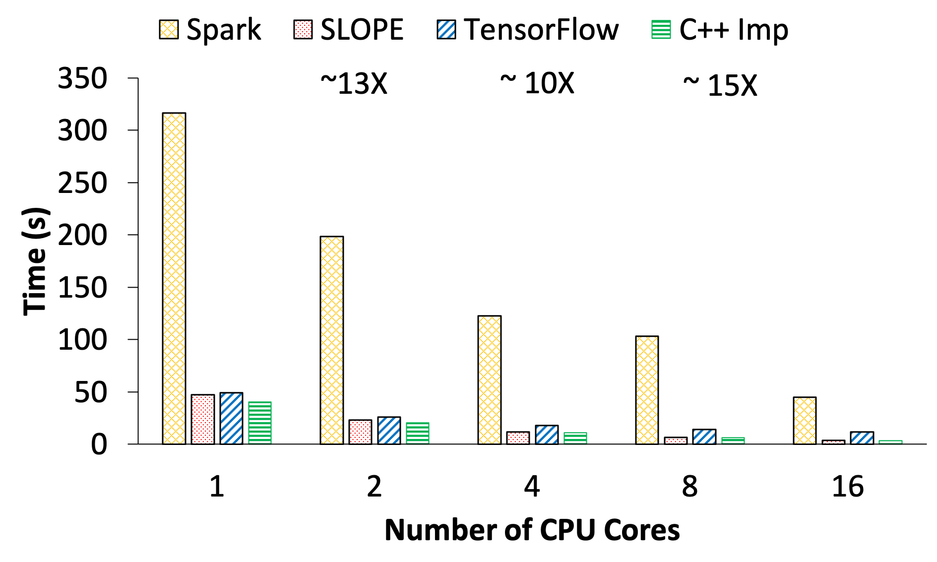
Comparing SLOPE, TensorFlow, Spark
Synthetic Workloads: 2 layers CNN with forward steps on a 64K by 64K 2D array
Single CPU Core

Slide 37
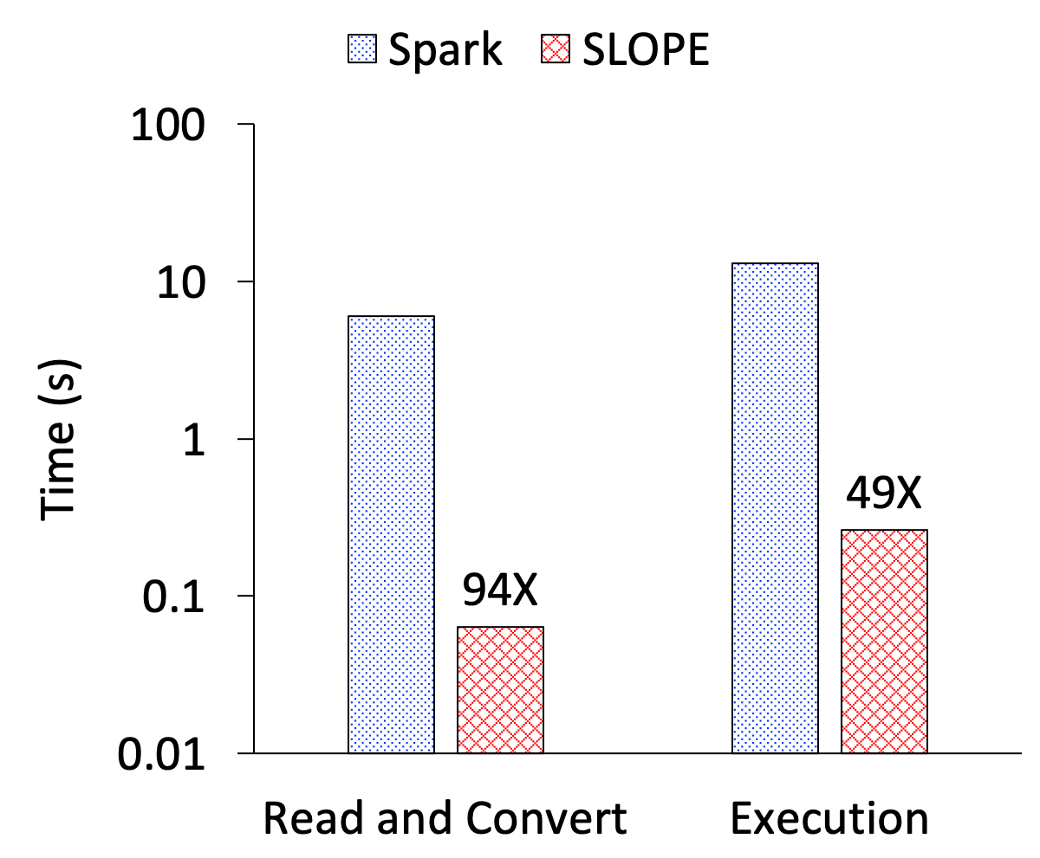
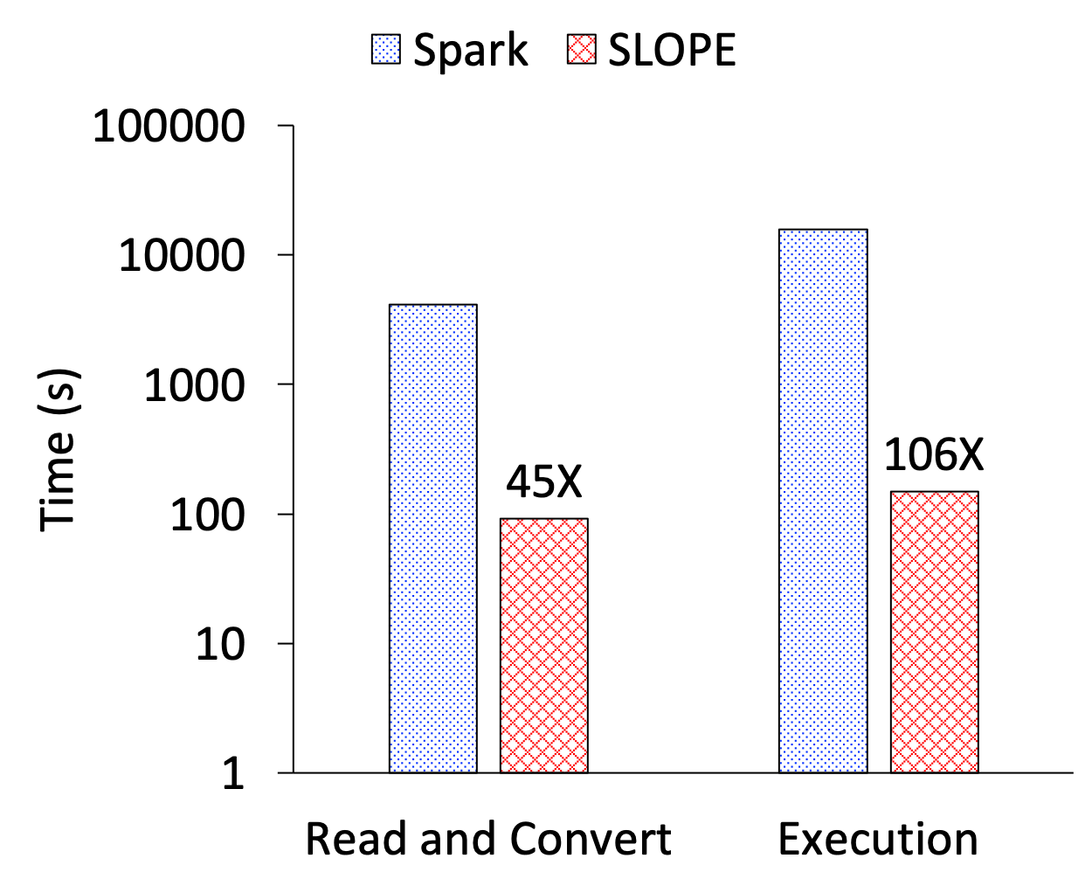
SLOPE is up to 106X faster on real-applications
CAM5
768 × 1152 2D array
3 Layers CNN (CONV, ReLU, Pooling)
VPIC
512 x 256 x 256 3D filed array + 263 GB particle data
Gradient and interpolation

Slide 38
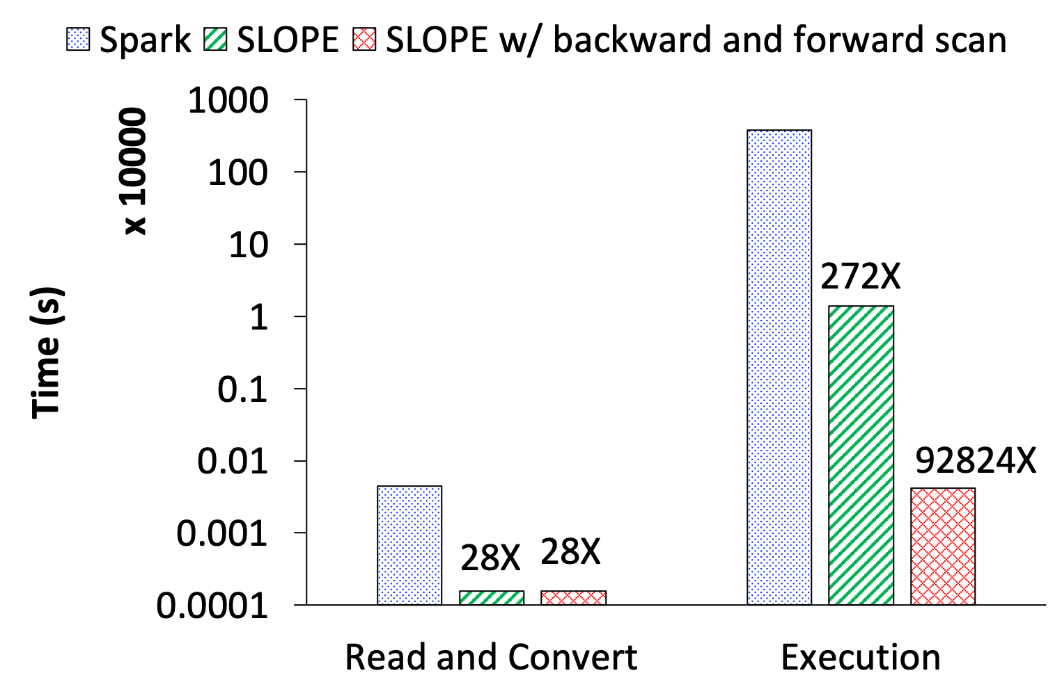
SLOPE could be 92,824X faster
BISICLES
12288 x 12288 2D array
Connected Component Labeling (CCL)
SLOPE advanced features
- iterate over many invocation of UDFs
- distributed array cache
- complex execution patterns: forward and backward scan
- in-place modifications of arrays
 | # of steps to convergence
w/o advanced feature | 10868
w/ advanced feature | 8

Slide 39
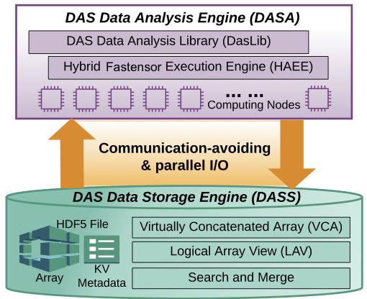
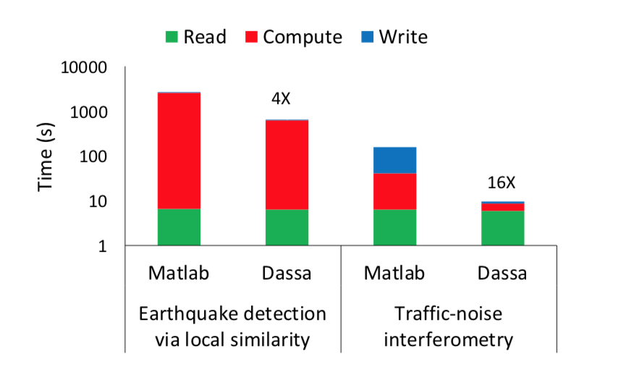
DASSA: FasTensor for Distributed Acoustic Sensing
Scientific Achievement
Distributed acoustic sensing (DAS) records strain or strain-rate along fiber-optic cables in subsurface at high frequency and large geophysical scale, producing mounts of data. This tool uses FasTensor to implement a variety of data analysis operations on high-performance computing systems for fast event detection.
Significance and Impact
Reduced the execution time of data analysis pipeline to identify earthquake from a set of distributed acoustic sensing data from weeks to seconds
Research Details
Extend Fastensor to support DAS specific data analysis operations
DasLib: sequential DAS data analysis operation
Multithreaded Fastensor: auto-parallel DasLib with less data duplications
DAS Storage Engine: efficient access to DAS data scattered among many small files
Software available at http://sdm.lbl.gov/fastensor
B. Dong, V. R. Tribaldos, X. Xing, S. Byna, J. Ajo-Franklin and K. Wu, "DASSA: Parallel DAS Data Storage and Analysis for Subsurface Event Detection," IPDPS 2020,

Slide 40
Scientific Data Management at Exascale
Outline
Introduction
Examples of Scientific Data Management
Deep Dive: FastBit Indexing
Deep Dive: FasTensor Automatic Parallelization Engine
Summary
John Wu
Notes:
Current work

Slide 41
Scientific Data Management Means Many Things
Data Analysis Challenges | FasTensor Technologies
Heterogamous scientific data formats | Lightweight Two-level Metadata Model
Independent data organization cross data sets | MDBin: Multi-dimensional Array Binning
Common scientific operations (e.g., interpolation) turn into complex SQL expression (e.g., 9-way join) | SCJoin: Spatially Clustered Join algorithm
Evaluations on Edison with tasks from analysis of magnetic reconnection (from Karimabadi, UCSD)
2TB (HDF5 file) with seven 1D particle attributes
Three 12 GB files (Binary) with 3D magnetic field
[Dong, Byna, Wu, 2015]
Query Running Time
Time of the whole data analysis lifecycle

Slide 42


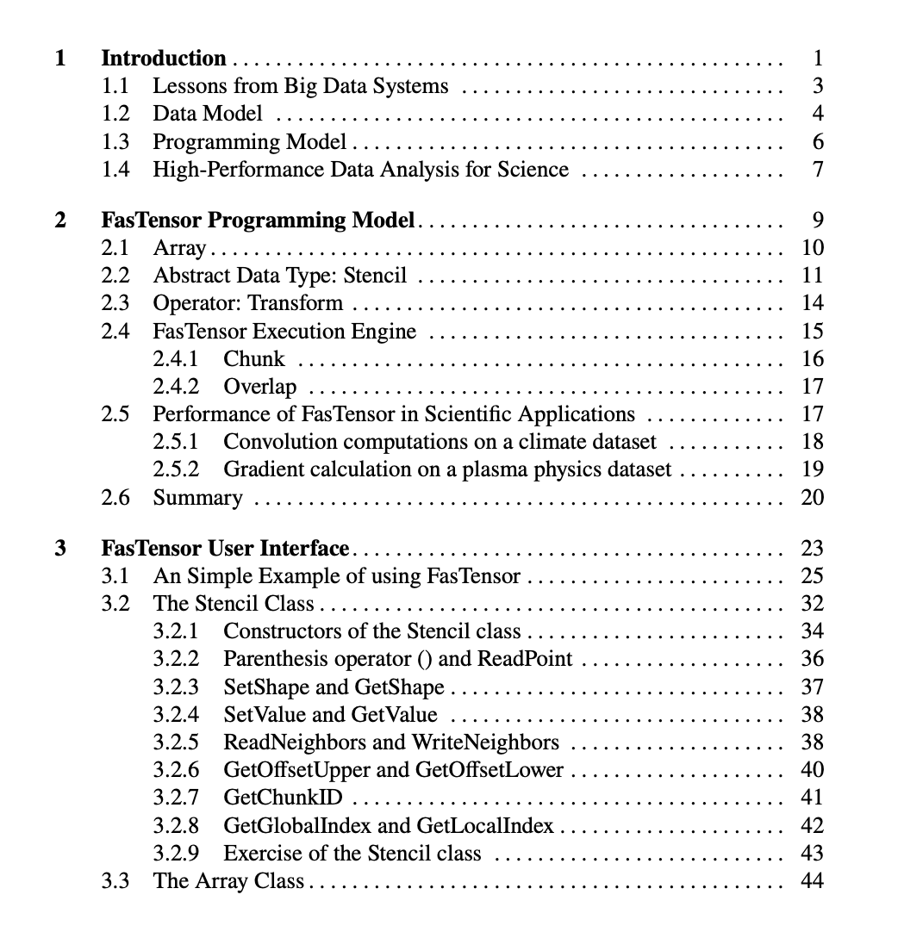
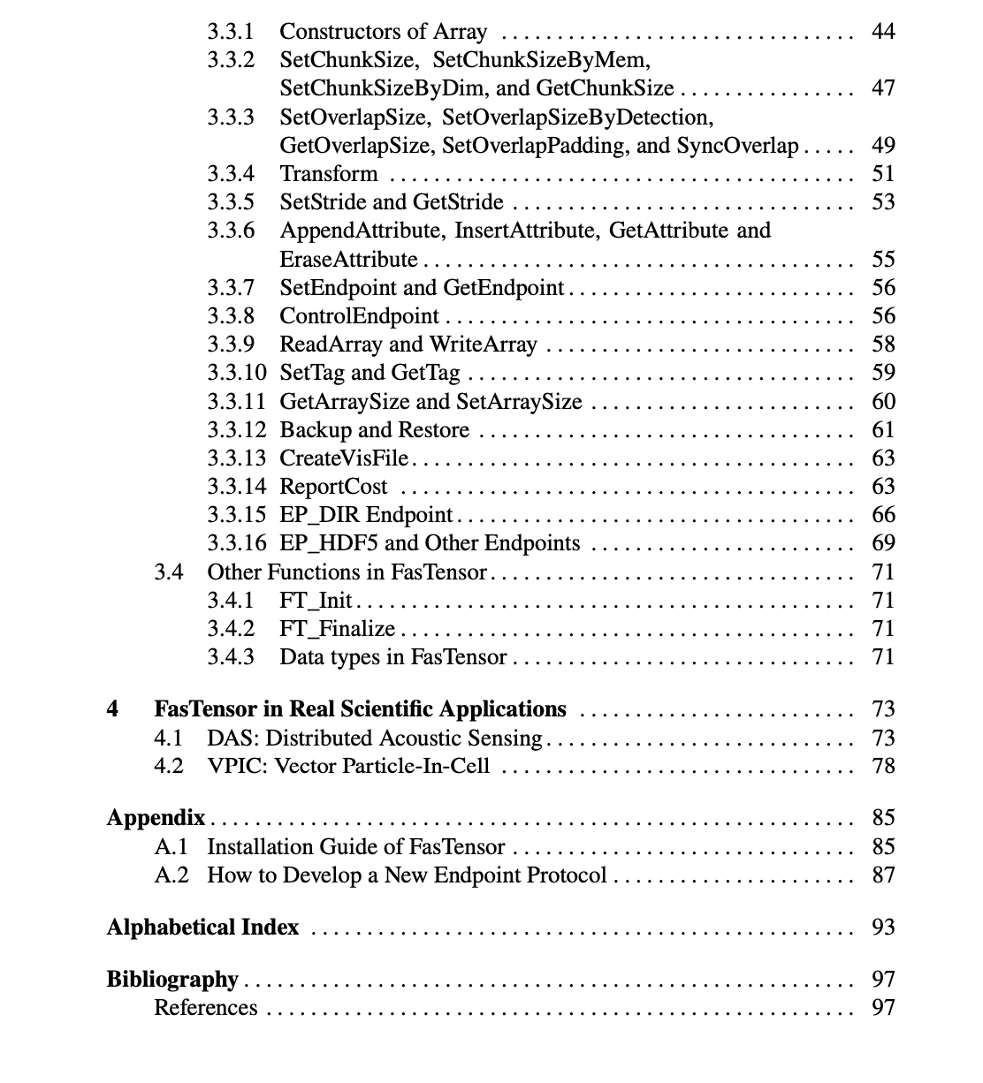
Summary
Commercial Big Data tools may not match scientific application requirements, e.g., key-value pair data model can’t easily represent multidimensional arrays, map-reduce not effective for some common operations
Processing exascale data requires many different data management tools, e.g., FastBit, FasTensor, HDF5, ADIOS, …
Exabytes of scientific data stored in files, directly working with these files is important to achieving good performance
Right tools could make a big difference: up to 92,824X in one example
A lot more to be done: (1) beyond simply arrays, such as AMR data, (2) GPU and accelerators, (3) deep storage integration, (4) distributed workflows, (5) supporting machine learning, …

Slide 43



Thanks!
FastBit software http://sdm.lbl.gov/fastbit
FasTensor software http://sdm.lbl.gov/fastensor
Team members:
J. L. Bez, S. Byna, B Dong, J. Gu, Q. Kang, M. Kiran, B. Mohammed, S. Shen, A. Sim, H. Tang
Computer science contributors:
H. Abbasi, E. W. Bethel, H Childs, J. Choi, J. Chou, M. Howison, K.-J. Hsu, C. Jones, S. Klasky, Q. Koziol, W-K Liao, K.-W. Lin, J. Liu, Q. Liu, J. Lofstead, J. Logan, K.-L. Ma, G. Ostrouchov, E. Otoo, M. Parashar, N. Podhorszki, E. Pourabbas. Prabhat, D. Pugmire, A. Romosan, O. Rübel, N. Samatova, K. Schwan, A. Shoshani, R. R. Sinha, K. Stockinger, Y. Tian, A. Uselton, G. Weber, M. Winslett, M. Wolf, W. Yoo, W. Yu
Application science contributors:
CS Chang, J. Chen, M. Churchill, W. Collins, E. Cormier-Michel, W. S. Daughton, S. Ethier, C. Geddes, H. Karimabadi, W. Koegler, J. Lauret, Z. Lukić , V. Markowitz, K. Mavrommatis, Md. Mostofa, P. Nugent, Ali Patwary, V. Perevoztchikov, A. M. Poskanzer, V. Roytershteynz, R. Strelitz, K. Suzuki, M. F. Wehner, W. Zhang
Funding:
Office of Advanced Scientific Computing Research, Office of Science, U.S. Department of Energy, under contract number DE-AC02-05CH11231

