Slide 1
Panel
Communications beyond the Thinking (spatial, terrestrial, speed, 5G/6G, streaming, high data processing, protocols, etc.)
NexComm
2021
6G- what new networking and connectivity promises ?
Eugen Borcoci, University POLITEHNICA Bucharest, Romania
eugen.borcoci@elcom.pub.ro

Slide 2
Panel
Communications beyond the Thinking (spatial, terrestrial, speed, 5G/6G, streaming, high data processing, protocols, etc.)
NexComm
2021
Panellist Position
6G- what new networking and connectivity promises ?
6G Goals
Roadmap to 2030
Architectural aspects
Networking and connectivity features
KPIs, Spectrum, physical layer
Network and connectivity research challenges
Note: The 6G concepts, architectures and technologies are still open research issues. This panel position will present a summary of some 6G trends related to network and connectivity advances w.r.t. 5G, compiled from publicly available research papers and documents (see References)

Slide 3
Panel
Communications beyond the Thinking (spatial, terrestrial, speed, 5G/6G, streaming, high data processing, protocols, etc.)
Eugen Borcoci : professor
University „Politehnica” of Bucharest (UPB)
Electronics, Telecommunications and Information Technology Faculty
http://www.electronica.pub.ro
Telecommunications Department
Address: 1-3, Iuliu Maniu Ave., 061071 Bucharest - 6, ROMANIA
E- mail address :eugen.borcoci@elcom.pub.ro
Expertise: teaching and research in specific domains of telecommunications and computer networks architectures,
technologies and services:
network architectures and services, management/control/data plane, protocols, 4G/5G, QoS assurance, multicast and
multimedia services over IP networks and heterogeneous access.
Recent research interest : Software Defined Networking (SDN), Network Function Virtualization (NFV), Fog/edge computing,
5G networking and slicing, vehicular communications.
Publications: 6 books, 4 textbooks and over 200 scientific or technical papers and scientific reports.
UPB team leader in many national and int’l European research projects.

Slide 4
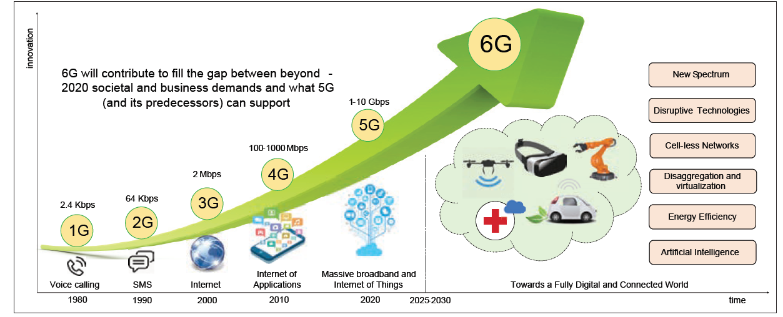
Panel
Communications beyond the Thinking (spatial, terrestrial, speed, 5G/6G, streaming, high data processing, protocols, etc.)
NexComm
2021
6G networking and connectivity
Historical and estimated 1G ..6G evolution
Source: M. Giordani, et al., "Toward 6G Networks:Use Cases and Technologies", IEEE Communications Magazine , March 2020

Slide 5
Panel
Communications beyond the Thinking (spatial, terrestrial, speed, 5G/6G, streaming, high data processing, protocols, etc.)
.
NexComm
2021
6G networking and connectivity
Why 6G?
Today- 5G is a strong technology intensively developed; however it has limitations w.r.t. future needs
6G Vision for 2030: the society will be data driven, served by near instant, unlimited wireless connectivity
6G goals:
meet novel network demands (e.g., ultra-high reliability, high capacity and efficiency, and low latency) in a holistic fashion, answering the new needs of economic, social, technological, and environmental context of the 2030 era
integration of the space, aerial, terrestrial, and maritime communications into a robust network
large range of applications and services:
AR/VR, Holographic tele-presence (teleportation), eHealth, pervasive connectivity, Industry 4.0 and robotics, unmanned mobility, new devices replacing smart phones
Telepresence -high resolution imaging and sensing, wearable displays, mobile robots and drones, specialized processors, distributed AI, haptic communication
Autonomous connected vehicles , massive URLLC (mURLLC), human-centric services, bio-Internet of things (B-IoT), nano-Internet of things (N-IoT), mobile broadband reliable and low-latency communication
Open research issues related to 6G networking and connectivity :
- what candidate architecture and technologies : lower layer (physical, L2, L3 ) and also higher layers?

Slide 6
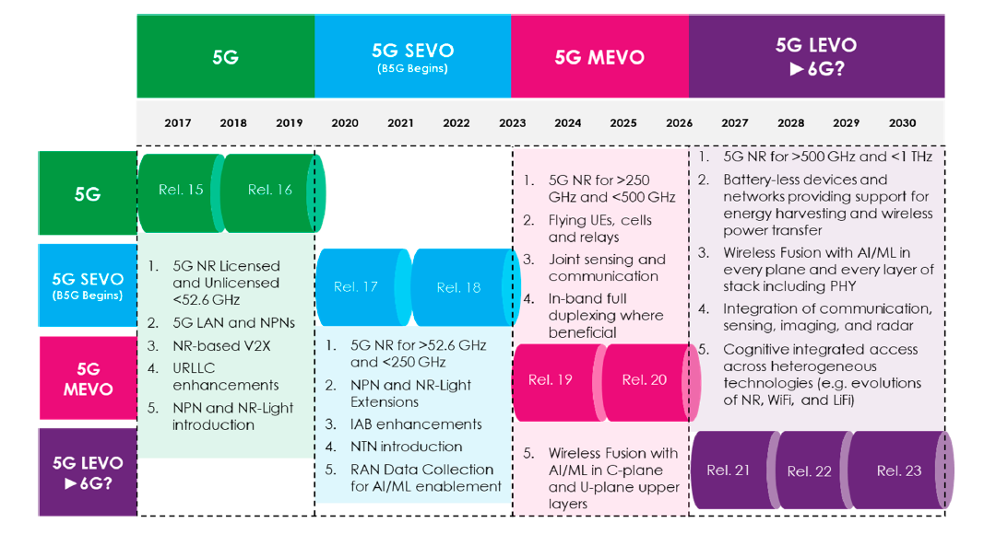
Panel
Communications beyond the Thinking (spatial, terrestrial, speed, 5G/6G, streaming, high data processing, protocols, etc.)
NexComm
2021
6G networking and connectivity
3GPP viewpoint : Roadmap to 2030 ; SEVO, MEVO, LEVO, 6G – Short, medium, long term evolution , 6G
AI – Artificial Intelligence
C-Plane – Control Plane
KPI- Key Performance Indicators
Li-Fi -Light Fidelity
NR- 5G New Radio
NPN-5G Non-Public Network
NTNs - Non-Terrestrial Networks
ML – Machine Learning
PHY- Physical Layer
RAN – Radio Access Network
UE- User Equipment
U-Plane - User Plane
URLLC- Ultra Reliable Low Latency Communication
V2X – Vehicle to Everything
Source: A. Mourad et al., "A Baseline Roadmap for Advanced Wireless Research Beyond 5G“, Electronics 2020, 9, 351; doi:10.3390/electronics9020351 www.mdpi.com/journal/electronics

Slide 7
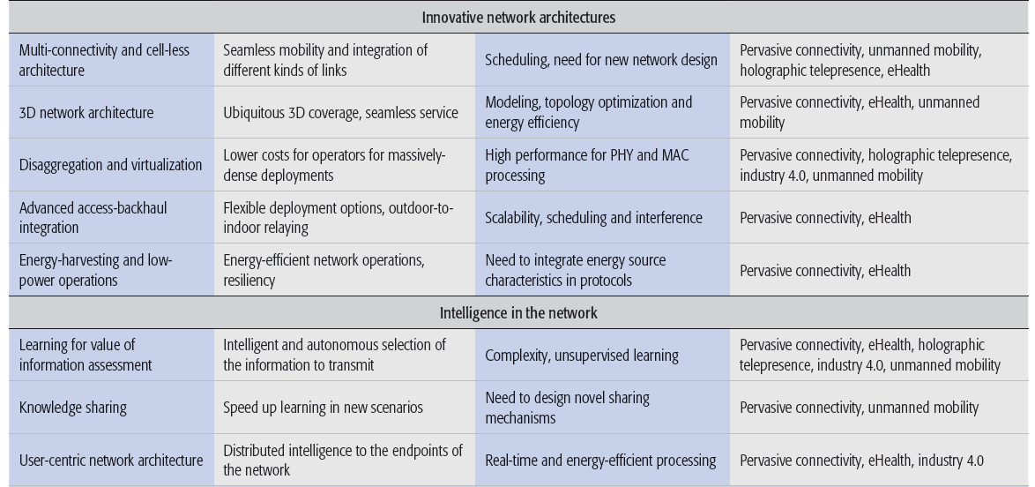
Panel
Communications beyond the Thinking (spatial, terrestrial, speed, 5G/6G, streaming, high data processing, protocols, etc.)
NexComm
2021
6G networking and connectivity
6G Architectural innovative aspects
6G proposes significant innovative architectures versus 5G
Source: M. Giordani, et al., "Toward 6G Networks:Use Cases and Technologies", IEEE Communications Magazine , March 2020

Slide 8
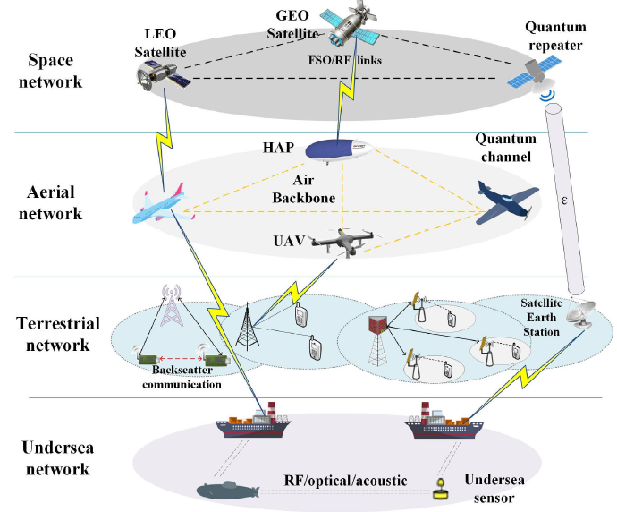
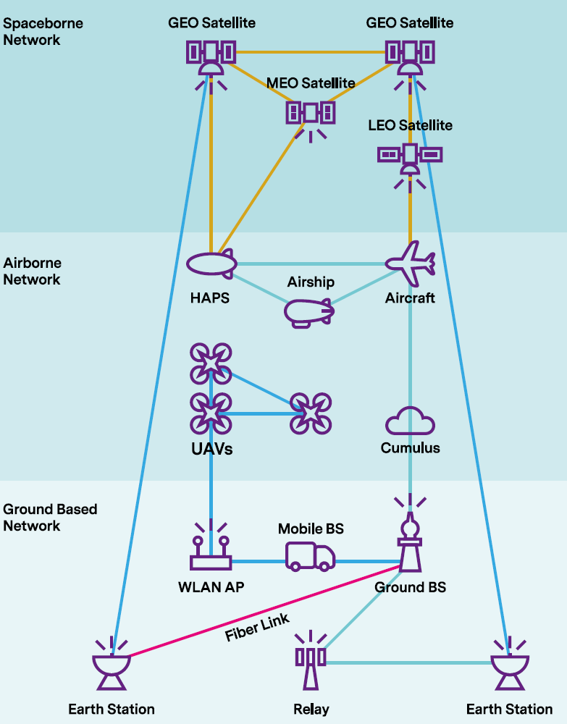
Panel
Communications beyond the Thinking (spatial, terrestrial, speed, 5G/6G, streaming, high data processing, protocols, etc.)
NexComm
2021
6G networking and
connectivity
Integrated Space Aerial,
Terrestrial and Undersea
Network
Ubiquituous 3d coverage
LEO- Low Earth Orbit
MEO- Medium Earth Orbit
GEO- Geostationary Earth Orbit
HAP- High Altitude Platforms
UAV- Unmanned Aerial Vehicle
Source: T.Huang, et al., "A Survey on Green 6G Network: Architecture and Technologies", IEEE Access, VOLUME 7, 2019, https://ieeexplore.ieee.org/stamp/stamp.jsp?arnumber=8922617
Source: 6G FlagShip, "WHITE PAPER ON BROADBAND CONNECTIVITY IN 6G“, 6G Research Visions, No. 10 June 2020, Univ. of Oulu

Slide 9
Panel
Communications beyond the Thinking (spatial, terrestrial, speed, 5G/6G, streaming, high data processing, protocols, etc.)
NexComm
2021
6G networking and connectivity
Novel 6G networking technologies
Nanonetworking
N-IoT is based on molecular communication; Different materials, such as graphene and meta materials can be used to build nanometer-range devices
physical design for molecular communication is a challenging task
Bionetworking
B-IoT using biological cells are used for communication using IoT
Novel routing schemes to be developed for B-IoT and N-IoT compared with traditional IoT
Efficient nano-devices and bio-devices must be developed for N-IoT and B-IoT
Optical networking
3D networking
drone-based user devices and drone-based base stations to enable communication networks
novel models ( including routing) must be devised for a 3D network ( it is substantially different compared with a 2D network)

Slide 10
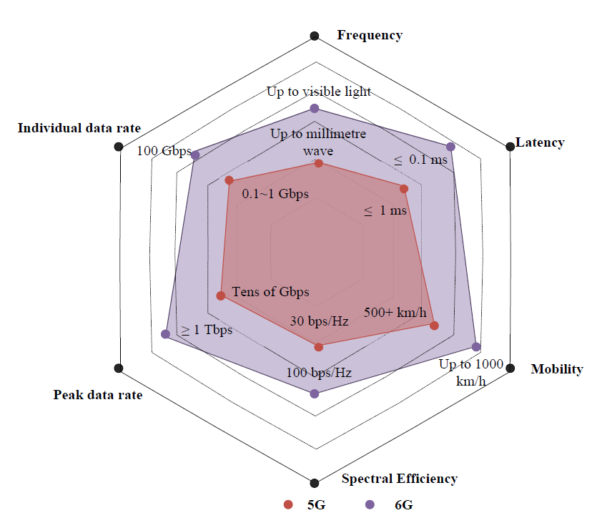
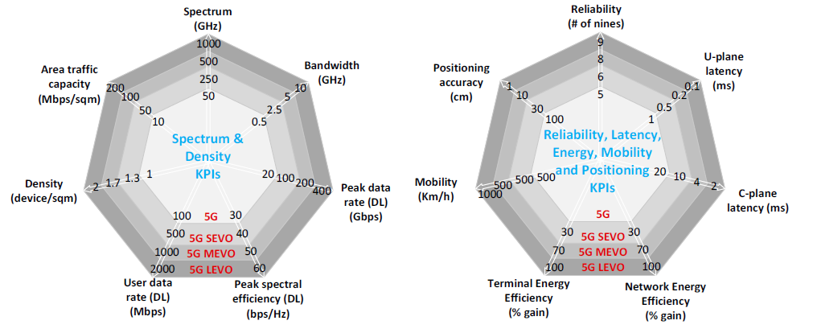
Panel
Communications beyond the Thinking (spatial, terrestrial, speed, 5G/6G, streaming, high data processing, protocols, etc.)
NexComm
2021
6G networking and connectivity
5G, 5G SEVO, 5G MEVO, 5G LEVO, 6G comparison
Source: A. Mourad et al., "A Baseline Roadmap for Advanced Wireless Research Beyond 5G“, Electronics 2020, 9, 351; doi:10.3390/electronics9020351 www.mdpi.com/journal/electronics
Source: Y.Zhao, et al., A Comprehensive Survey of 6G Wireless Communications INTERNET OF THINGS JOURNAL, 2020, arXiv:2101.12475v1 [cs.NI] 29 Jan 2021

Slide 11
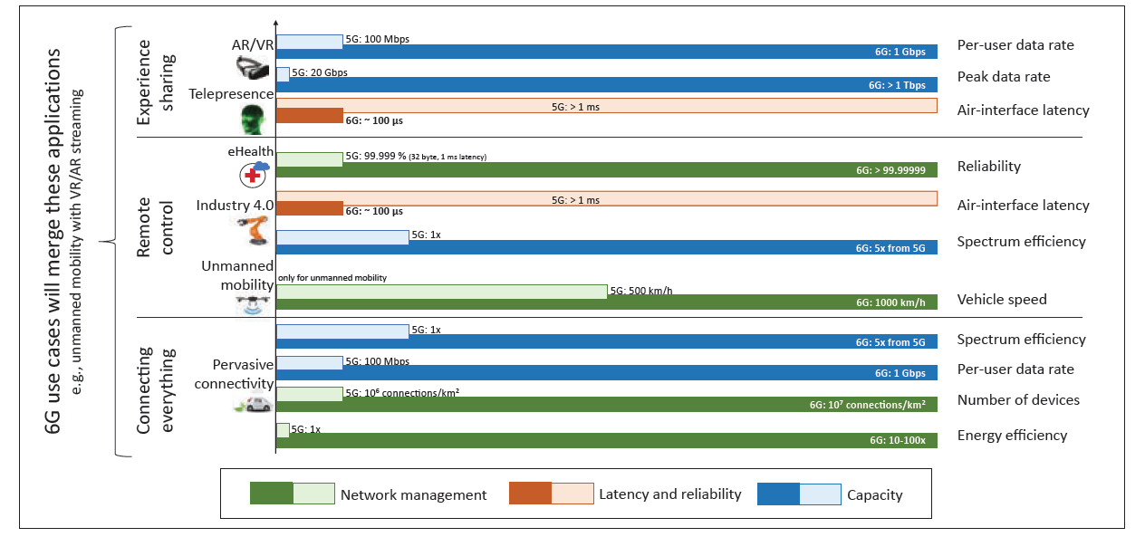
Panel
Communications beyond the Thinking (spatial, terrestrial, speed, 5G/6G, streaming, high data processing, protocols, etc.)
NexComm
2021
6G networking and connectivity
KPIs for some use cases – comparison 5G/6G
- significant improvements with respect to 5G
Source: M. Giordani, et al., "Toward 6G Networks:Use Cases and Technologies", IEEE Communications Magazine , March 2020

Slide 12
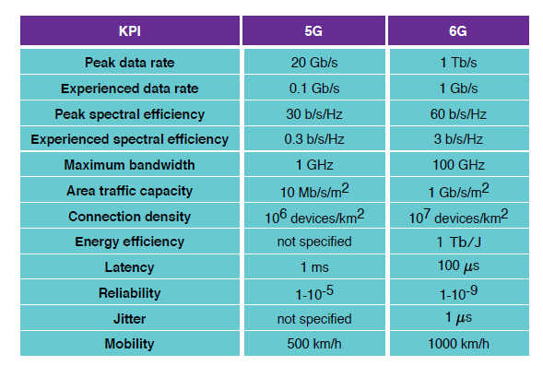
Panel
Communications beyond the Thinking (spatial, terrestrial, speed, 5G/6G, streaming, high data processing, protocols, etc.)
.
NexComm
2021
6G networking and connectivity
Potential spectrum
regions for 6G.
6G Spectrum, physical layer features
5G : sub-6 GHz and 24.25 to 52.6 GHz
6G: expansion to potential new bands from low-bands to low THz and visible light region Enablers at the Infrastructure Level
Ultra-Massive MIMO and Holographic Radio
Beamforming beyond the Beam-Space Paradigm
Holographic Radio
Intelligent Reacting Surfaces
User-Centric and Scalable Cell-Free Networking
Integrated
Access and Backhaul
Space and Terrestrial Networks
Broadcast and Multicast Networks
Source: N.Rajatheva et al., "White Paper on Broadband Connectivity in 6G- Research Visions", https://arxiv.org/pdf/2004.14247.pdf

Slide 13
Panel
Communications beyond the Thinking (spatial, terrestrial, speed, 5G/6G, streaming, high data processing, protocols, etc.)
.
NexComm
2021
6G networking and connectivity – some research challenges
Increased hardware complexity
Low power circuits with high-performance processing capabilities
Intelligent wireless energy harvesting
Seamless coexistence of multiple RATs, AI-based adaptive transceivers
Dynamic radio resource allocation
Pre-emptive scheduling in massive connectivity
Security and Privacy- distributed models
Flexible network slicing
Intelligent cell-less architecture
Integration of space, air, terrestrial and maritime communications
AI-based management and control

Slide 14
Panel
Communications beyond the Thinking (spatial, terrestrial, speed, 5G/6G, streaming, high data processing, protocols, etc.)
NexComm
2021
THANK YOU !

Slide 15
Panel
Communications beyond the Thinking (spatial, terrestrial, speed, 5G/6G, streaming, high data processing, protocols, etc.)
NexComm
2021
Panelist Position
References
M. Giordani,et al., "Toward 6G Networks:Use Cases and Technologies", IEEE Communications Magazine, March 2020
A. Mourad et al., "A Baseline Roadmap for Advanced Wireless Research Beyond 5G“, Electronics 2020, 9, 351; doi:10.3390/electronics9020351 www.mdpi.com/journal/electronics
N.Rajatheva et al., "White Paper on Broadband Connectivity in 6G- Research Visions", https://arxiv.org/pdf/2004.14247.pdf
T.Huang, et al., "A Survey on Green 6G Network: Architecture and Technologies", IEEE Access, VOLUME 7, 2019, https://ieeexplore.ieee.org/stamp/stamp.jsp?arnumber=8922617
Y.Zhao, et al., A Comprehensive Survey of 6G Wireless Communications INTERNET OF THINGS JOURNAL, 2020, arXiv:2101.12475v1 [cs.NI] 29 Jan 2021
Matti Latva-aho, Kari Leppänen, "KEY DRIVERSAND RESEARCH CHALLENGES FOR 6G UBIQUITOUS WIRELESS INTELLIGENCE", 2019, http://jultika.oulu.fi/files/isbn9789526223544.pdf
M.H. Alsharif et al., "Sixth Generation (6G)Wireless Networks:Vision, Research Activities, Challenges and Potential Solutions", https://www.mdpi.com/2073-8994/12/4/676
K.B. Letaief, et al., "The Roadmap to 6G:AI Empowered Wireless Networks", IEEE Communications Magazine , August 2019
B.Aazhang, P.Ahokangas, et al., "Key drivers and research challenges for 6G ubiquitous wireless intelligence (white paper)", https://www.researchgate.net/publication/336000008_Key_drivers_and_research_challenges_for_6G_ubiquitous_wireless_intelligence_white_paper

