Slide 1
Towards Elastic Edge Computing Environments: An Investigation of Adaptive Approaches
Authors: Abdullah Aljulayfi and Karim Djemame
Presenter: Abdullah Aljulayfi
University of Leeds, UK
Prince Sattam Bin Adbulaziz University, KSA
ml16afa@leeds.ac.uk

Slide 2
Presenter’s Bio
BSc in Computer Science from Prince Sattam Bin Abdulaziz University.
MSc in Advanced Computer Science (Cloud Computing) from the University of Leeds.
Present: PhD student working on auto-scaling SAS for Edge Computing at the University of Leeds.
A member of the Distributed Systems and Services Research Group at the School of Computing, University of Leeds.

Slide 3
Agenda
Problem statement and motivations
Auto-scaling self-adaptive system architecture
Experimental design
Results
Hypothesis evaluation and take-away message.
Conclusion and future work

Slide 4
Problem statement and motivation
Proactive
Environment
Dynamicity of IoT
workload
Self-adaptive system for Auto-scaling
Workload
Reactive
+
EC nature
Application scenario
Hybrid

Slide 5
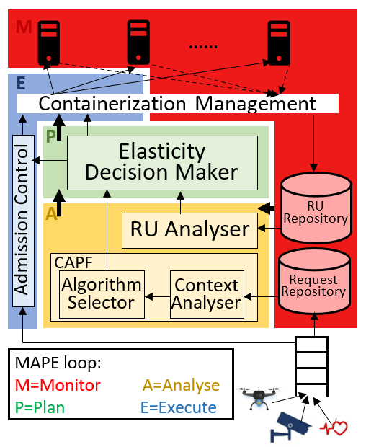
Auto-scaling self-adaptive system architecture
Control loop: Monitor Analyse Plan Execute (MAPE).
Monitor: Resource Utilisation Repository and Request Repository.
Analyse: Resource Utilization Analyser and CAPF.
Plan: Elasticity Decision Maker.
Execute: Admission Control.

Slide 6
Auto-scaling self-adaptive system architecture (Cont.)
What is new?
Adaptation approaches: Proactive, reactive, and hybrid.
Admission control.
Algorithms support: Proactive, reactive, hybrid, and admission control.
SAS evaluation: Edge Computing, three real IoT workloads, and application scenarios.

Slide 7
Experimental design
Implementation scenarios:
Profiled applications:
Heavy load:
Face Recognition (FR).
Emergency Traffic Management (ETM).
Medium load:
Augmented Reality (AR).
Health Monitoring (HM).
Low load:
Industrial Health Monitoring (IHM).
Intelligent Parking (IP).
Scenarios |  | Adaptation approaches | Considered applications
1: Mixed applications |  | Proactive | All
 |  | Reactive | All
 |  | Hybrid | All
2: Single application | A | Proactive | FR
 |  | Reactive | FR
 |  | Hybrid | FR
 | B | Proactive | AR
 |  | Reactive | AR
 |  | Hybrid | AR
 | C | Proactive | IHM
 |  | Reactive | IHM
 |  | Hybrid | IHM

Slide 8
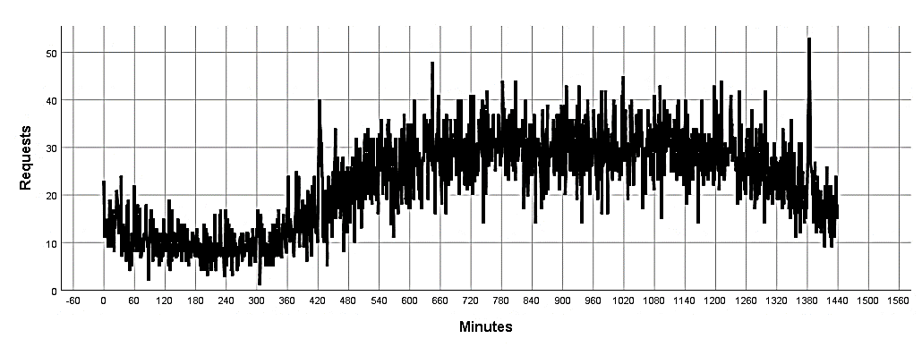
Experimental design (cont.)
Workload dataset:
Provided by Shanghai Telecom.
Contains 6 Months, 6,952,921 records, 9739 mobile devices, and 3042 BSs.
Select: 2nd as a decreasing, 12th as an increasing, and 14th as a fluctuating.
Decreasing
Hours
1-5
Increasing
Hours 6-12
Fluctuating
Hours 13-20
21-24
http://sguangwang.com/TelecomDataset.html

Slide 9
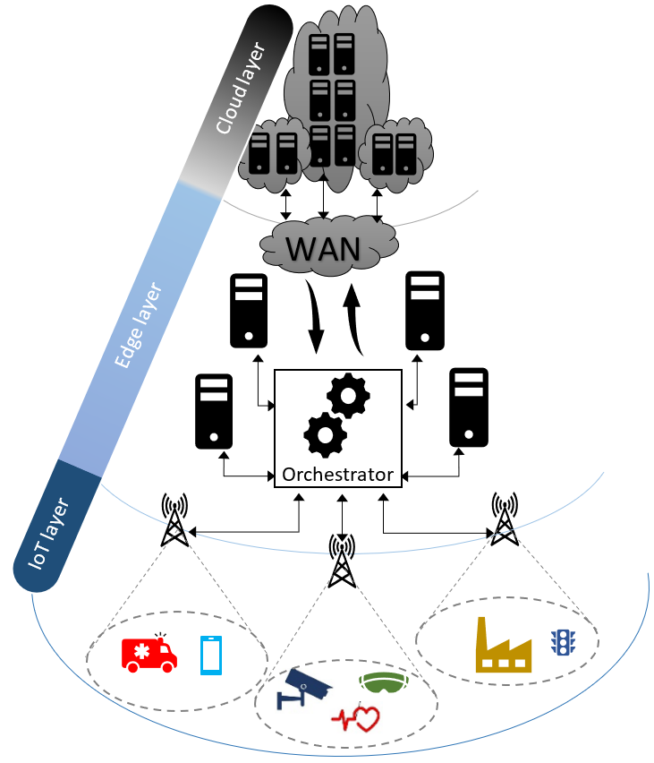
Experimental design (cont.)
Simulation:
EdgeCloudSim.
Hypothesis:
hypothesis 1: The use of the hybrid adaptation in an elasticity framework will provide the highest acceptance rate as compared to both proactive and reactive adaptations.
Hypothesis 2: The proactive adaptation will perform better than the reactive adaptation due to the prediction ability that helps acting prior events happen.
C. Sonmez, A. Ozgovde, and C. Ersoy, “EdgeCloudSim : An environment for performance evaluation of edge computing systems”, Trans. Emerg. Telecommun. Technol., vol. 29, no. 11, pp. 1–17, 2018

Slide 10
Results
Scenario 1 (mixed applications):
Scenario 2A (Single application- Face Recognition):

Slide 11
Results (Cont.)
Scenario 2B (single application- Augmented Reality):
Scenario 2C (single application- Industrial Health Monitoring):

Slide 12
Hypothesis evaluation and Take-aways message
Hypothesis evaluation:
Hypothesis 1: The use of the hybrid adaptation in an elasticity framework will provide the highest acceptance rate as compared to both proactive and reactive adaptations.
It is true in all scenarios.
Hypothesis 2: The proactive adaptation will perform better than reactive adaptation due to prediction ability that helps acting prior events happen.
It is true for scenarios 2A, 2B, and 2C (single application scenario).
It is disproved for scenario 1 (mixed applications scenario).
Take-away message:
It is important to use the hybrid adaptation SAS in highly fluctuating environments such as Edge Computing.
It is important to evaluate the adaptation approaches according to the considered scenario, workload, and environment.
Lack of data about the nature of the submitted requests can have a significant impact.

Slide 13
Conclusion and future work
Conclusion:
The SAS for Edge Computing environment is designed and evaluated considering the adaptation approaches.
Several scenarios are considered to investigate the effect of the workload and applications on the Edge Computing environment.
A set of take-aways messages are made.
Future work:
Evaluate the SAS adaptation approaches using a higher workload.
Consider QoS.
Cloud layer offloading policy.

Slide 14
Questions

