Slide 1
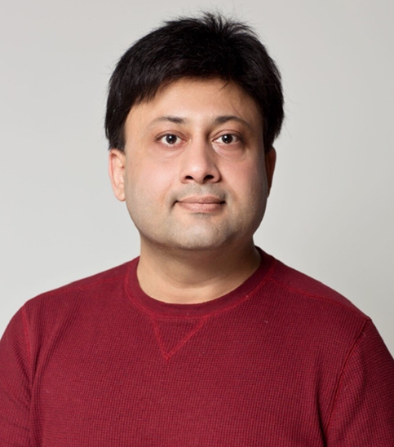
Technology acceptance of an online speech and language assessment application for stroke patients- the medical caregivers' viewpoints GLOBAL HEALTH 2021
Awais Ahmad
Lecturer in Computer Science | e-Health Researcher | Internationalization coordinator
Department of Computer and Systems Sciences
Campus Östersund
Mid Sweden University Sweden

Slide 2
Introduction
Stroke is a major cause of death and different kinds of chronic disabilities in adults, and Speech and language loss is the most common disease for stroke survivors.
The process of relearning communication skills is difficult and a time taking process. Technology-enhanced systems (TES) can be useful in speech and language relearning, however, the acceptance and usability of TES for stroke patients have been a matter of concern and more research is needed in this area.
This study evaluates the technology acceptance and adoption of an online speech and language assessment application.

Slide 3
Aim
Despite the fact that several advanced and sophisticated technologies are available in the health sector, the use and acceptance of these technologies are doubtful and more research is needed to find the critical factors that might affect technology acceptance.
This study is aimed to access and evaluate the technology acceptances of an eHealth application by using the Unified Theory of Acceptance and Use of Technology (UTAUT) as a theoretical model.
The addressed research question was :
1. What is the technology acceptance of a speech and language assessment application from medical caregivers’ viewpoint?

Slide 4
Unified Theory of Acceptance and Use of Technology (UTAUT)
UTAUT model was designed to assess the user behavior and intention to use technology.
The UTAUT model suggests the following four technology acceptance elements
Performance expectancy
Effort expectancy
Social influence
Facilitating conditions

Slide 5
Speech and Language Assessment System (A-ning) Overview The assessment and implementation process: Patient’s page

Slide 6
The assessment and implementation process: Speech therapist’s page

Slide 7
Manual and pepper-pen based evaluation

Slide 8
Speech and Language Assessments Application
Step 1: Patient’s information

Slide 9
Speech and language Assessments Application
Step 2: Patient’s speech and language impairment diagnosis

Slide 10
Speech and language Assessments Application
Step 3: Patient’s speech and language impairment evaluation

Slide 11
Study Participants
Participants | Professional role | Region | Years of experience
Participant 1 | Speech therapist #1 | Stockholm | 25
Participant 2 | Speech therapist #2 | Mid Sweden Region | 4
Participant 3 | Speech therapist #3 | Mid Sweden Region | 5
Participant 4 | Occupational Therapist | Mid Sweden Region | 5
Participant 5 | Physiotherapist #1 | Mid Sweden Region | 8
Participant 6 | Physiotherapist #2 | Mid Sweden Region | 3

Slide 12
Speech and language assessments Application- Patients’ Interface

Slide 13
Study Findings
To evaluate the technology acceptance, the results were thematically analysed and categorized according to the UTAUT model’s determinants.
However, these categories were not enough to cover the contents of the interviews. Therefore, privacy and security, and previous knowledge and experience about technology were added as extra categories.

Slide 14
Study Findings
Performance expectancy explains perceived usefulness
Online evaluation
Automated and instant results
Effort expectancy explains ease of use
Synchronization with previous workflow
Folders with descriptive headlines, where assignments from each category could be stored
Social influence: co-workers’ views about the usefulness of the system
Facilitating conditions: Technical infrastructure, education and training, and personal support

Slide 15
Study Findings
Privacy and security
Previous knowledge and experience
Users’ participation in the design and development
User participation == User acceptance

Slide 16
Research contributions and Conclusions
The relationship between a user’s personality and his/her behavioural intentions to use a given technology is complex and it depends upon several different factors. Such factors are user’s trust in personal data security, personal integrity and privacy, their previous experience with technology, and the willingness to learn the new technologies.
The patient's ability to use a specific technology heavily depends upon the patient’s physical and cognitive health after stroke.
Technology acceptance evaluation shows that the developed application is useful and efficient for speech therapists. However, to enhance the performance expectancy, the potential users (speech therapists and patients) should be involved throughout the application development process and all the application functionalities should be comprehensively discussed with them.
Online treatment might provide a better quality of life and independent living to the patients and their close relatives.
The intention to use the technology also depends upon an early user’s participation in system development and design.

Slide 17
Future Work
This evaluation was carried out with a speech therapist and caregiver perspective which is an important part of the process. The next important step is to get the patient perspective, in an evaluation that preferably also should involve some patients' relatives and friends.
Furthermore, the multi-stakeholder approach should include administrative staff at health centers and hospitals to get their view on statistical features and security aspects.

Slide 18
THANK YOU Email: awais.Ahmad@miun.se
Awais Ahmad
Lecturer in Computer Science | e-Health Researcher | Internationalization coordinator
Department of Computer and Systems Sciences
Campus Östersund
Mid Sweden University Sweden

